Slide 1
Care Program Training

Slide 2
Agenda
Why Care Programs?
Care Programs
Care Manager Journey Review
Specific Scenarios
Activate and Engage Framework

Slide 3









Digital care management increases the capacity for high touch therapeutic support
Digital Care Management
Continuous and sustained member experience
Convenient and less invasive for members
Identifies and surfaces insights about emerging needs in real-time
Opportunity for both member and staff-driven interactions
Designed to support and scale the care team relationship while enabling staff to operate top of license
Onboarding phone call
Phone call
Phone call
Traditional Telephonic
Care Management
No contact.
No contact.
Start
1 Month
3 Months
Onboarding mobile app
Digital
Care Management
Sustained mobile messages, reminders, educational content and other interactions
Source: “A Pragmatic Methodology for the Evaluation of Digital Care Management in the Context of Multimorbidity.” Taylor & Francis, Journal of Medical Economics,
11 Feb. 2021, www.tandfonline.com/doi/full/10.1080/13696998.2021.1890416.
Notes:
Wellrame is a digital platform that enables plans to transform how they deliver care managmenet from traditional telephonic to digital care managment.
Let's walk through the traditional workflow that we hear from plans
They make multiple unsuccessful attempts to reach the member by phone, which as we know is time consuming and frustrating.
When they finally reach the member, only have a small time frame to engage the member and make sure you are getting done everything that you need to get done
The member may not feel comfortable answering questions, may not have time, or may not have questions or issues in that exact moment
This model does not present opportunities for patients to share meaningful information nor does it provide a space for care managers to interact with that information.
We aren't changing the service model here, this isn't an app that's coming in and replacing the care manager and the service that you provide– digital cannot replace the clinical judgement and personal touch of a human being. Staff will still evaluate members' needs, identify a plan of care but now you have a set of digital tools that you get to leverage to deliver those interventions directly to your members through the mobile app—no more email, no more long phones calls where you are trying to evaluate, screen, educate and solve problems all in a short window. Digital allows members to engage with education, screenings, instructions, med reminders, messages, on their own time, when its convenient and easy for them. And as they interact with the digital platform, real-time insights about their health and how they are engaging are sent back to you and the care team, so you can keep a pulse on your members' needs proactively, evolve their plan of care and provide more timely and personalized support because you know more about the member.

Slide 4
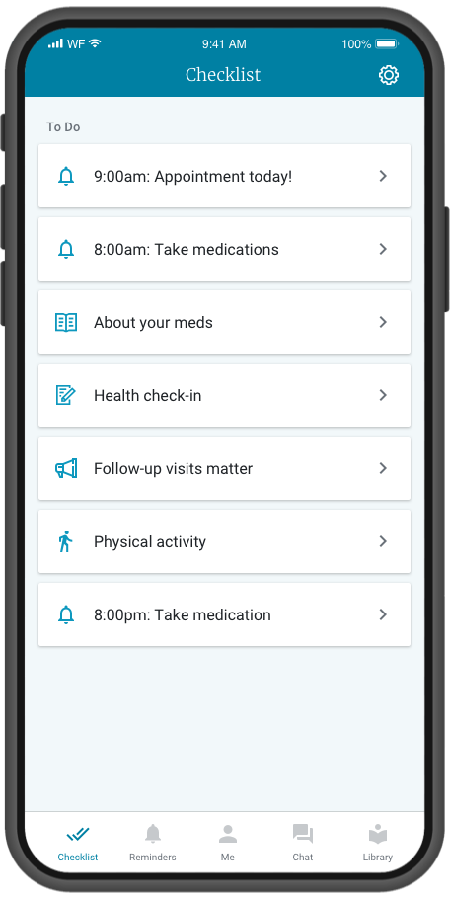





Health Checklist
Each day, members will receive a Health Checklist on their mobile device. The checklist items are designed to keep members on track with their care plan.
Tasks may include (but are not limited to):
Medication Reminders
Health Reminders
Biometric, Behavioral, and Psychosocial
Survey Questions
Educational Articles & Videos
Physical Activity Goals
Notes:
The health checklist is the first tab members will be presented with each time the open the app
This checklist displays tasks for the member to complete in order to stay on track with their care plan
Tasks can include things like reminders, survey questions, educational content, and physical activity prompts
These tasks change daily, depending on the member's Care Program or whatever reminders they might have set
The checklist serves as the member's personalized guide to promote healthy activities in line with their unique care plan
Essentially, the member's list of "to-dos" that guide them through their personalized care plan

Slide 5
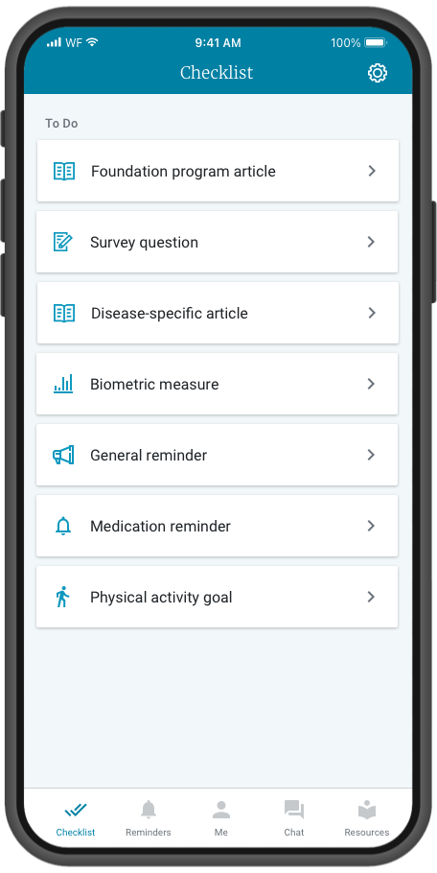
Personalization of the health checklist is driven by staff actions
Care Programs
Added by staff based on the members needs; each program has a curriculum of daily articles and surveys.
Biometric Monitoring Programs
Added by staff, these survey programs ask members to input key biometric data on a recurring basis.
Medication or General Reminders
Daily or 1-time reminders that can be set up
by the member or staff.
Notes:
Checklist will have items for Care Programs, supplemental education resources, reminders, and more – creating a personalized educational experience via the Wellframe app

Slide 6



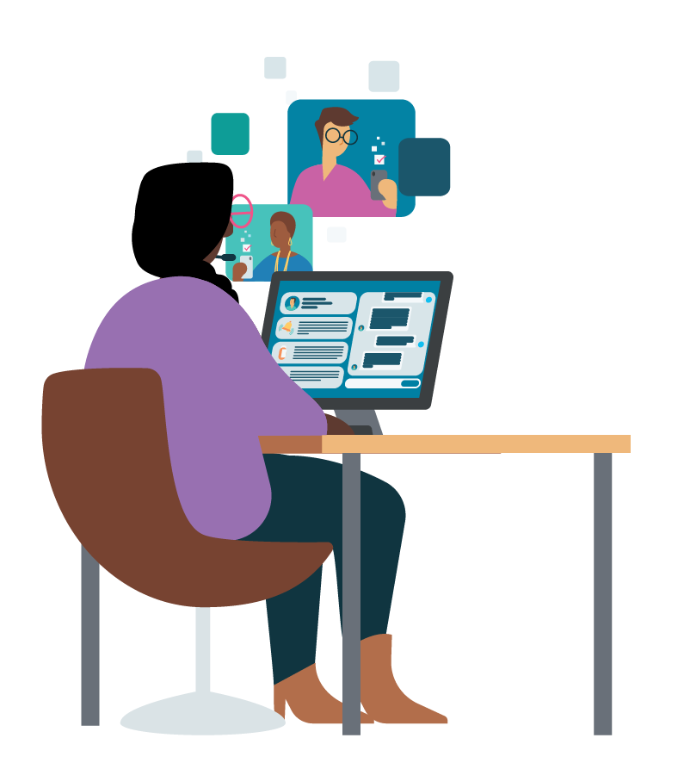


Care Manager Journey
INVITE
ACTIVATE
Welcome the member and curate their profile using app features and care programs to drive member engagement and retention.
Provide members with a personalized value story for digital care management.
OPTIMIZE
Track and manage your overall caseload activity and engagement using the app efficiency features.
ONBOARD
Facilitate timely member onboarding, including downloading the app and setting up their account.
ENGAGE
Continue to engage
your members regularly. Address their needs through messaging, reviewing insights and updating care plan as needed.
CARE MANAGER
Notes:
Invite: Provide members with a personalized value story for digital care management.
Onboard: Facilitate timely member onboarding, including downloading the app and setting up their account.
Activate: Welcome the member and personalize their profile using app features and care programs to drive member engagement and retention.
Engage: Continue to engage your members regularly. Address their needs through messaging, reviewing insights and updating care plan as needed.
Optimize: Track and manage your overall caseload activity and engagement using the app efficiency features.

Slide 7
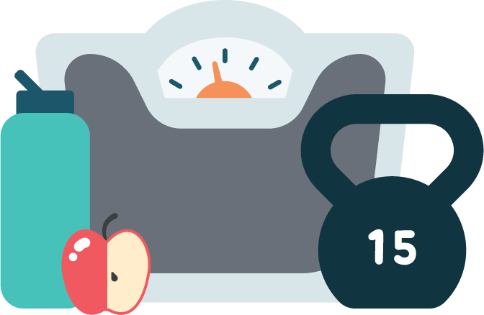
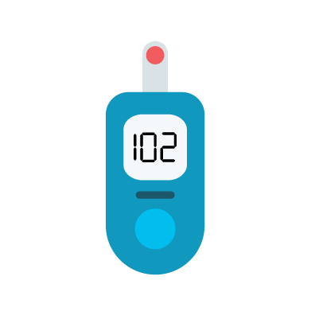
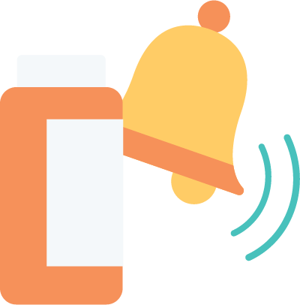
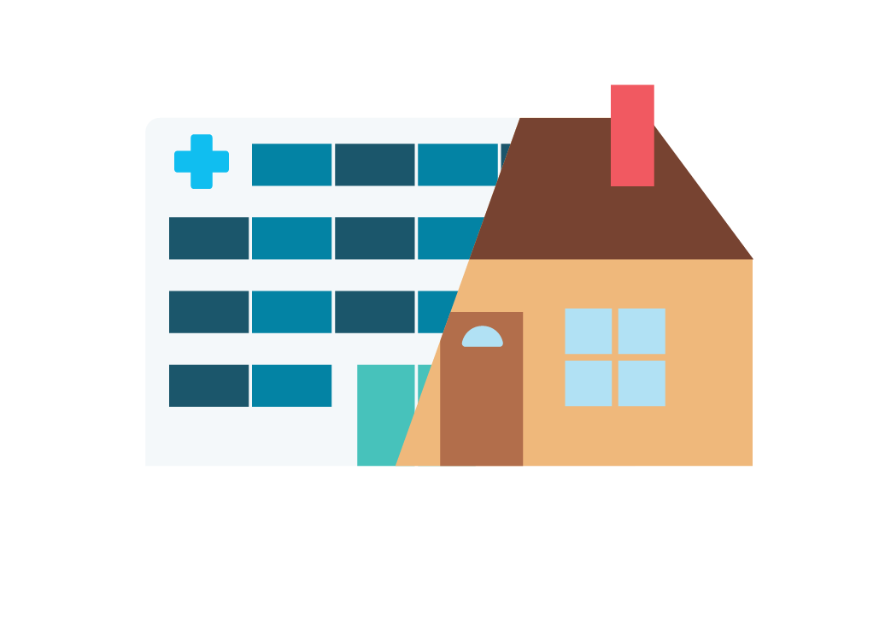
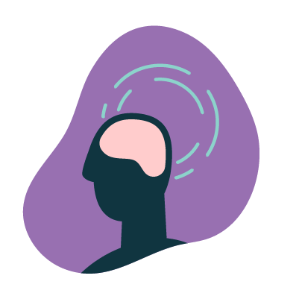
Member Activation & Engagement Framework
Care Programs
Biometric Monitoring Programs
Medication & General Reminders
Engagement & Retention
Instructions
Messaging

Slide 8

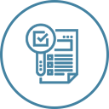


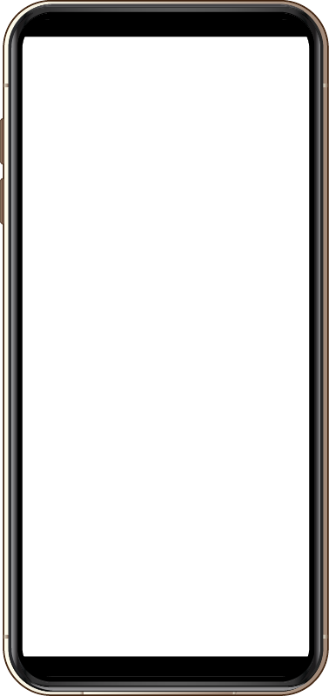
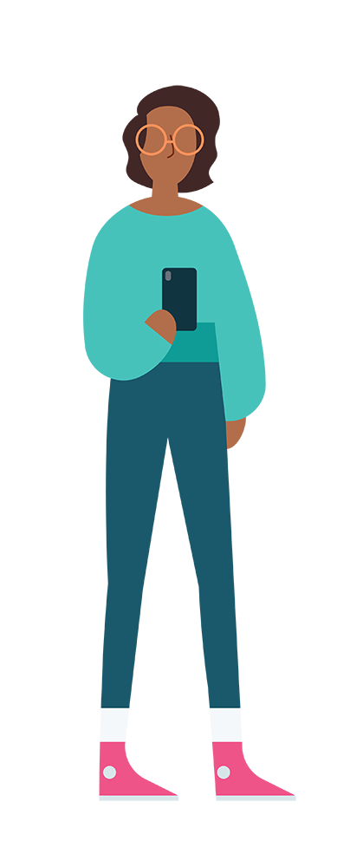
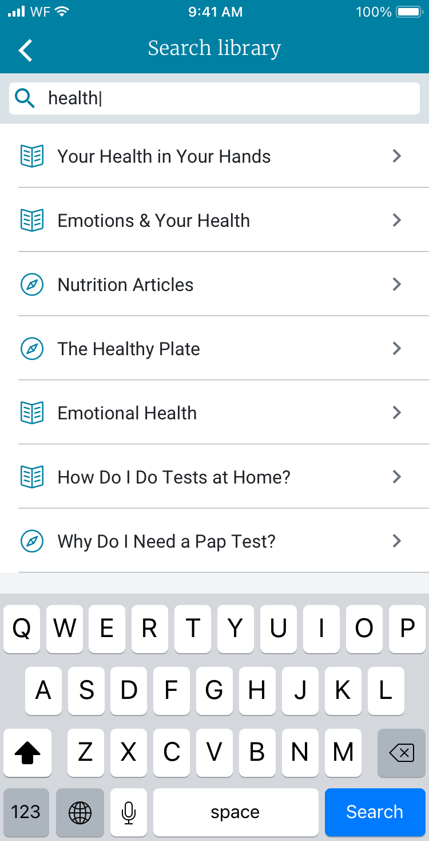
Target health behaviors and address quality measures with programs designed to meet the holistic needs of members
CARE PROGRAMS
Diabetes Type II Diabetes Prediabetes Support Coronary Artery Disease (CAD) Congestive Heart Failure (CHF) Hyperlipidemia Atrial Fibrillation (AFIB) Asthma Hypertension Chronic Obstructive Pulmonary Disease (COPD) End-Stage Renal Disease (ESRD)/Kidney Disease Medical Care Transitions (Pre-Discharge & Post-Discharge) Surgical Care Transitions (Pre-Admissions, Pre-Discharge
& Post-Discharge) Behavioral Health & Wellness Coronary Artery Disease (CAD) Percutaneous Coronary Intervention Cardiac Catheterization (PCI) Myocardial Infarction Cardiac Rehab Congestive Heart Failure (CHF) Chronic Obstructive Pulmonary Disorder (COPD) Total Knee Arthroplasty End-Stage Renal Disease (ESRD)/Chronic Kidney Disease Bundle Chronic Kidney Disease Hemodialysis Peritoneal Dialysis
Prep for Dialysis Prep for Vascular Access Behavioral Health & Wellness Program Depression Anxiety Bipolar Disorder Post Traumatic Stress Disorder Schizophrenia Substance Abuse Cancer Support
Breast Cancer Lung Cancer Prostate Cancer Maternal Health Care Bundle
Maternal Health Program (Prenatal & Postpartum Support) Multiple Pregnancy Gestational Diabetes Gestational Hypertension Substance Abuse & Maternal Health Prenatal Biometrics Neonatal Intensive Care Unit (NICU) Support
Pediatric Asthma Early and Periodic Screening, Diagnostic and Treatment (EPSDT) Lifestyle Management & Comorbidities Wellness & Prevention Stress Management Weight Loss Physical Activity Smoking Cessation Substance Abuse
Proprietary Care Program Composition
CHRONIC CARE & COMPLEX CARE
MATERNAL
HEALTH
BEHAVIORAL HEALTH
LIFESTYLE MANAGEMENT & COMORBIDITIES
Educational Articles
Surveys
Dashboard
Alerts
Encouragements
CARE TRANSITIONS
PEDIATRIC CAREGIVER
ONCOLOGY
GAPS IN CARE
Expanded educational content for all members, regardless of risk level
On-Demand Articles:
Annual checklist
Caregiver support
Gaps in care
COVID-19
Health plan navigation
Lifestyle and wellness
Musculoskeletal
Behavioral Health and Wellness
Elderly & Aging
Women’s Health
Notes:
Unlike many standalone point solutions to address specific conditions, such as maternity health or diabetes, Wellframe was designed to support the holistic needs of members in one comprehensive solution
Unlike static or traditional patient education, our programs are uniquely designed for mobile interaction personalization, and to trigger alerts for staff.
All articles are written to a 4th-grade reading level to meet health literacy needs
Readily available in English and Spanish
Can be “assigned” by staff members, auto-deployed at scale to member segments, or searchable on demand by members

Slide 9
On-Demand Articles:
Expanded, self-service educational content for all members, regardless of risk level
CARE PROGRAMS
ANNUAL CHECKLIST
CAREGIVER SUPPORT
GAPS IN CARE
COVID-19
HEALTH PLAN NAVIGATION
LIFESTYLE AND WELLNESS
MUSCULOSKELETAL
WOMEN’S
HEALTH
ELDERLY AND AGING
BEHAVIORAL HEALTH AND WELLNESS
Notes:
150 + articles nested under these 10 on demand bundles. Continue to add vertically and horizontally…building out new focus areas like Women’s health, Elderly & Aging, & Behavioral Health more recently.

Slide 10
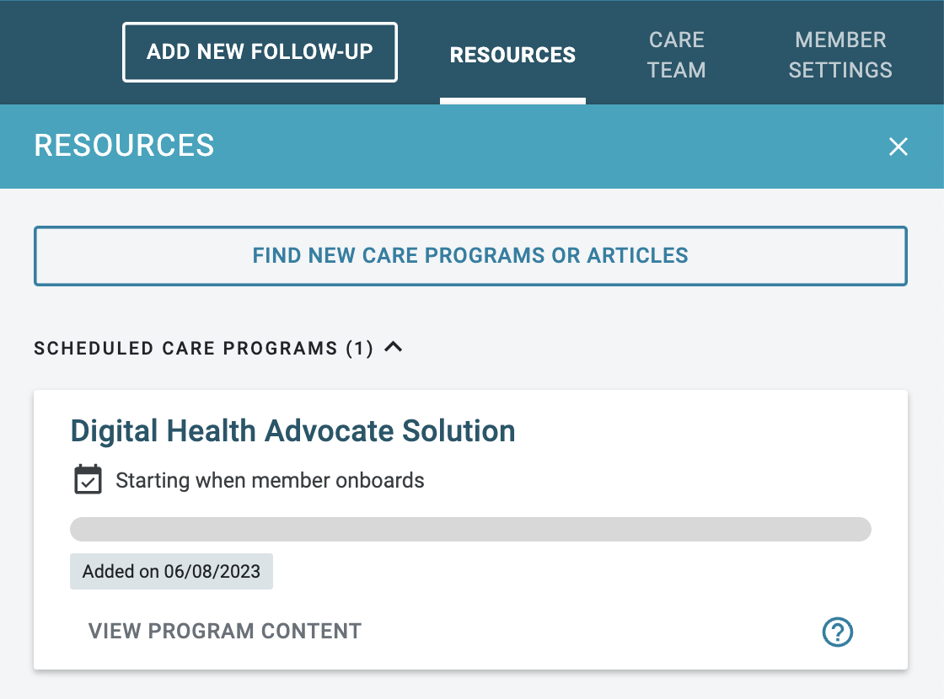
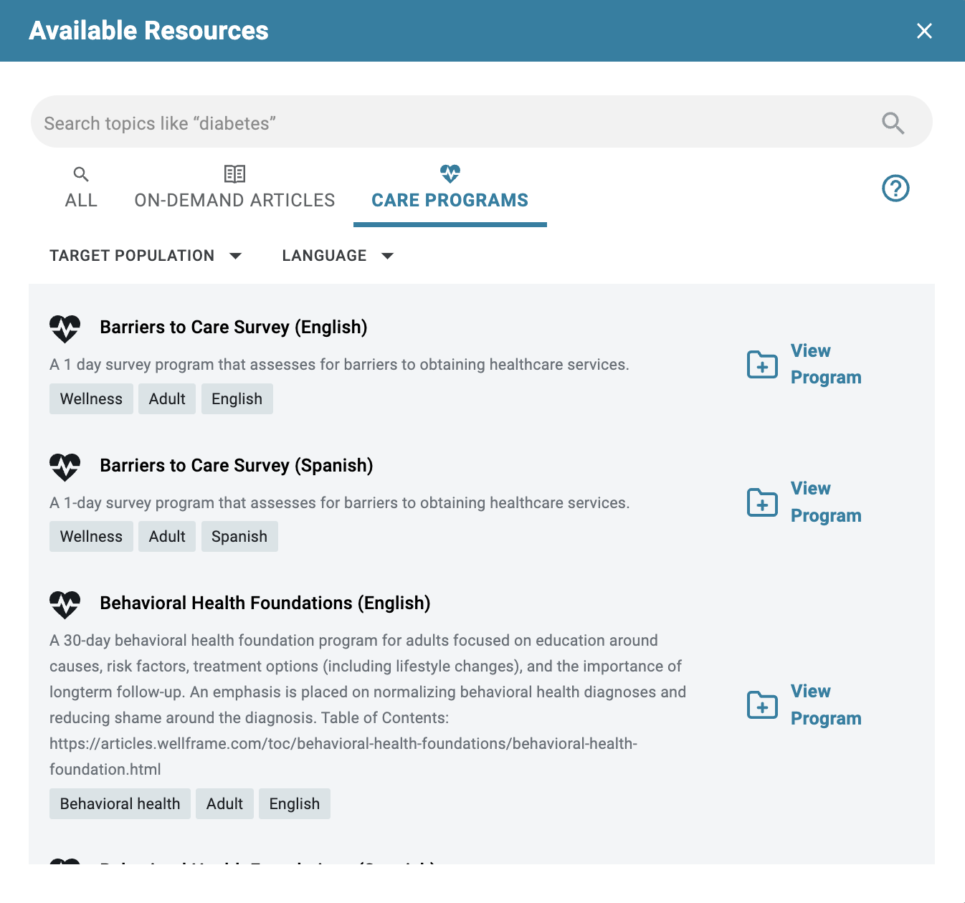
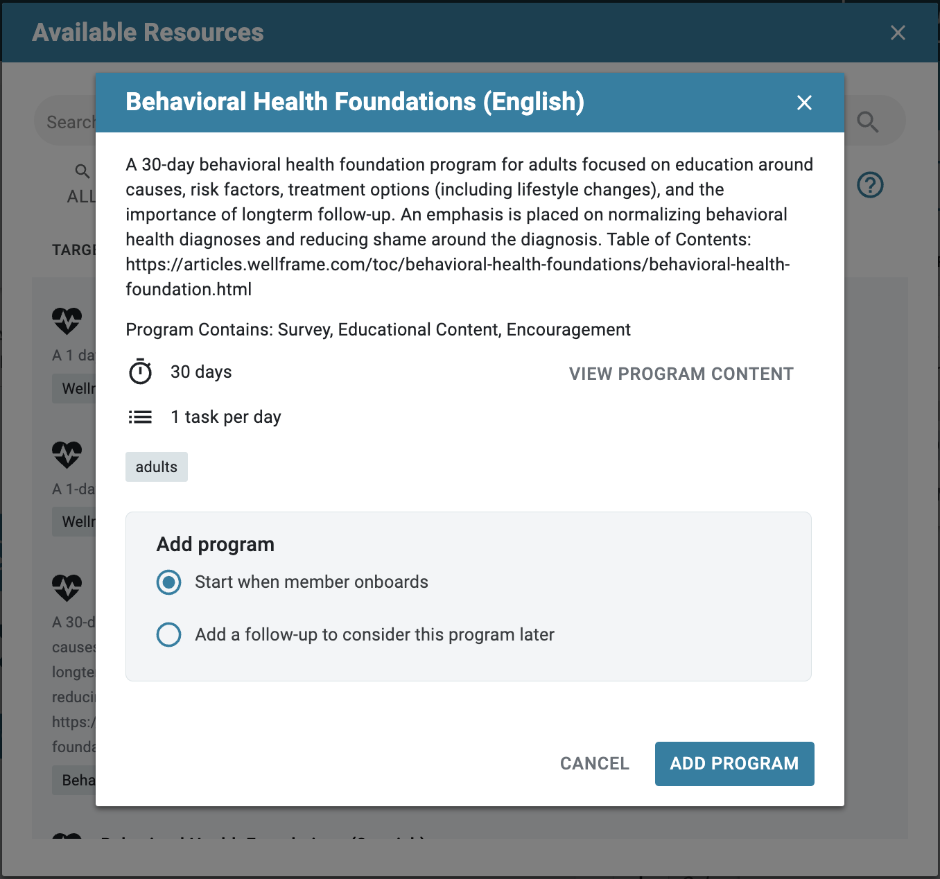
ONBOARDING CARE PROGRAM FLEXIBILITY
How to assign a care program prior to member onboarding
CARE PROGRAMS
See subsequent slides for details at each step.
Step 1
Navigate to Resources modal; select “Find new care programs…” *
Step 2
Search, filter, or scroll to find the care program for member enrollment
Step 3
Select “Start when member onboards;” then “Add Program”
* “Find new care programs…” button name reflects the Resources enabled for each customer’s dashboard

Slide 11
Adding biometric monitoring programs to promote self-management and accountability
BIOMETRICS
Use Weekly Weight & Physical Activity report to promote member's with lifestyle goals.
Align Blood Sugar and Blood Pressure biometrics with members' specific testing schedules.
Daily and Weekly Pain Biometrics enable you to support both acute and chronic pain tracking:
  Post-Op
  Oncology
  Chronic pain
Biometric Programs

Slide 12
What’s in a biometric monitoring program?
BIOMETRICS
SURVEYS
A daily or weekly survey that appears on the members checklist and enables the user to input both quantitative and qualitative data about their self-managed biometric, including:
Their biometric reading (i.e. blood pressure, blood sugar, weight or pain rating)
How their reading compares against their goals/target range
Whether they are experiencing any symptoms
Surveys include general management guidance based on evidence-based clinical guidelines but
always refer members back to their provider's instructions & recommendations.
DASHBOARD ALERTS
Automated notification designed to surface pertinent member insights from surveys back to the dashboard users. Alerts also provide end-user decision support in an effort to help guide next steps.
Dashboard users will always be notified if:
A reading is outside the clinical guideline recommendation
Member reports a reading is outside of their target range
Member reports experiencing any symptoms
Notes:
And while we have a broad range of programs in different clinical areas, that range in length & scope....all our programs are comprised of the same core components, that are consistent across the portfolio. These include Educational articles, Encouragements, Surveys, and Dashboard Alerts.

Slide 13
Biometric monitoring program best practices
BIOMETRICS
Biometrics do not contain any articles; members will not receive health education unless they are enrolled in additional, relevant care programs.
We typically recommend use of biometrics as a supplement to a clinical care program. There are some exceptions where a clinical care program is not necessary. For example, a member who is not interested in receiving health education through a care program but may benefit from the accountability provided in a biometric program.
Biometrics include clinical questions and clinical alerts
We only recommend use of biometrics if a clinician is managing the member or available for clinical escalation.
Biometrics foster member activation and engagement
The earlier in the member journey that a biometric program is added, the better chance that the member is engaged and retained. We have seen up to 2.1x increase in engagement for members enrolled in biometric programs.
Notes:
And while we have a broad range of programs in different clinical areas, that range in length & scope....all our programs are comprised of the same core components, that are consistent across the portfolio. These include Educational articles, Encouragements, Surveys, and Dashboard Alerts.

Slide 14
When to Use a Biometric Program
BIOMETRICS
If biometric management is part of your care management team's program
→ Example: Care Manager is part of a dedicated diabetes management care team focusing on blood sugar monitoring
If the member expresses interest in monitoring a biometric or working towards a goal
→ Example: Member would like to lose weight or track their blood pressure
1
3
2
If the the member is managing a new condition or medication that requires them to track a biometric
→ Example: Member diagnosed with gestational diabetes who needs to track their blood sugar
→ Example: Member is managing new blood pressure diagnosis; wants to report back to their provider
4
If the care manager would like to boost member accountability and engagement
→ Example: Member expresses that they would like more to do on the app or care manager wants to provide more targeted to-dos for the member
Notes:
And while we have a broad range of programs in different clinical areas, that range in length & scope....all our programs are comprised of the same core components, that are consistent across the portfolio. These include Educational articles, Encouragements, Surveys, and Dashboard Alerts.

Slide 15

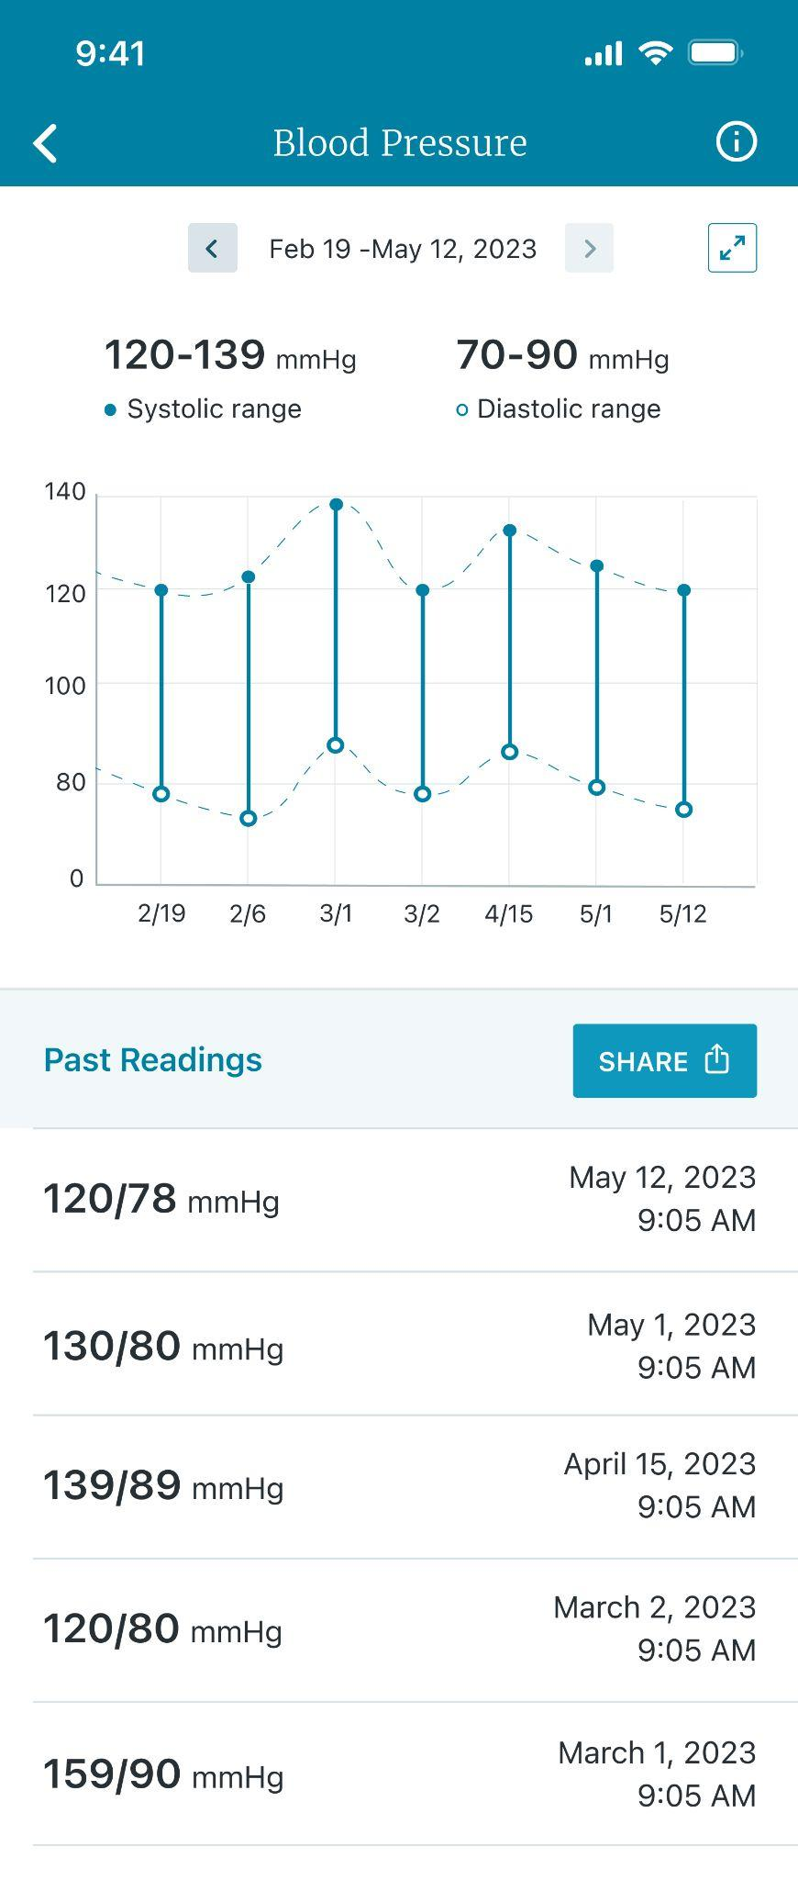
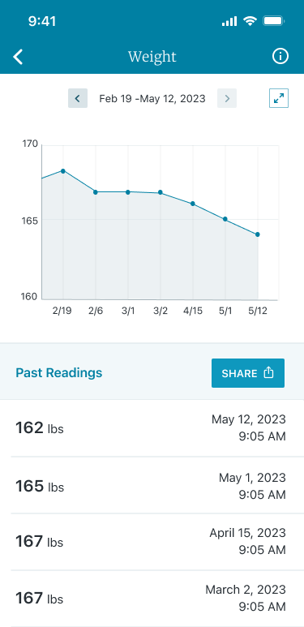
Health data visualizations in mobile app
Image: Expanded blood pressure widget
Image: Expanded weight tracker widget

Slide 16
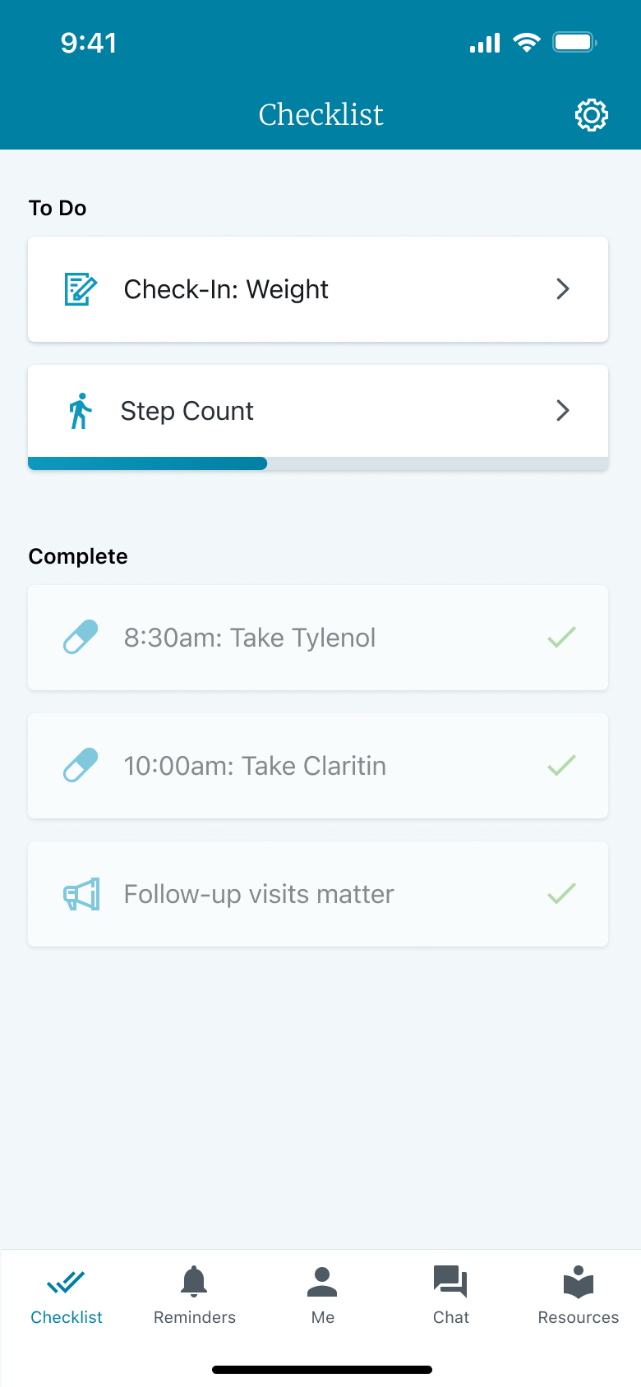
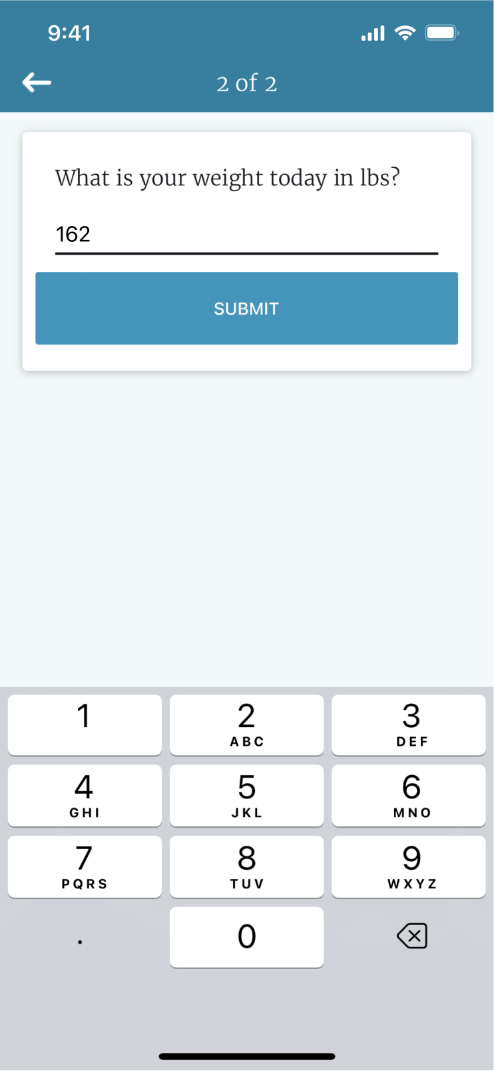
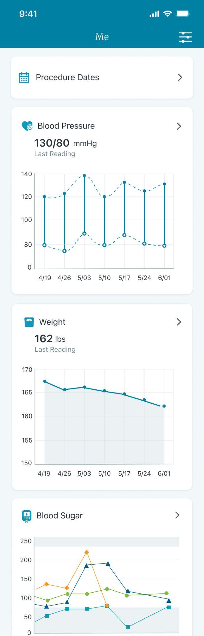
HEALTH DATA VISUALIZATIONS IN MOBILE APP
The member experience
Indicates member action to tap screen
NOTES:
Widget displays immediately upon entering the first data point.
Neither members nor staff can currently set goals for these widgets. Goal setting is a future enhancement on the product roadmap.
Step 1
Checklist task appears to enter weight or blood pressure
Step 2
Enter weight or blood pressure reading
Step 3
View data within the ‘Me’ Screen

Slide 17
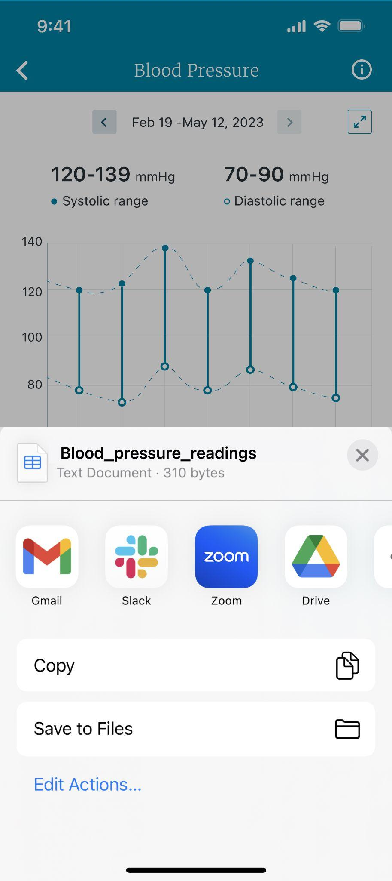
DATA VISUALIZATIONS IN MOBILE APP:
Downloading and sharing reports
BIOMETRICS
Easily export data from the app for personal use or to share with a care team or caregivers.
Tap “share” on the expanded widget screen.
Select from the presented options. Members will see the sharing options available or selected on their device.
NOTE: This generates a csv file with a complete list of entered data.
Image: Expanded blood pressure data screen
Image: Example options to share blood pressure data

Slide 18
DATA VISUALIZATIONS IN MOBILE APP
Biometric care programs enabling the data visualization widgets
BIOMETRICS
Members will see the associated widget displayed in their ‘Me’ Screen when they have been enrolled in one of the following care programs and have entered their weight or blood pressure reading.
Blood Pressure Biometric Programs:
Monitoring: Daily Blood Pressure
Monitoring: Morning Blood Pressure
Monitoring: Afternoon Blood Pressure
Monitoring: Evening Blood Pressure
Monitoring: Weekly Blood Pressure
Weight Management Biometric Programs:
Monitoring: Daily Weight, Chronic Disease
Monitoring: Weekly Weight, Lifestyle
Blood Sugar Biometric Programs:
Monitoring: Fasting Breakfast
Monitoring: Pre-Lunch
Monitoring: Pre-Dinner
Monitoring: Bedtime
Monitoring: 2 Hour Postprandial Breakfast
Monitoring: 2 Hour Postprandial Lunch
Monitoring: 2 Hour Postprandial Dinner

Slide 19
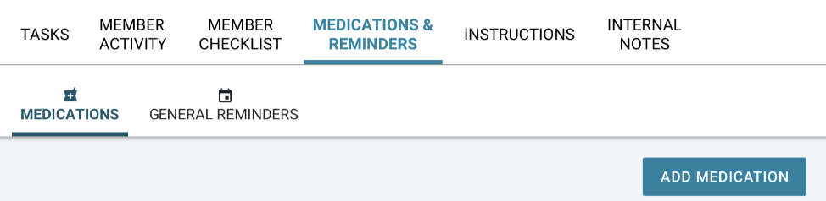
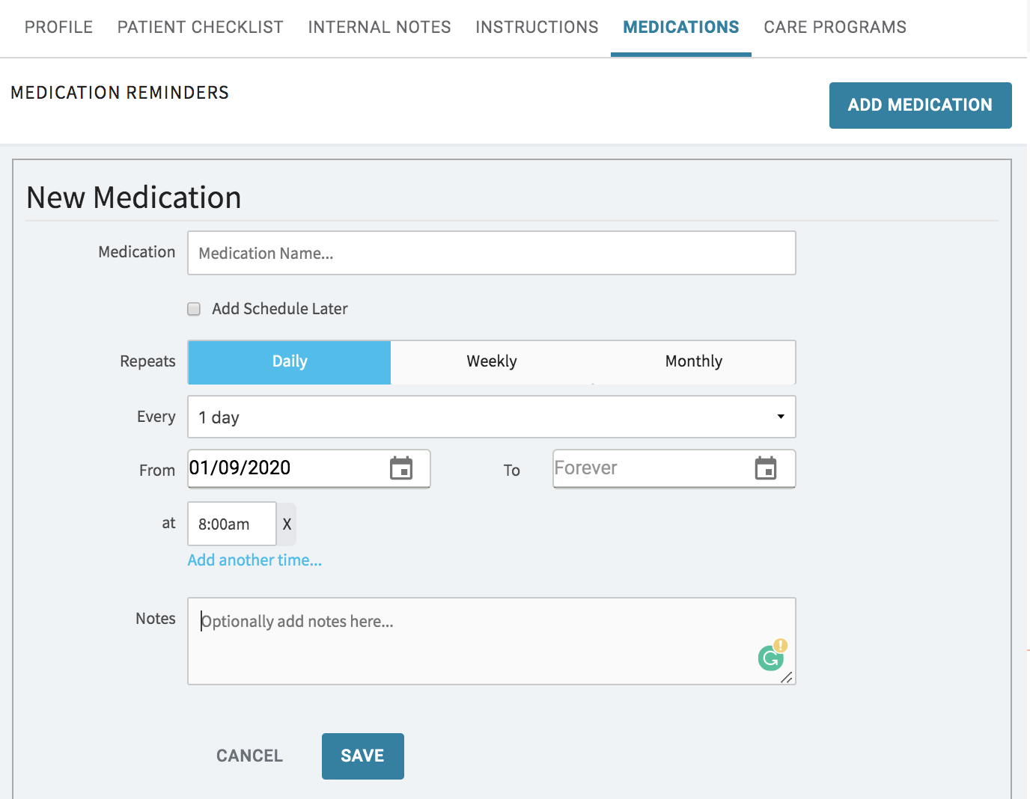
Adding medication reminders and general reminders to improve adherence and track health events
ACTIVATE
REMINDERS
REMINDERS
1
Use medication reminders to reconcile members’ meds or align on current medication list
  Review dosage, time, form/route
Track members’ adherence to identify and address barriers
Promote goals by setting general reminders to: walk, exercise, journal, etc
Set reminders for important activities such as:
  Picking up medications
  Scheduling or attending appointments
  Scheduled phone calls with care team
2
3
4
Notes:
Norine
Best practice call outs - Norine and best practice work group - with Sherry

Slide 20
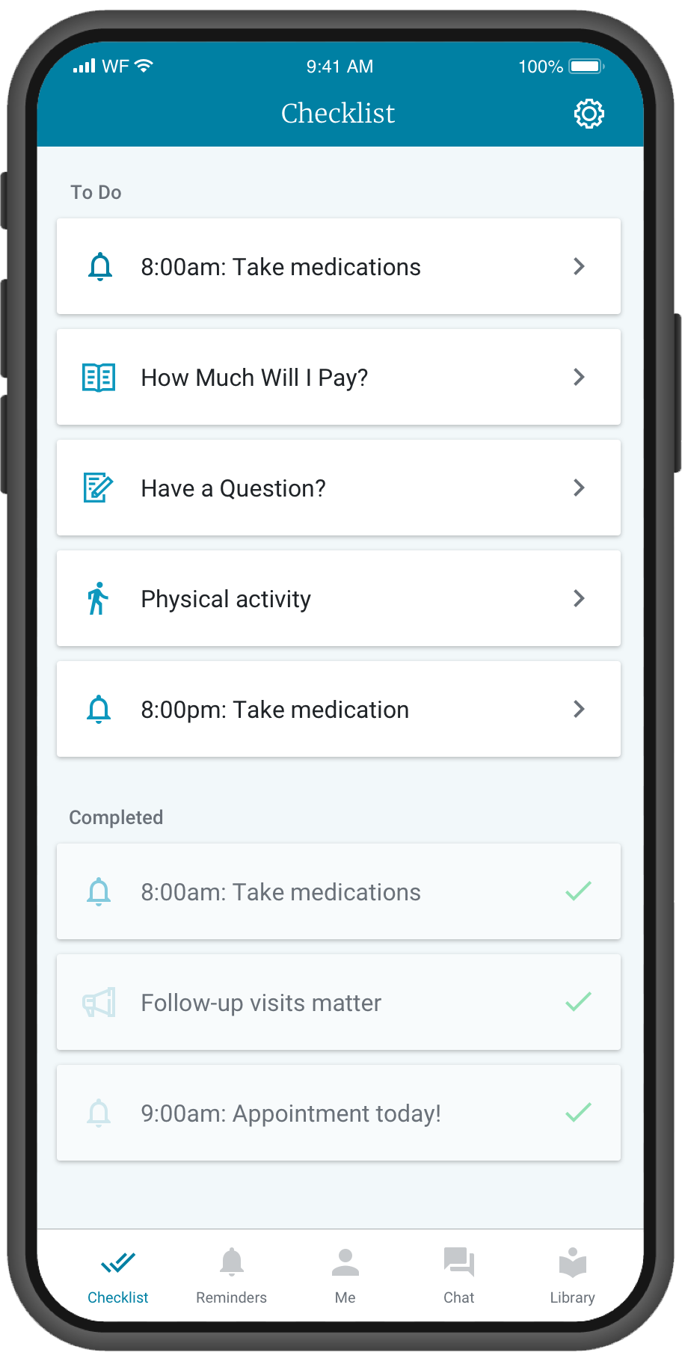
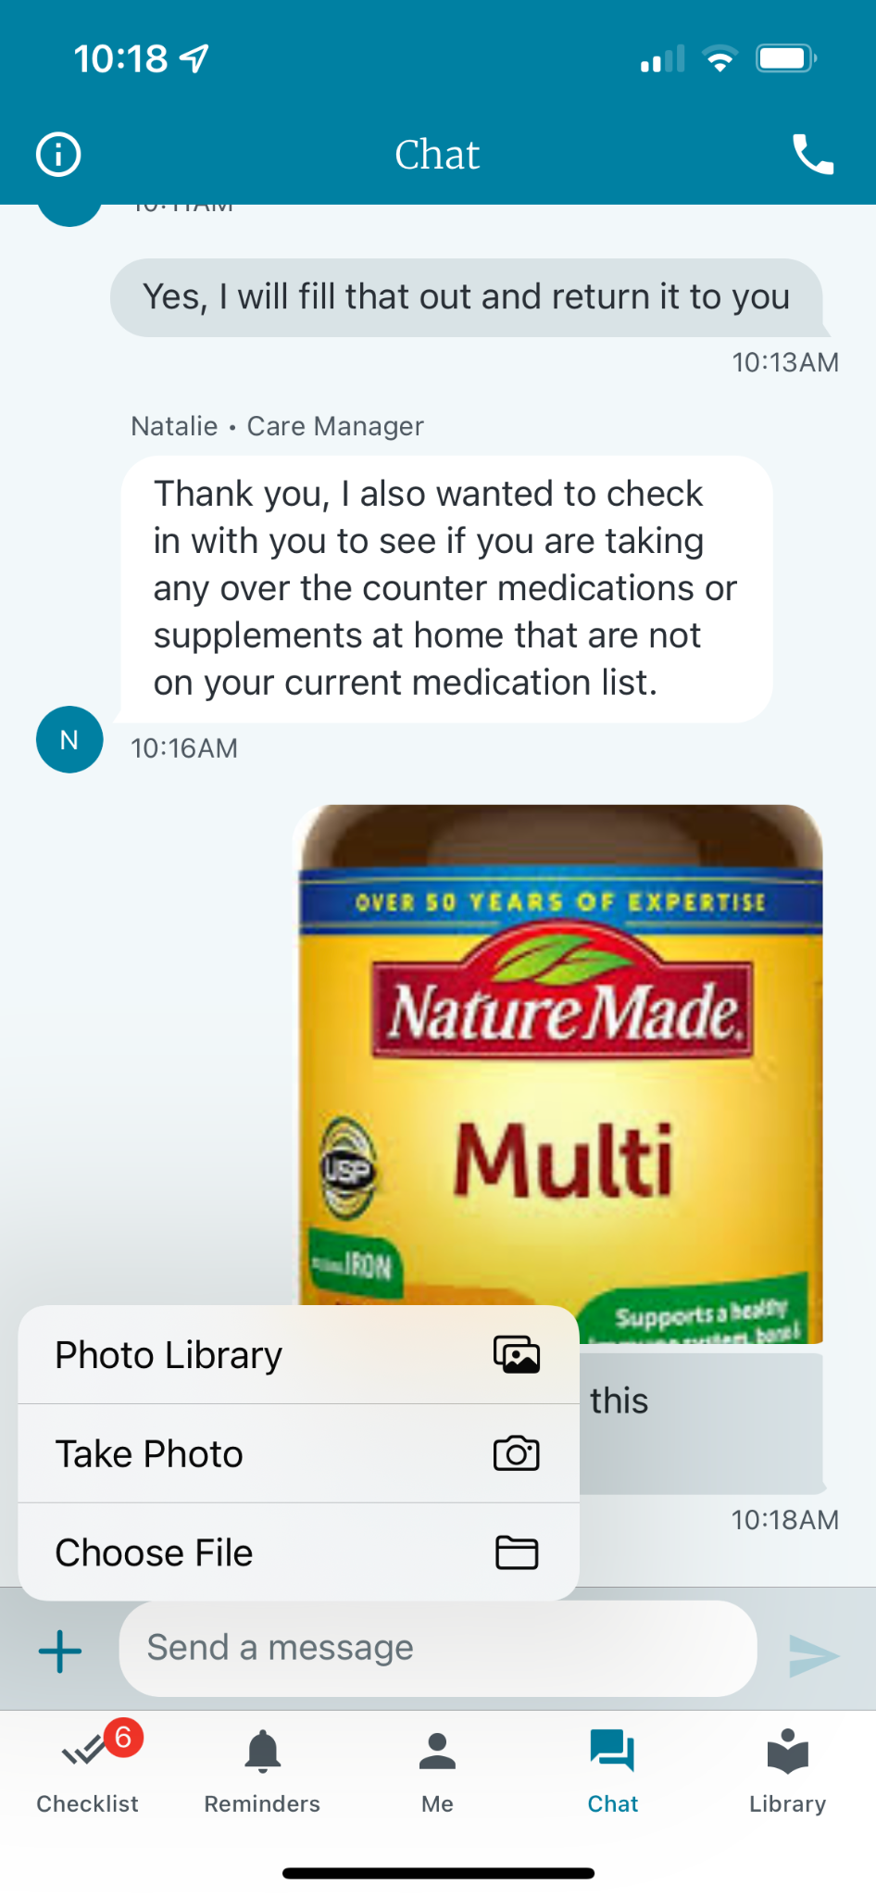
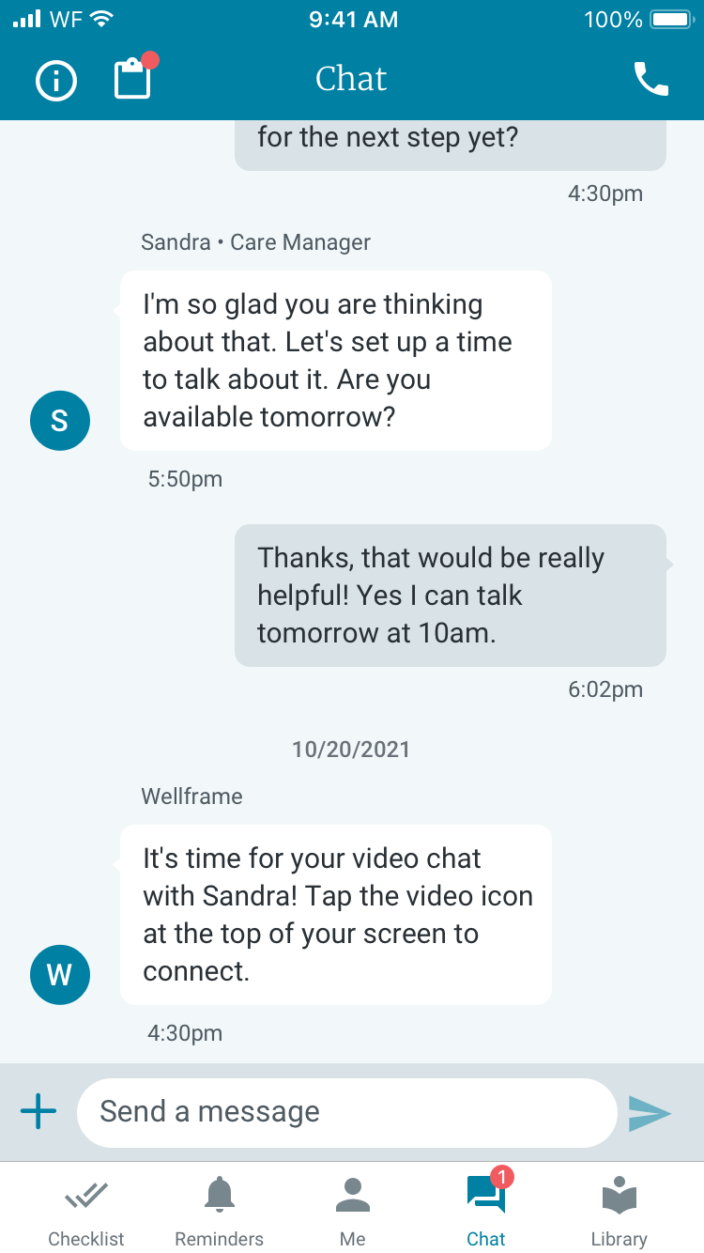
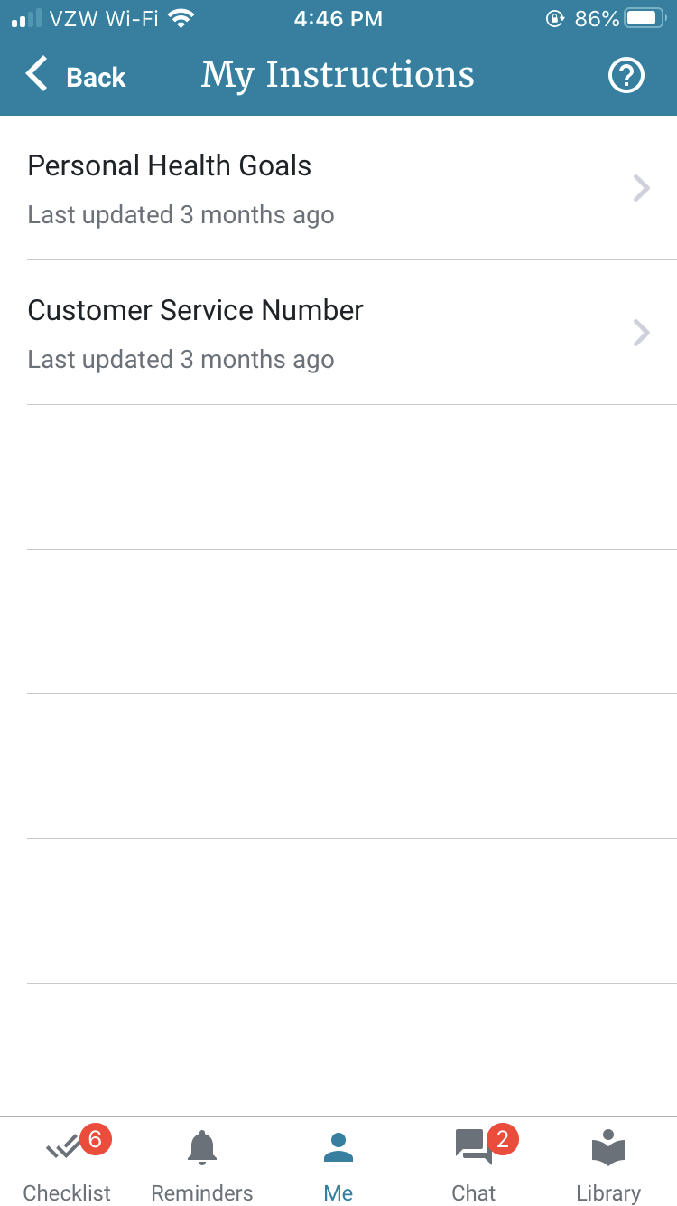
Use instructions to provide members with specific information and/or guidance
INSTRUCTIONS
Share critical information:
  Contact information & addresses.
  Discharge instructions
  Resources
  Medication instructions
Document member goals and/or plan of care.
  Track progress against goals
  Recap information discussed with member
  Share relevant resources/links
Instructions

Slide 21
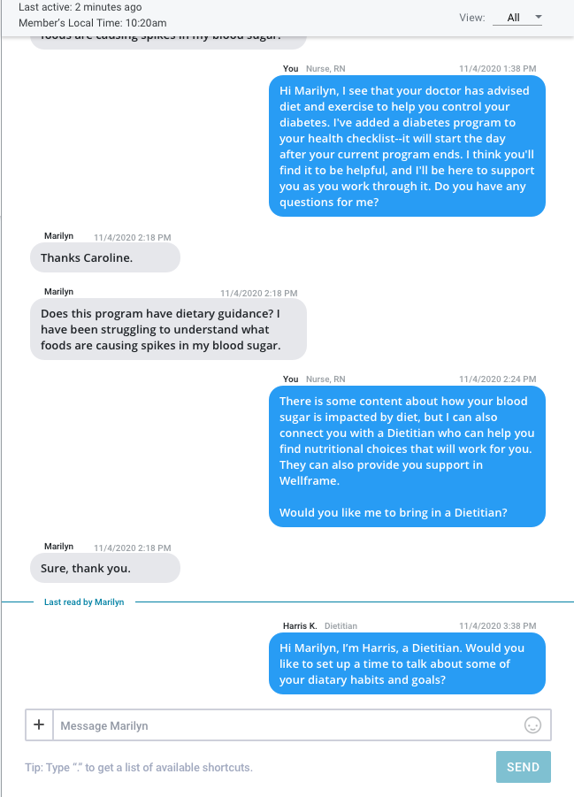
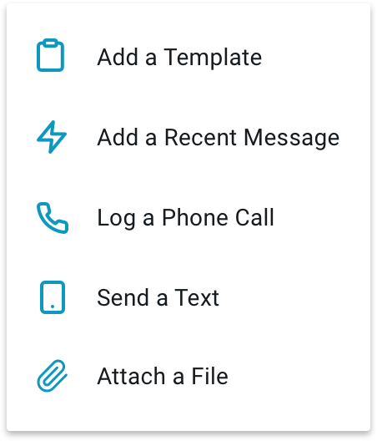
ACTIVATE
MESSAGING
Proactive messaging helps to engage members and guide their journey
Outreach to members right after they onboard to welcome them to digital care management, align on care management goals, and set expectations around their digital engagement
  What should they expect from you?
  What do you expect from them?
Use group messaging to regularly outreach to your caseload
  Send encouragements to engage with features on the app
  Send reminders to attend preventive health visits, keep a safe environment at home, practice mindfulness, or provide tips for managing meds
Messaging quality impacts member engagement - the more personalized, the more likely a member is to respond or take action
Send template or recent messages
Notes:
Norine

Slide 22
Set expectations with your members to guide their digital experience
MESSAGING
Why is this important?
Setting expectations provides the member with a sense of security, understanding and empowerment. It guides the member to engage while also clarifying what you will provide for them.
What should be included in the conversation?
What is digital care management? What is a care manager?
How do I use this app? What am I expected to do?
What type of program is the member participating in?
  Examples: Wellness, Chronic Care, Transitions of Care, Maternity
What is the expected duration of the program?
  Examples: 30, 45 days
How often will the member be hearing from the Care Manager/Plan representative through messaging?
  Examples: weekly, monthly
What else is the member expected to do and how will it provide value for them?
When/How do you deliver this message?
During the initial telephone call followed by message once the member onboards; staff can use templates messages to develop different messaging for each program

Slide 23
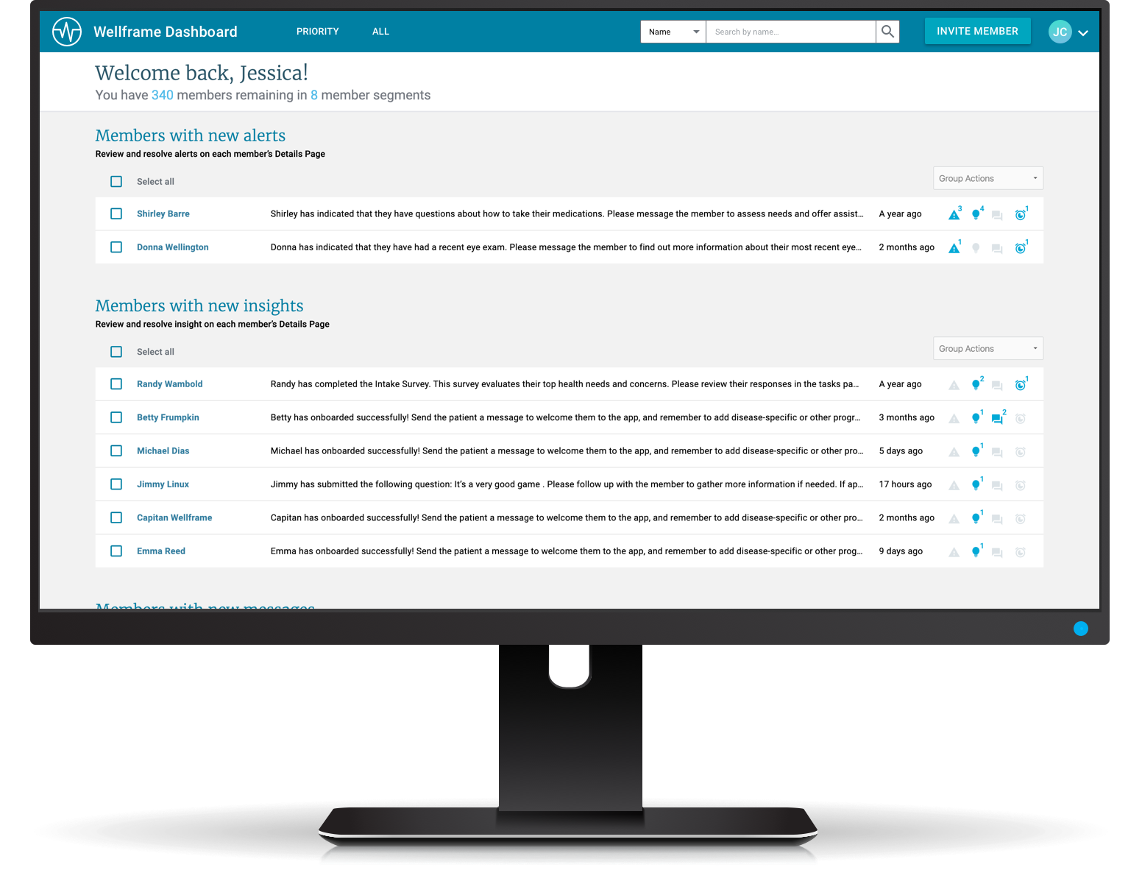
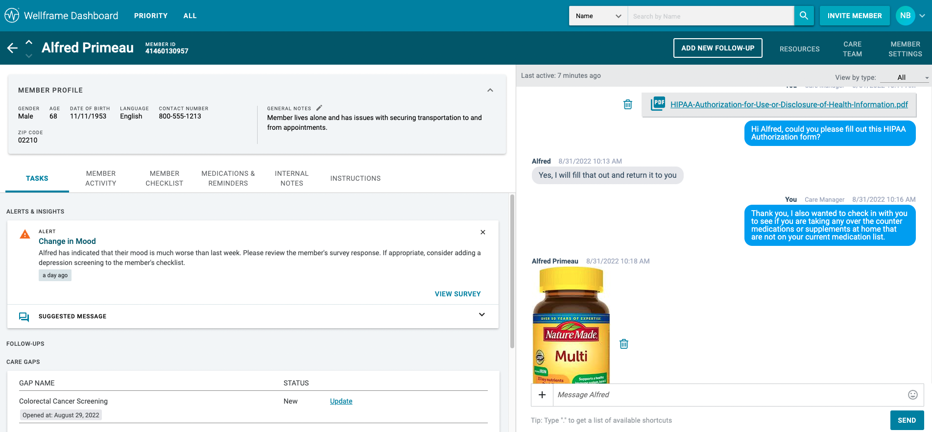

THE STAFF EXPERIENCE
Attachments in chat
ENGAGE
STAFF DON’T NEED TO RETYPE COMPLEX INFORMATION
Attach digital documents like supplemental educational materials or discharge instructions
Saves time and improves efficiency
Reduces error
Add text to accompany an attachment
Filter conversations to include or exclude attachments
Delete attachments when appropriate to do so

Slide 24
Wellframe DCM Programs
CARE PROGRAMS
LIFESTYLE MANAGEMENT
& COMORBIDITIES
Welcome Program
Wellness & Prevention
Managing Stress
Weight loss
Migraines
Physical Activity
Smoking Cessation
Fall Prevention
Social Isolation
Caregiver Support
Substance Use Disorder*
Prediabetes Support*
Adult Biometrics
CHRONIC CARE & COMPLEX CARE
Type 2 Diabetes
Prediabetes Support*
Coronary Artery Disease
Heart Failure
Hyperlipidemia
Atrial Fibrillation
Asthma
Hypertension
Chronic Obstructive Pulmonary Disease
Chronic Kidney Disease
MATERNAL HEALTH
Prenatal and Postpartum support
Multiple Pregnancy
Gestational Diabetes
Gestational Hypertension
Substance Use Disorder
Prenatal Biometrics
PEDIATRIC CAREGIVER
Newborn Wellness and Prevention
Pediatric Biometrics
Neonatal Intensive Care Unit Support
Asthma
Care Transitions- Medical/Surgical
Care Transitions- Type 1 Diabetes
Care Transitions- Pneumonia
GAPS IN CARE BUNDLES
Breast Cancer Screening
Colorectal Cancer Screening
Cervical Cancer Screening
Chlamydia Screening
Diabetic Blood Sugar
Diabetic Kidney Disease
Diabetic: Eye Exam
CARE TRANSITIONS
Medical Care Transitions
Surgical Care Transitions
Behavioral Health Care Transitions
Myocardial Infarction
Cardiac Rehab
Percutaneous Coronary Intervention
ONCOLOGY
Cancer Support
Breast Cancer
Lung Cancer
Prostate Cancer
* These programs appear in multiple bundles
Notes:
Newest bundle Healthspan includes: 4 programs ranging from 13-21 days in length
Your Health Across Your Life: How to Feel Better Longer
Preventive Care: Why Regular Appointments Add Up
Making Habits Stick: The Foundation of Good Health
Helping Yourself and Others in a Medical Emergency

Slide 25
Team Specific Scenarios

Slide 26
Case Management Specific Scenarios

Slide 27
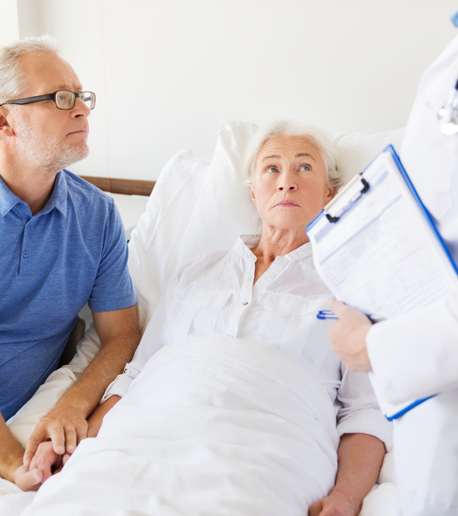
Nancy is 69 and came in to the hospital after experiencing chest pain and extreme shortness of breath. She was diagnosed with complex empyema pneumonia with surgical intervention. She is very weak from her 7 day hospital stay and is now discharging on several antibiotics, physical therapy. She has new specialist appointments. The member's husband is requesting case management.
Notes:
Supplemental program education & monitoring program CAD and HTN

Slide 28


Care Programs : Best Practices
Enrolled in a Personalized Care Program
Enrolled in a Biometric Program
Patient Instructions Entered
Medication/General Reminders Entered
Care Transitions- Surgical
Biometric Monitoring- Pain
Care Team Info
Diet info
Activity info
Discharge instructions (if available)
New provider appointments
New antibiotics entered
Activity goal
Next f/u call with care team

Slide 29

Lorena is 59 with a diagnosis of breast cancer and has an upcoming bilateral mastectomy scheduled. She has been given a lot of information about a care plan but is scared she won’t remember it all and losing the all the papers she was given.
Notes:
Instructions- Plan of Care, Post discharge transition of care content
Mention the pre-admission content

Slide 30
Care Programs : Best Practices
Enrolled in a Personalized Care Program
Enrolled in a Biometric Program
Patient Instructions Entered
Medication/General Reminders Entered
Oncology- Cancer Support
Breast Cancer
Biometric Monitoring- Pain
Care Team info
Diet info
Activity info
New provider appointments
Radiation appointments (if appropriate)
Chemo appointments (if appropriate)
Next f/u call with care team

Slide 31

Meredith, 28, is pregnant with her first child and has a diagnosis of gestational diabetes. When you connect, you have meaningful calls, but, many times you get her voicemail. She’s also said that she sometimes forgets what information/ advice you shared.
Fast forward, Meredith delivers early at 32 weeks, and new baby girl is in the NICU.

Slide 32
Care Programs : Best Practices
Enrolled in a Personalized Care Program
Enrolled in a Biometric Program
Patient Instructions Entered
Medication/General Reminders Entered
Maternal Health (prenatal/postpartum support)
Gestational Diabetes
Neonatal Intensive Care Unit Support- post delivery
Monitoring blood sugar daily- gestational diabetes
Care Team info
Diet info
Activity info
New Provider appointments
New Medications
Next f/u call with care team

Slide 33
Disease Management/Chronic Condition Specific Scenarios

Slide 34

Roger, 63, is diabetic who doesn’t communicate his blood sugar readings. He expressed interest in setting some goals that he shared with you but says he’ll probably forget about them. He enjoys connecting with you but he says he’s so busy that he sometimes does not have the time for a call.

Slide 35
Care Programs : Best Practices
Enrolled in a Personalized Care Program
Enrolled in a Biometric Program
Patient Instructions Entered
Medication/General Reminders Entered
Diabetic Program
Lifestyle: Managing Stress or Physical Activity
Biometric Monitoring- Blood sugar
Care Team Info
Diet info
Goals
New provider appointments
Encourage medications
Enter goals
Next f/u call with care team

Slide 36

Felicity, 54, has hypertension. She forgot her last cardiologist appointment. She tends to look up information about her condition by googling and at times relies on unreliable sources.

Slide 37
Care Programs : Best Practices
Enrolled in a Personalized Care Program
Enrolled in a Biometric Program
Patient Instructions Entered
Medication/General Reminders Entered
Hypertension Program
Lifestyle:
Stress management or physical activity
Monitoring- Blood pressure
Care Team Info
Diet info
Activity info
Goals
Provider appointments
Encourage entering meds
Enter goals
Next f/u call with care team

Slide 38

Ivan, 40, recently got diagnosed with asthma. He is motivated to make healthier choices. He started new medications. He wants to make healthier choices like walk every day, and lose weight.

Slide 39
Care Programs : Best Practices
Enrolled in a Personalized Care Program
Enrolled in a Biometric Program
Patient Instructions Entered
Medication/General Reminders Entered
Asthma Program
Lifestyle: Physical activity, weight management.
Monitoring- weekly weight
Care Team Info
Diet info
Goals – physical activity/weight goals
Provider appointments
Encourage entering new medications
Enter weight goals
Next f/u call with care team

Slide 40
TOC Specific Scenarios

Slide 41

Arnold is 67 years old hospitalized with a CHF exacerbation. He lives alone. His children live in another city. Arnold will go home in 2 days on new diuretic medications and fears not having anyone to support him once he’s back home. He’d like to have someone to talk to and guide him.
Notes:
Pre discharge- chat & messaging
CHF content
And post discharge content

Slide 42
Care Programs : Best Practices
Enrolled in a Personalized Care Program
Enrolled in a Biometric Program
Patient Instructions Entered
Medication/General Reminders Entered
Care Transitions- Medical
Monitoring- Weight
Care Team Info
Diet info
Activity info
Discharge instructions (if available)
Provider appointments
New medications
Activity goal
Next f/u call with care team

Slide 43
Lorena is 70 scheduled for an elective hip replacement. She has been given a lot of information about a care plan but is scared she won’t remember it all and losing the all the papers she was given.
Notes:
Instructions- Plan of Care, Post discharge transition of care content
Mention the pre-admission content

Slide 44
Care Programs : Best Practices
Enrolled in a Personalized Care Program
Enrolled in a Biometric Program
Patient Instructions Entered
Medication/General Reminders Entered
Care Transitions- Surgical
Monitoring- Pain
Care Team Info
Diet info
Activity info
Discharge instructions (if available)
Provider appointments
Pain medications
Activity goal
Next f/u call with care team

Slide 45

Mae, a 65-year-old woman, came in for a lap choley. She is married and is generally quite healthy, as is her husband, Jack. She is planned to discharge post op day 1. She says she’s worried about remembering all the information her doctor shared and remembering all of the post-discharge doctor’s appointments and new medication to take twice a day.
Notes:
Post discharge General reminders reminders & follow-ups to check in with the member before, the day of, after their check up

Slide 46
Care Programs : Best Practices
Enrolled in a Personalized Care Program
Enrolled in a Biometric Program
Patient Instructions Entered
Medication/General Reminders Entered
Care Transitions- Surgical
Monitoring- Pain
Care Team Info
Diet info
Activity info
Discharge instructions (if available)
Provider appointments
New medications
Activity goal
Next f/u call with care team

Slide 47
Population HealthSpecific Scenarios

Slide 48


Chris, 39, is new to the plan. He’s is on a couple prescribed medications, but his conditions are managed well. He is interested in staying well.

Slide 49
Care Programs : Best Practices
Enrolled in a Personalized Care Program
Enrolled in a Biometric Program
Patient Instructions Entered
Medication/General Reminders Entered
Welcome Program
DIA
Monitoring- Might depend on assessment info
Care Team Info
Diet info
Activity info
Current medications
Activity goal
Next f/u call with care team

Slide 50
Ivan, 40, is motivated to make healthier choices. He wants to walk every day, fill out a diet journal, and learn new recipes. He has a first degree relative with colon cancer and has not had a screening yet.

Slide 51
Care Programs : Best Practices
Enrolled in a Personalized Care Program
Enrolled in a Biometric Program
Patient Instructions Entered
Medication/General Reminders Entered
Welcome Program
DIA
GIC – Colorectal Cancer Screening
Monitoring- ?
Care Team Info
Diet info
Activity info
Current medications (if any)
Activity goal
Next f/u call with care team

Slide 52

Linda, 43, has asthma. She is compliant with her medication regimen but has expressed interest in quitting smoking.

Slide 53
Care Programs : Best Practices
Enrolled in a Personalized Care Program
Enrolled in a Biometric Program
Patient Instructions Entered
Medication/General Reminders Entered
Asthma
Smoking Cessation
Monitoring- ?
Care Team Info
Coping strategies
Current medications
Activity goal
Next f/u call with care team

Slide 54
Next Steps
Choose care programs to personalize the member experience and promote self-management.
Choose monitoring programs to personalize the member experience and promote self-management.
Apply best practices for member activation- leverage welcome message, medication/general reminders and instructions.

