Slide 1
Invite and Onboard Inservice
2026

Slide 2
Agenda
Personalizing Your Wellframe Invite
  Invite Process
  Member Personas
  Invite Activity
  Invite Use Cases
Onboarding
  Onboarding Process
  Follow Up process
Key Takeaways
Q & A

Slide 3
Personalizing Your Wellframe Invite

Slide 4






Care Manager Journey
INVITE
Provide members with a personalized value story for digital care management.
CARE MANAGER
Timing matters.
Don't wait until the end of the call to invite members to use Wellframe. Look for opportunities to embed it in your conversation naturally and highlight how you can use it to support your member's plan of care.
Think digital first.
Members will look to you to set the tone for their interest and engagement. Introduce digital as your primary mode for managing members to increase their buy-in.
Take advantage of the first call.
Members are more likely to fully onboard if you complete it on the first call with them. If needed, schedule a follow up call to walk them through the process.
Prepare ahead of time.
Review your members' clinical history and reasons for referral to care management. Plan how you can personalize your invite based on their needs.
Notes:
Example of this engagement

Slide 5




Explaining the Wellframe Features
NVITE
INVITE
INVITE
FEATURE
SAMPLE SCRIPT
Messaging | “Send and receive messages whenever you have a question about your care, want to schedule a call, or just need a little support. Secure messaging through the app can be a convenient and private way to ask questions about your health without having to find time in a busy day to call!“
Daily health checklist | “Complete tasks to stay on track with your care plan. These tasks might be education readings or a quick video or survey to help your care manager see how you are doing. The more tasks you complete the more they will be able to support you and help if you have questions.”
Reminders | “Set reminders to attend scheduled physician appointments, or take routine medications.”
Educational articles & videos | “Clinical information about your condition and other information relevant to you, accessible at any time on your smartphone or tablet.”
Notes:
Here are some sample talking points for explaining the different Wellframe features:
For messaging, highlighting that it is secure, convenient, and there when you need it.
For the daily health checklist, explaining that this might include articles, surveys, and videos and their progress through the checklist will allow their care team to know how they are doing.
Explaining that medication and general reminders can be added into the app by either the member on the app or by their care team.
And finally, explaining that the education articles and videos will contain information that is relevant to them and can be accessed anytime on their phone or tablet.

Slide 6

Member Personas
“New Diagnosis” Diane
Recent diagnosis of Type 2 diabetes.
New diabetes medications ordered.
Monitoring blood sugars.
New specialist follow up appointment.
States she “feels overwhelmed with remembering everything”.
Wellframe Features to Highlight
Checklist for:
  Medication Reminders
  Follow Up Appointment Reminder
Messaging with Care Manager
Personalized care programs
Educational Articles/Videos

Slide 7

Wellframe Features to Highlight
Care Management programming that works with the member’s schedule.
Checklist for:
  Medication Reminders (new medication)
Messaging feature with Care Manager to provide ongoing support.
Personalized care programs- Stress Management.
Blood pressure Biometric monitoring to enable the CM to monitor.
“Ongoing Condition” Connie
History of hypertension with recent hospitalization for elevated BP.
New order to monitor blood pressure.
Started new medication.
Feels “stressed” about the recent hospitalization.
Works nights and not sure she can commit to telephonic CM.

Slide 8

Member Personas
“Value Seeker” Sam
Interested in taking advantage of all the benefits of his health insurance.
Asks a lot of questions about “cost or how to save money”.
Savvy shopper for savings.
Wellframe Features to Highlight
Included within benefits- no additional cost.
Provides access directly to Care Manager (also part of benefits package).
Resources to assist in health care navigation.
Highlight preventative care programs.

Slide 9

Wellframe Features to Highlight
Real-time access including HIPAA secure messaging to Care Management staff.
Access to educational article/videos.
Care Management on the member’s timeframe based on personalized care programs.
“Easy Button” Ben
Very busy.
Expresses the need for fast and easy secure communications.
Time is very important
Manages health on his timeframe.

Slide 10
Activity
Putting in Your Words
  Think about one of your current members on your caseload.
  What member persona would they fall into?
  What Wellframe feature would resonate with them most? What would matter to them?
  How would you explain the benefits of Wellframe to them?
  Write out your script for them.
"Mary, based on what you have told me, it sounds like our digital care management program will fit your needs really well, it allows for secure messaging in case any questions come up, especially if you are not up to talking. It also has an area to enter the new medications you were prescribed so you will not forget to take the afternoon doses. I can send you the link right now and stay on the line with you to make sure you get it downloaded."

Slide 11



Addressing Concerns
CONCERN
SAMPLE SCRIPT
If member feels it will take too long to sign up | “Let’s take a few minutes to get you signed up now. This will make it easier for you to stay in touch with your care team, and to text back and forth. This can be especially helpful now, and will only take about 3 minutes.”
If member is concerned about privacy & security | “You might be familiar with seeing your doctor on the computer during an appointment so that they can check on your health history and take notes about your visit. Our app has to follow the same rules as those computer programs to make sure your data is protected. The app makes it just as easy as text messaging to contact your care manager but it is secure in order to protect your personal information.”
If member is worried about how this may change the telephonic relationship | “The app will make it easier for us to stay connected between phone calls and when it’s most convenient for you. We can still speak by phone when you want. Think of the app as giving us more opportunities to connect -- it will also let me know how things are going for you and will let me know when you need extra support!”
If the member is unfamiliar with apps and downloading apps | “‘App’ is short for application. It is a program or piece of software that serves a specific purpose and can be downloaded onto your smartphone or tablet. Apps can be related to health management, such as Wellframe, or any other purpose, such as listening to music, reading the news, or playing a game. To find the Wellframe App -- as well as any other app -- you go to the Google Play Store if you have an Android phone or the Apple App Store if you have an iPhone."
If member is concerned about data usage | “The app does not use a significant amount of data, but if you do have concerns about data usage, we suggest using the app when your mobile device is connected to wifi, particularly when viewing a video included in one of the educational articles “
Notes:
Here are some sample talking points based on common member concerns:
Some members are concerned that it will take a long time to sign up. On average, signing up only takes 3 minutes and you can walk them through the steps right then on the phone.
Some members worry that they will not be able to reach you via telephone if they utilize Wellframe. In fact, Wellframe makes it easier to coordinate a phone call so that you don’t have to play phone tag.
Also, members might be concerned that the app will take up too much data. The Wellframe app will use a fraction of the data that other apps such as Facebook or Instagram use. We suggest that members connect to wifi while using the app if they are concerned about data usage.

Slide 12
Invite Use Cases

Slide 13

Arnold is 67 years old hospitalized with a HF exacerbation. He lives alone. His children live in another city. Arnold will go home in 2 days on new diuretic medications and fears not having anyone to support him once he’s back home. He’d like to have someone to talk to and guide him.
What could be highlighted when offering Wellframe?
Notes:
Supplemental program education & monitoring program CAD and HTN

Slide 14

Roger, 63, is diabetic who doesn’t communicate his blood sugar readings. He expressed interest in setting some goals that he shared with you but says he’ll probably forget about them. He enjoys connecting with you but he says he’s so busy that he sometimes does not have the time for a call.
What could be highlighted when offering Wellframe?
Notes:
Supplemental program education & monitoring program CAD and HTN

Slide 15


Chris, 39, recently started attending outpatient therapy after a inpatient behavioral health stay. He’s learned coping skills like a mood journaling but sometimes forgets. He’s been prescribed new medications. He has a lot of people on his care team but it’s hard to keep all of them and their contact information straight.
What could be highlighted when offering Wellframe?

Slide 16

Nancy is 69 and came in to the hospital after experiencing chest pain and extreme shortness of breath. She was diagnosed with pneumonia. She is very weak from her 7 day hospital stay and is now discharging on several antibiotics, physical therapy. She has new specialist appointments.
What could be highlighted when offering Wellframe?
Notes:
Supplemental program education & monitoring program CAD and HTN

Slide 17
Onboard Process

Slide 18



Care Manager Journey
ONBOARD
ONBOARD
Complete the invite form and facilitate member onboarding.
CARE MANAGER
Wellframe is here to help.
Review the Wellframe Help Center articles for support or direct members to our support team if they need technical assistance.
Timing matters.
Members are the most likely to onboard in the first few days after they were invited. Take advantage of that window to reach out to your members.
Be prepared.
The job aid, dashboard, onboarding script, and onboarding tour should be up to facilitate onboarding. These resources can help your troubleshoot as needed.
Monitor your members.
Each time you login, review the priority view segments to identify any members that haven't completed onboarding. These members may need additional outreach or prompting to finish the onboarding process.
Notes:
Example of this engagement

Slide 19
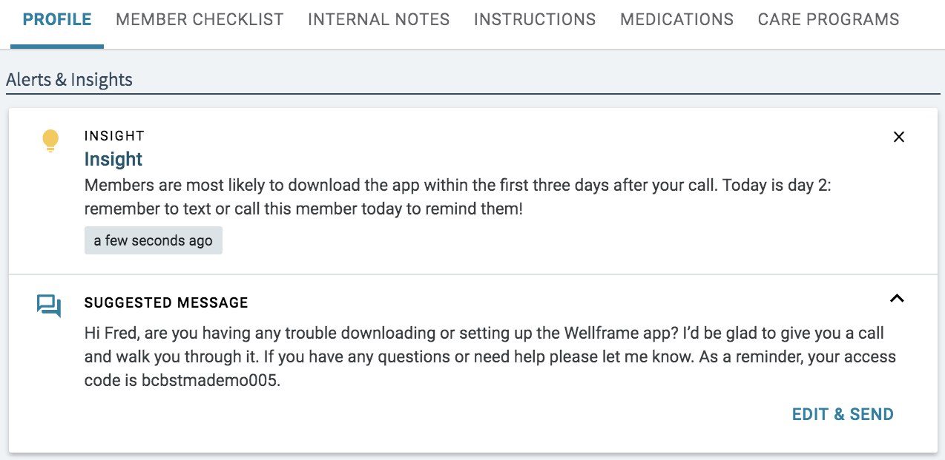
Insights to Assist with Member Onboarding
Notes:
These are insights for staff to reach out to member who have not onboarded after day 2, 3, and 7- My understanding is that WF send an SMS message on day 2 and the Engagement Specialists will send an SMS message on day 7. There may be some opportuninity inbetween day 2-7. Some customers will also make a call inbetween this time period as well to follow up.

Slide 20
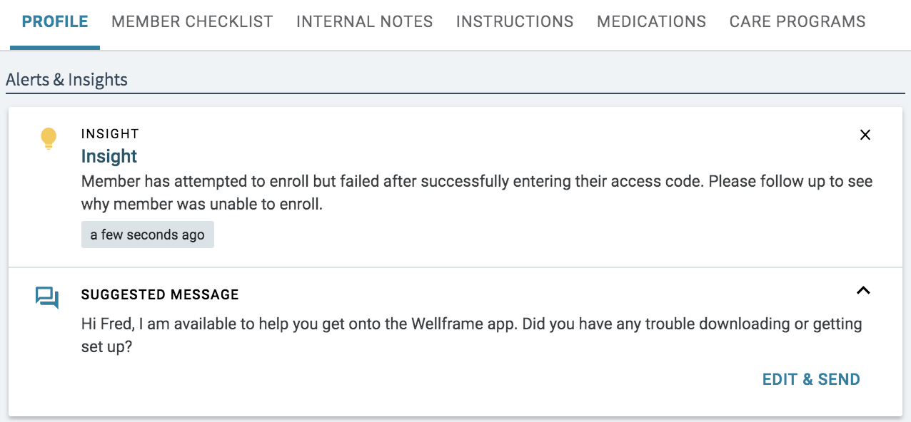
Attempted Onboarding Insight
Notes:
These are insights for staff to reach out to member who have attempted onboarding but did not complete

Slide 21
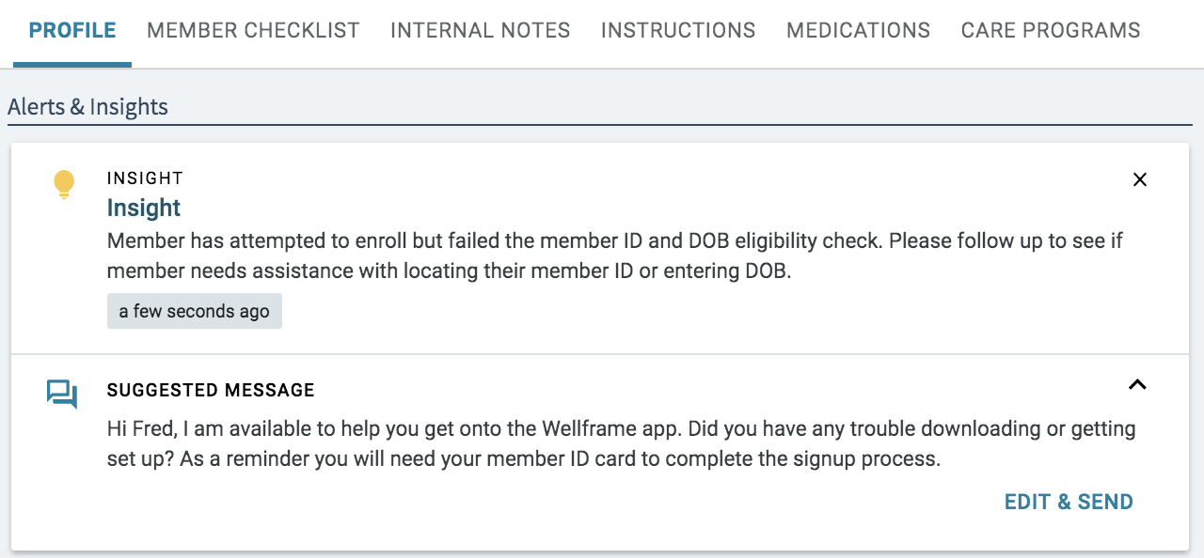
Failed Onboarding Insight
Notes:
This is an insight for staff to reach out to member who had failed onboarding

Slide 22
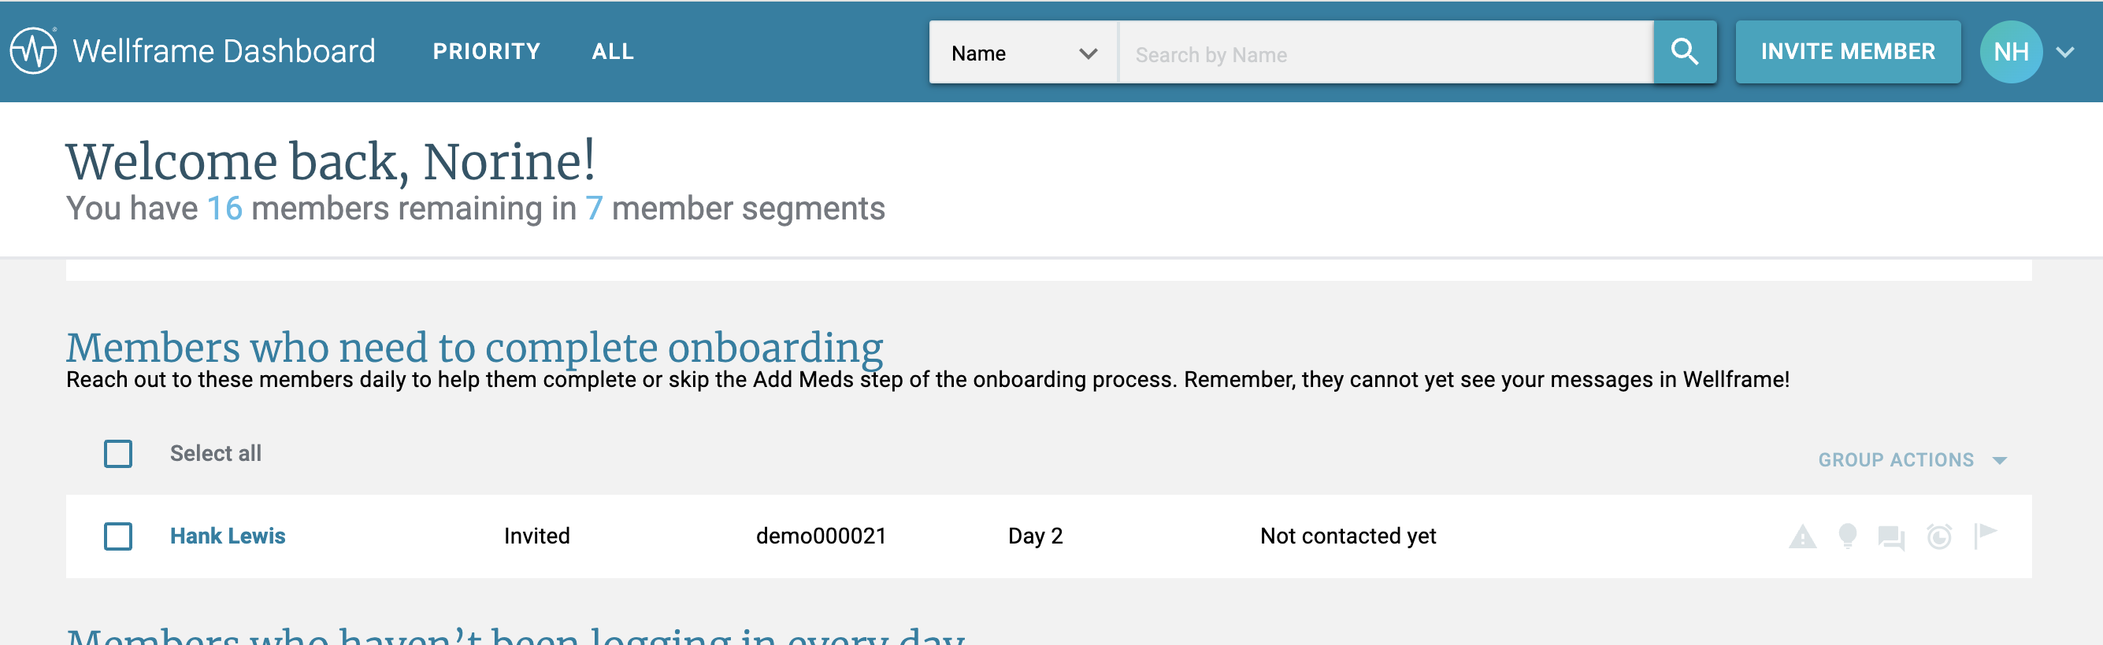
Dashboard View
Notes:
This is an insight for staff to reach out to member who had failed onboarding

Slide 23
Key Takeaways

Slide 24

Key Takeaways
Be sure to use the invite process and connect the member's unique need with features of the Wellframe platform that will benefit them (i.e chat, checklist, education, etc.).
  Active listening skills help identify what matters to members!
Enable an onboarding follow up process to ensure members have support until fully onboarded.
  Consider a process to include:
    Members who have not attempted to onboard yet.
    Members who have attempted or failed onboarding.

Slide 25
Questions?

