Slide 1


Optimize Inservice
2025
©2025 HealthEdge Software, Inc. | HealthEdge®, HealthRules®, HealthEdge Source™, GuidingCare®, EDGEcelerate™, Wellframe™, Wellsquared™.
HealthEdge and Wellframe logos are registered trademarks or trademarks of HealthEdge Software, Inc. All Rights Reserved.

Slide 2
Agenda
Review Care Manager Journey
  Optimize
  Best Practices
Optimizing Dashboard Features for Workflow Efficiencies
  Group Actions
  All View
Dashboard Overview Page
  Benefits to Staff
  A Closer Look
  Member States
Key Takeaways

Slide 3
Care Manager Journey:
Optimize

Slide 4



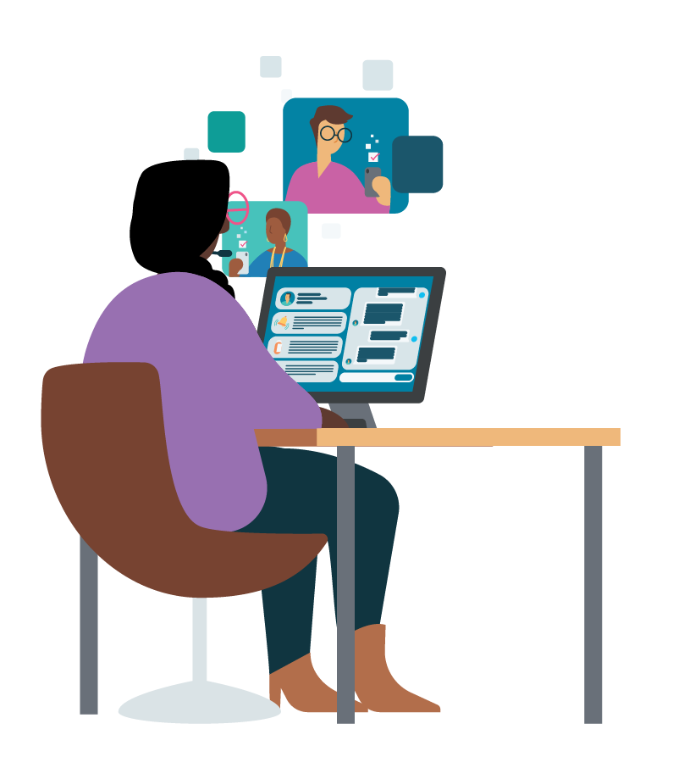


Care Manager Journey
INVITE
ACTIVATE
Welcome the member and curate their profile using app features and care programs to drive member engagement and retention.
OPTIMIZE
Provide members with a personalized value story for digital care management.
Track and manage your overall caseload activity and engagement using the app efficiency features.
ONBOARD
Facilitate timely member onboarding, including downloading the app and setting up their account.
ENGAGE
Continue to engage
your members regularly. Address their needs through messaging, reviewing insights and updating care plan as needed.
STAFF
Notes:
Invite: Provide members with a personalized value story for digital care management.
Onboard: Facilitate timely member onboarding, including downloading the app and setting up their account.
Activate: Welcome the member and personalize their profile using app features and care programs to drive member engagement and retention.
Engage: Continue to engage your members regularly. Address their needs through messaging, reviewing insights and updating care plan as needed.
Optimize: Track and manage your overall caseload activity and engagement using the app efficiency features.

Slide 5




Care Manager Journey
OPTIMIZE
OPTIMIZE
Track and manage your overall caseload activity and engagement using the app efficiency features.
CARE MANAGER
Leverage All View, Dashboard Overview Page, and Member States.
These views will enable you to check-in on with your entire caseload. The filters allow you to segment your caseload by different attributes to inform your actions.
Track engagement across your caseload.
The engagement filter allows you to view members who have been less active on the app. You can also track when these members were last contacted and how long they have been on the app to determine if they need additional outreach.
Group actions enable efficiency.
Once you have filtered your caseload, you can use different group actions to manage these members at scale. Send a group message to less engaged members, set a group follow-up to remind yourself to check in with them again in a week or consider adding group instructions to send plan-specific information or resources to a group of members.
Perform dashboard hygiene.
Set a regular cadence to check in on your caseload and determine if any members need additional outreach, should be moved to maintenance, or should be marked as done.
Notes:
Example of this engagement

Slide 6
Optimizing Dashboard Features

Slide 7
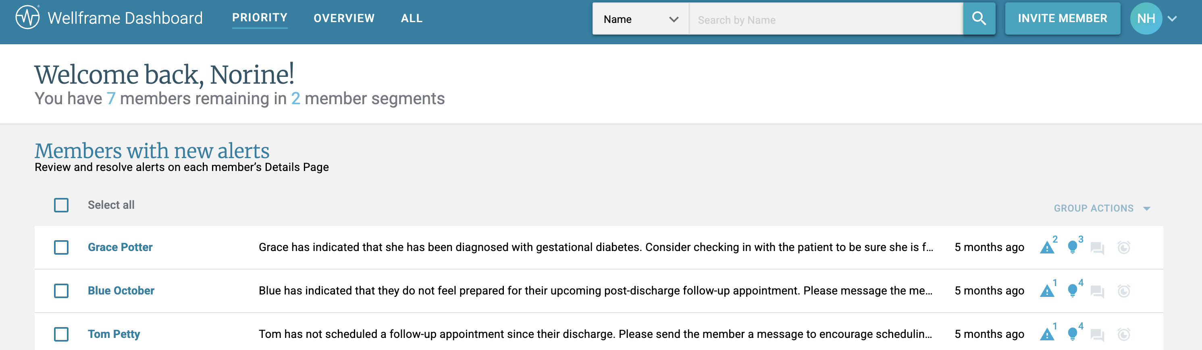
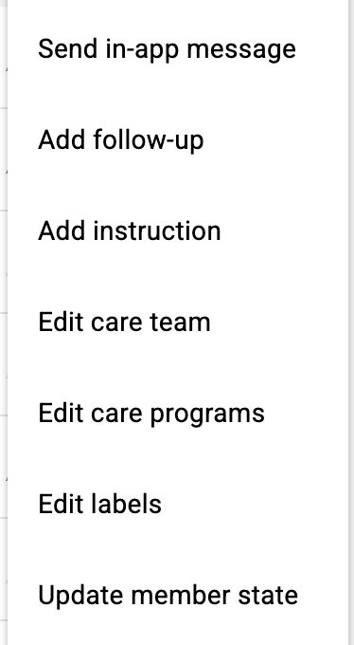
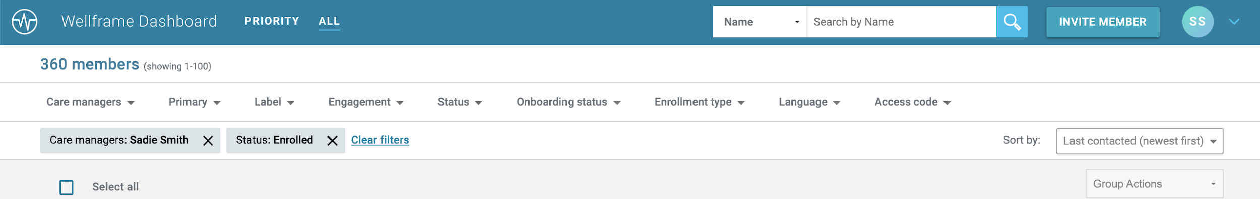

Group Actions
Priority View: select a few or all members within a segment and open the Group Actions menu.
You can use the Group Actions menu from the Priority View and All View to efficiently take actions across a group of members, including:
Send in-app message
Add follow up
Add instruction
Edit care team
Edit care programs
Edit labels
Update member states
All View: use the filters to drill down to your desired group of members, select a few or all members from the results, and open the Group actions menu
Examples of when to use group actions: General health reminders or information such as flu shot, plan resources and updates such as office is closed, reassigning members to another staff member, and more!
TIP
Use shortcuts such as .firstname to customize the message
Notes:
From the All View and the Priority View, you have the ability to do group actions which allows you to efficiently take action across a group of members.
Those actions include sending in app messages, adding a follow-up or instructions, and editing the care team and care programs.

Slide 8
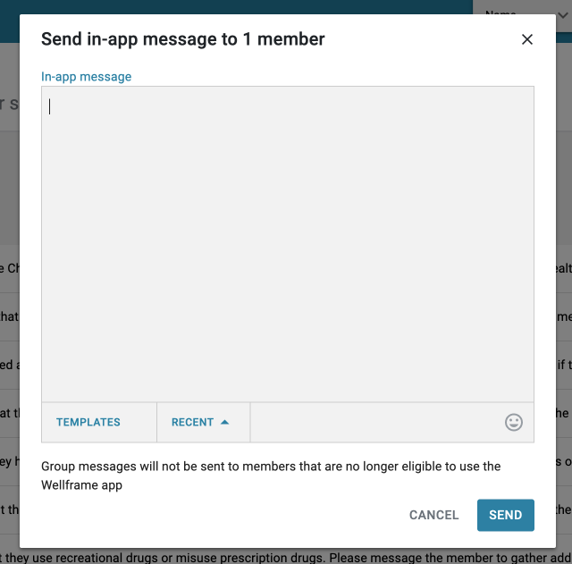
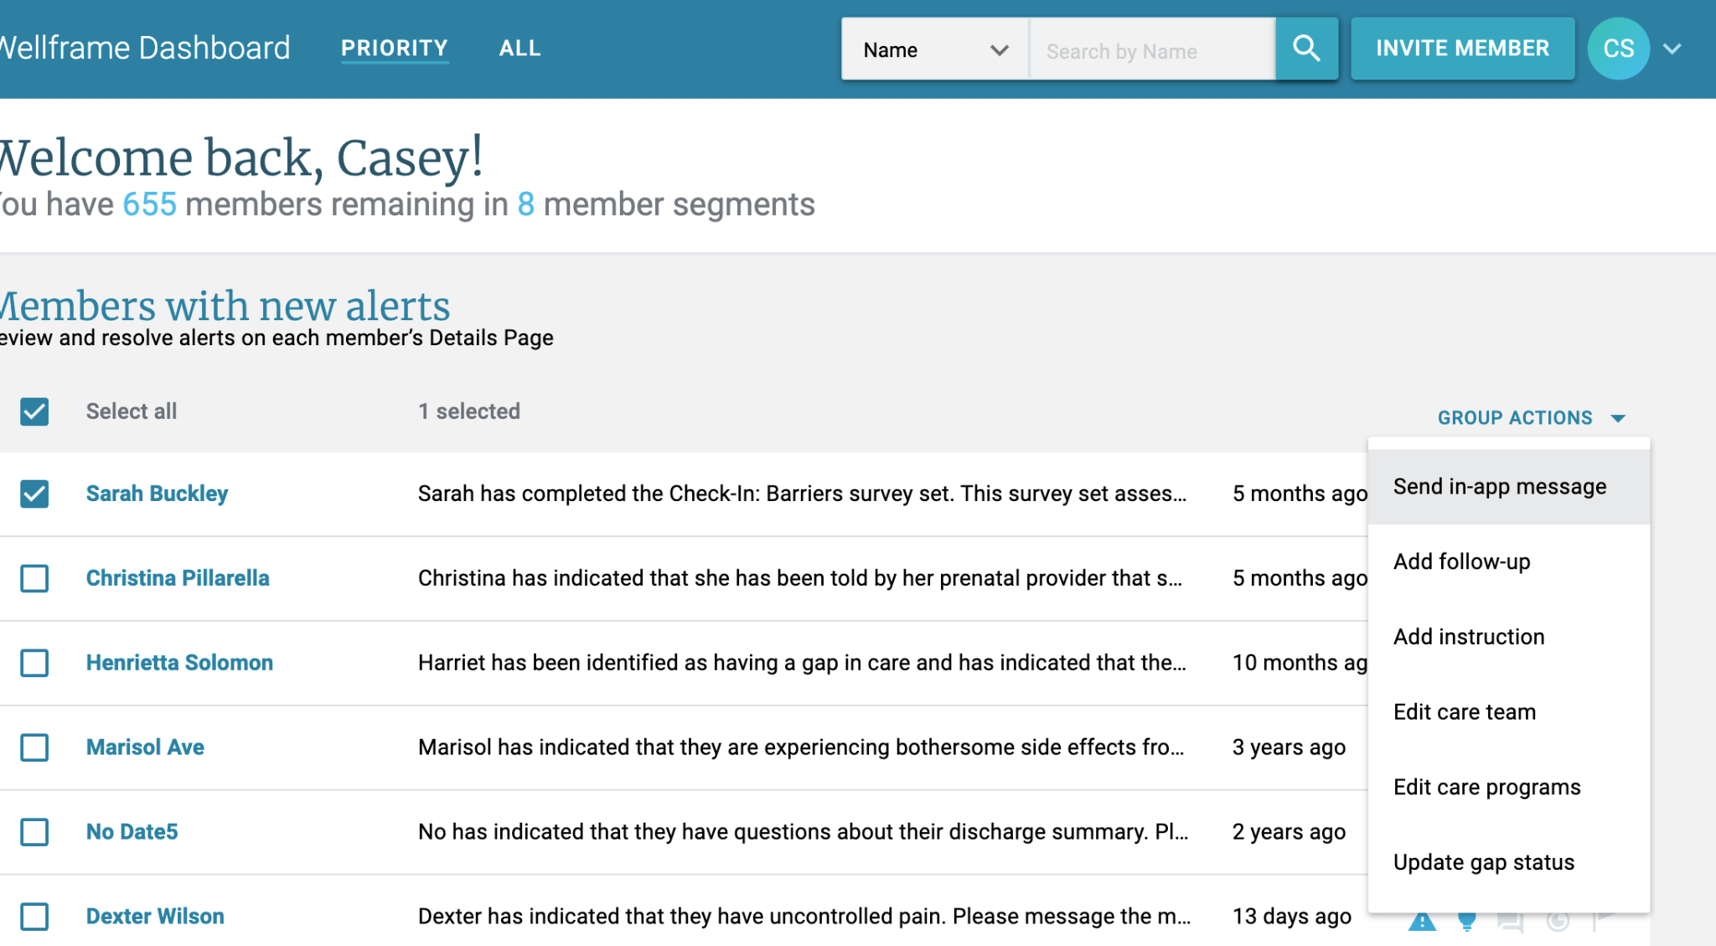
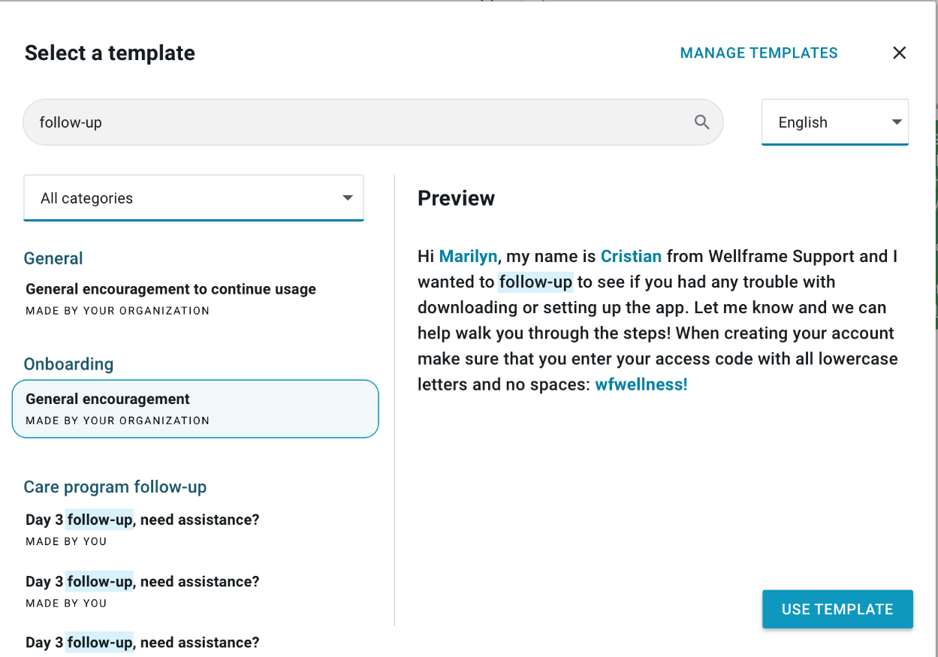
MY MESSAGES
Group messaging
Staff can use pre-written messages for group messaging.
1
Select members and initiate a group message from dashboard priority or all view
2
Note: Templates button no longer has a carrot icon
IMAGE: in-app group message modal
3
IMAGE: Staff dashboard priority view
Find and select a pre-written message
IMAGE: ‘Select a template’ screen in the My Messages feature

Slide 9
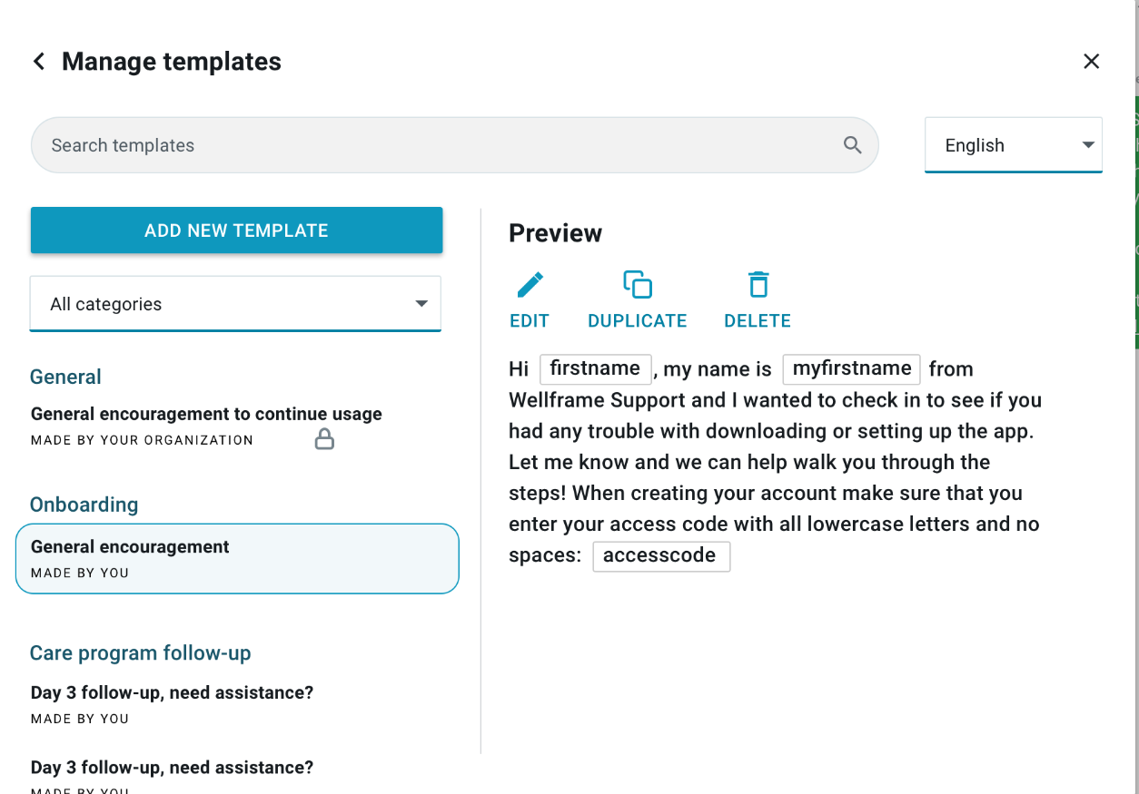
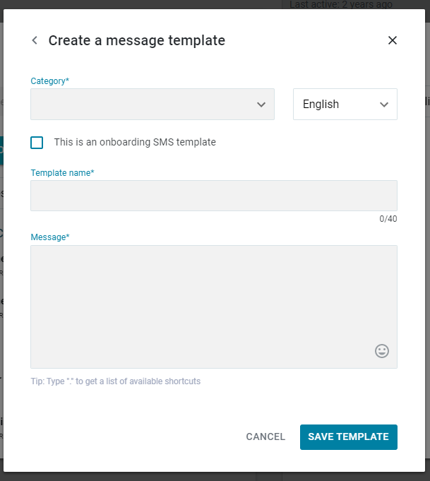
MY MESSAGES
Creating a personal pre-written message
Staff can prepare and organize frequently used messages for their own personal use.
IMAGE: Manage Templates screen in the My Messages feature
IMAGE: Create a Message screen in the My Messages feature

Slide 10
MY MESSAGES
Creating a personal pre-written message (cont’d)
Staff can prepare and organize frequently used messages for their own personal use.
Select an existing category or create a new one.
Indicate the language (translation not provided). Dropdown options are English, Spanish, Haitian-Creole.
Indicate whether or not this message can be used for onboarding SMS text messages.
Write the body of the message. Shortcuts can be included!
Name the individual message (must be a unique name; 40 character limit).
Save and exit, returning to Managing Templates screen. The newly created template will appear in the preview.
NOTE: Category, Template name, and Message fields are required.
IMAGE: “Create a message” screen in My Messages feature

Slide 11
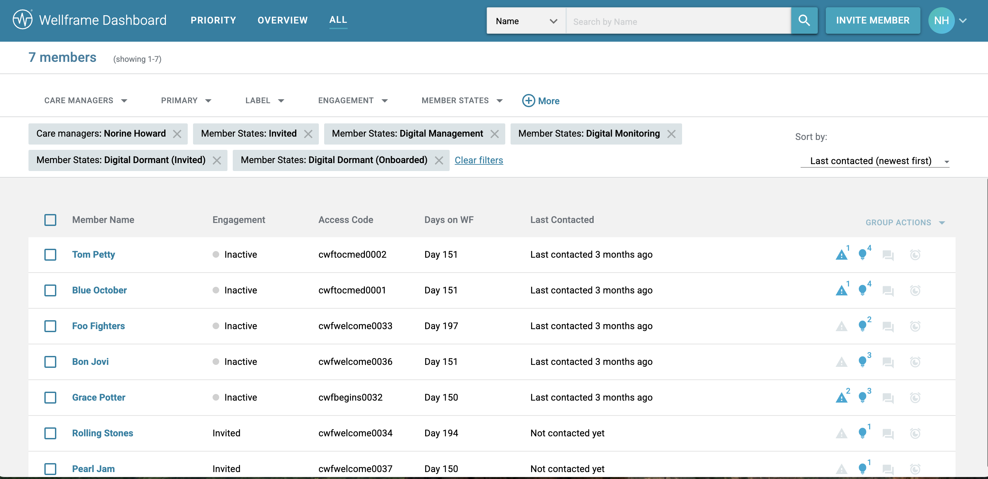

Slide 12
Dashboard Overview Page

Slide 13
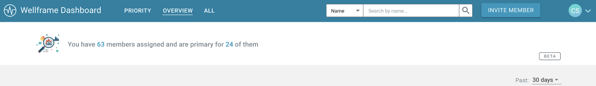
DASHBOARD OVERVIEW PAGE
A closer look
Staff will continue to land on the Priority View page at login. They can navigate to the new Overview through the header.
The Summary at the top of the Overview Page shows how many members are assigned for to the currently logged-in staff user, including how many members the staff user is the primary for on the care team.
This filter controls the time frame for the Overview Page data, with the default as 30 days.

Slide 14
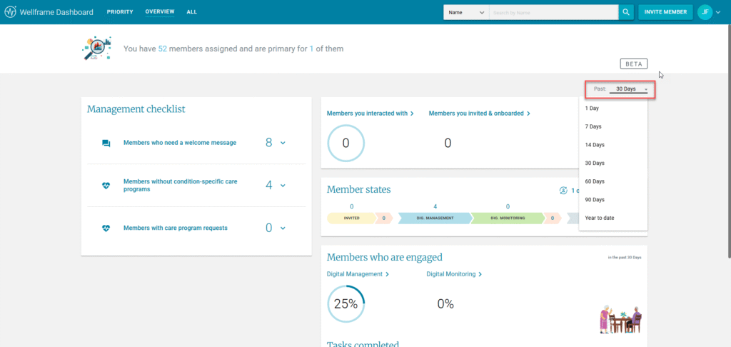
Dashboard Overview Page
Each of the options within each section contains functionality to view the list of members and the ability to drill into their respective profiles.
Within the Overview Page, there are four individual widgets you can use to help you manage your digital panel:
Management Checklist
Member Counts
Member States
Members Who Are Engaged
Reach.

Slide 15
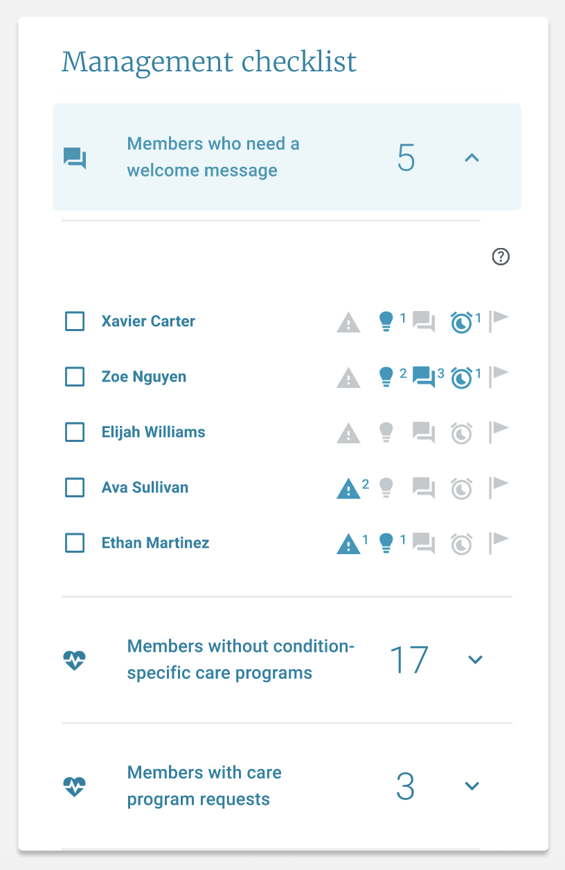
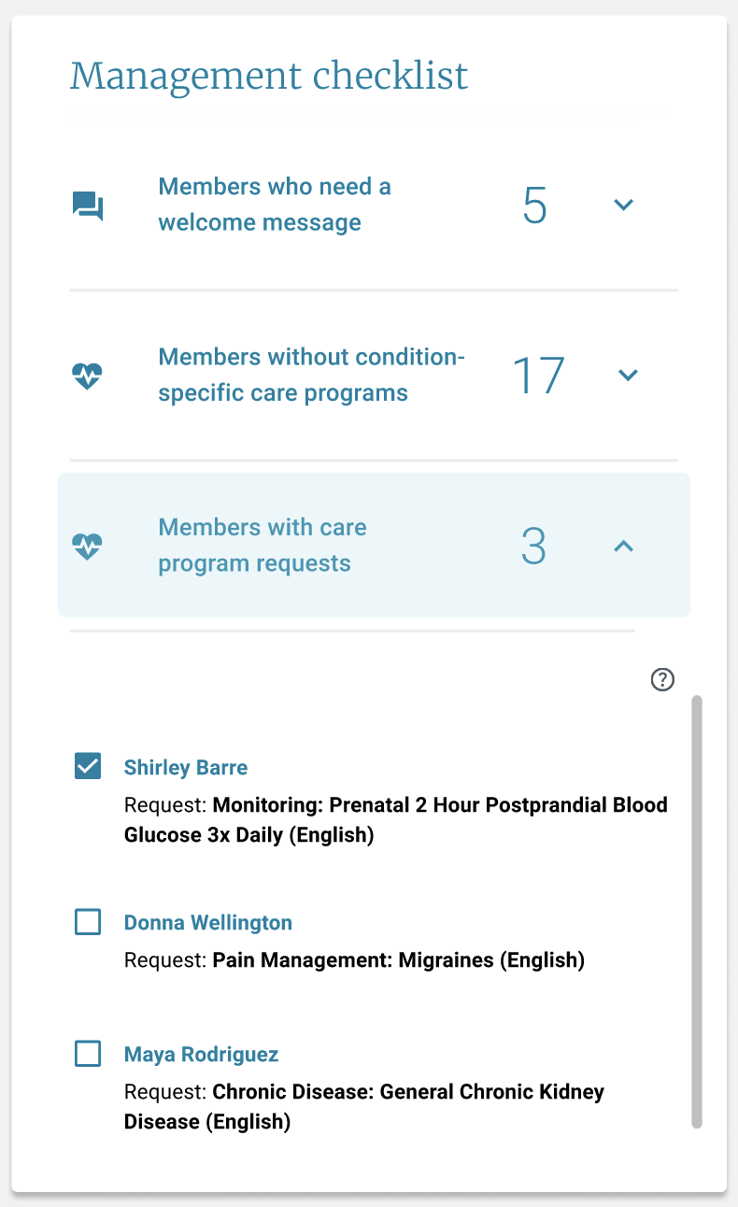
DASHBOARD OVERVIEW PAGE
A closer look
The Management Checklist shows open activation tasks across the staff user’s panel. Included in the Management Checklist for this release:
Members who need a welcome message
Any members that have not yet received their first in-app message
Members without condition-specific care program
Includes Digital Management members if they are currently only enrolled in the following care programs: wellness, biometrics, gaps in care, and digital advocate
Members with care program requests
Any members that have an outstanding request to enroll in a care program
Sections in Management Checklist can be expanded to view all member icons, similar to Priority View
Expanding the Care Program Requests will show the requested care program name
Notes:
A condition-specific care program is any care program not including wellness, biometrics, gaps in care, and digital advocate. (not included in the staff performance score)
: Behavioral Health, Care Transitions, Chronic Disease, Lifestyle Management, Maternal Health, Oncology, Pain Management

Slide 16
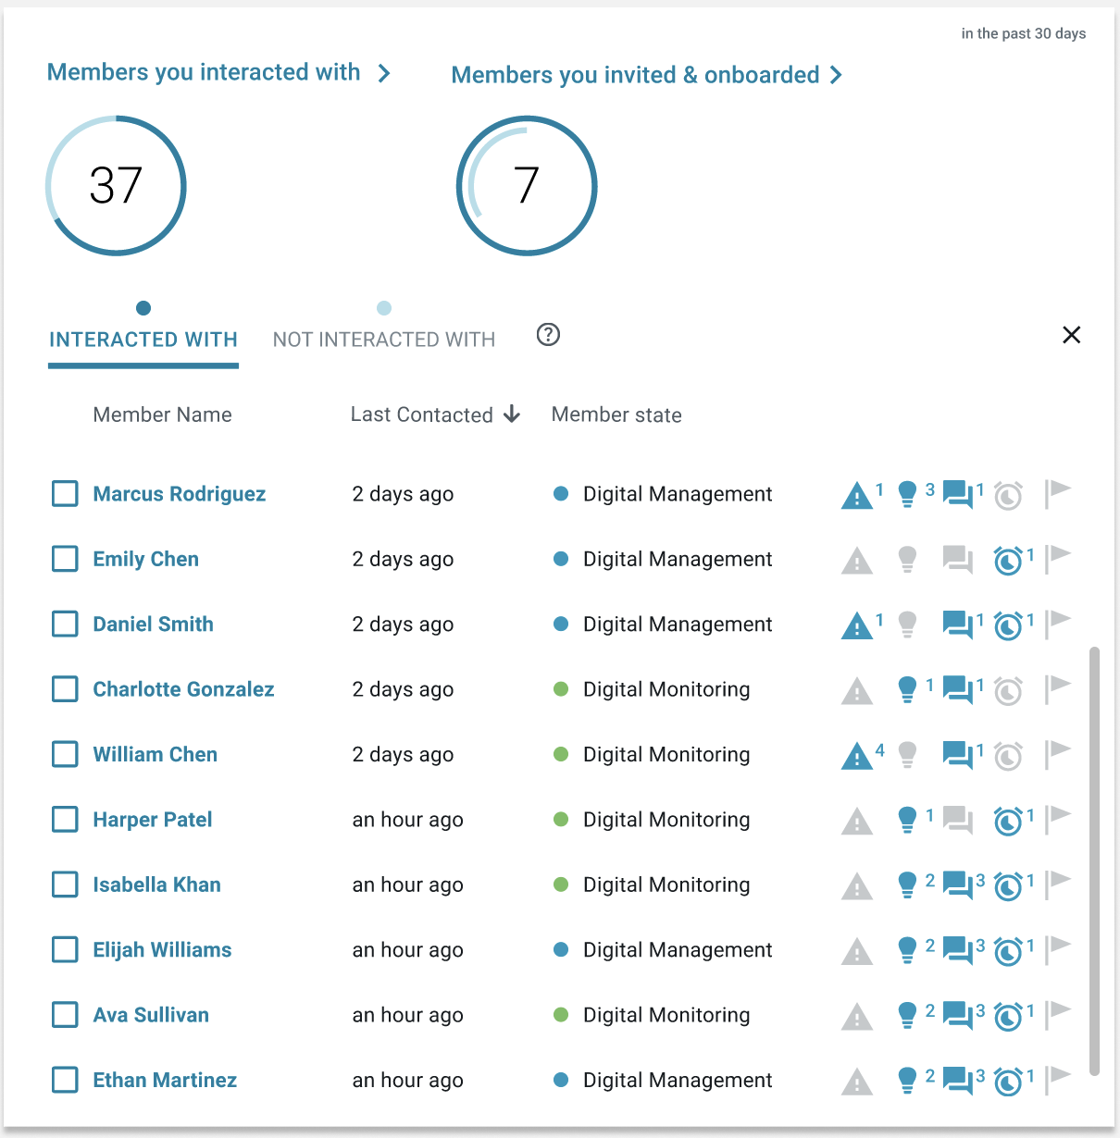
DASHBOARD OVERVIEW PAGE
A closer look
Staff can toggle between members they have interacted with versus not interacted with.
Members you interacted with and have not interacted with
includes onboarded members currently assigned to the staff user. Details included are Member Name, Last Contacted, Member State, and Member Icons.
Interactions within the time-frame selected include sending any message, scheduling a care program (staff-assigned or through a member request), setting up a medication or general reminder, and adding an instruction.
Interactions do not include dismissing alerts or insights, follow ups, viewing survey results, changing a member state, updating member details, and other similar activities.
Depending on workflows, staff can easily reach out to members with whom they have not interacted with in an extended period of time.

Slide 17
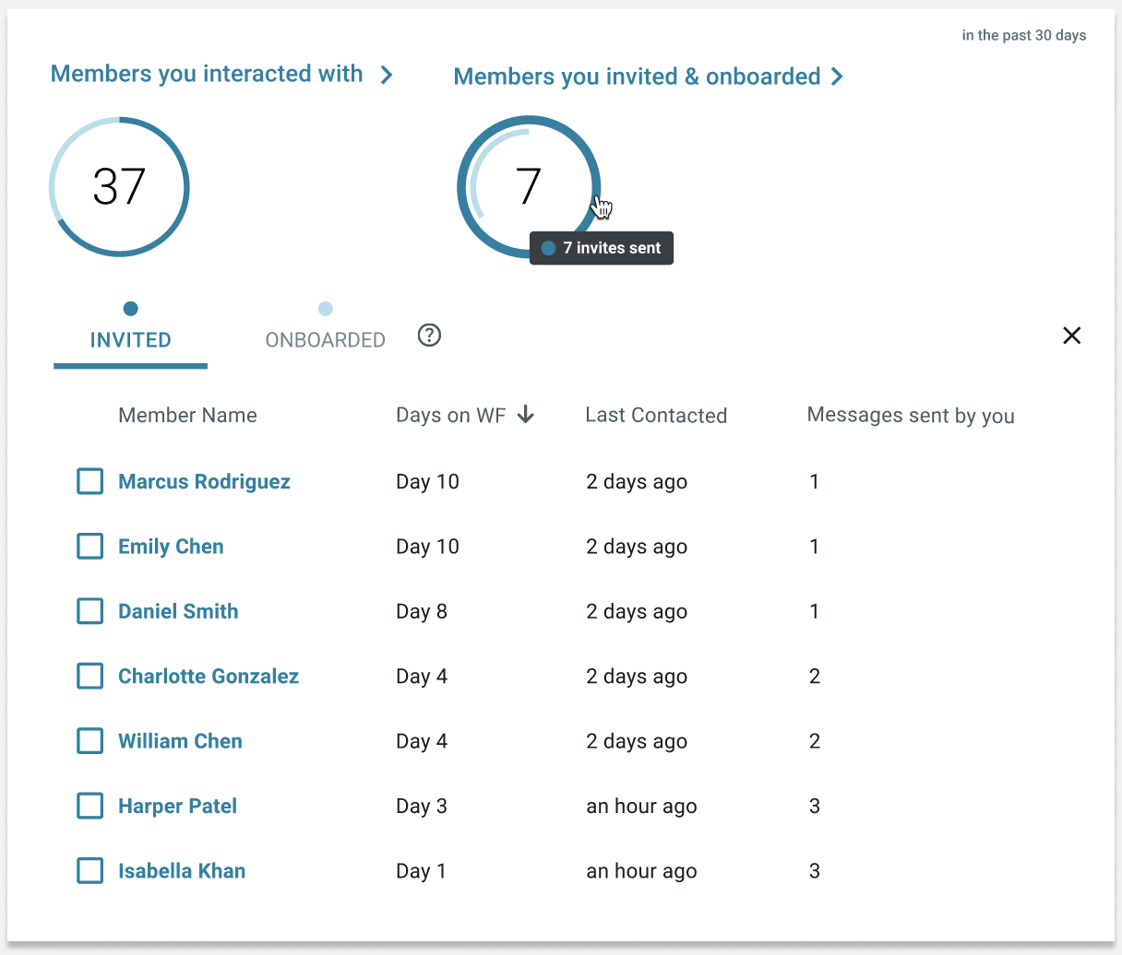
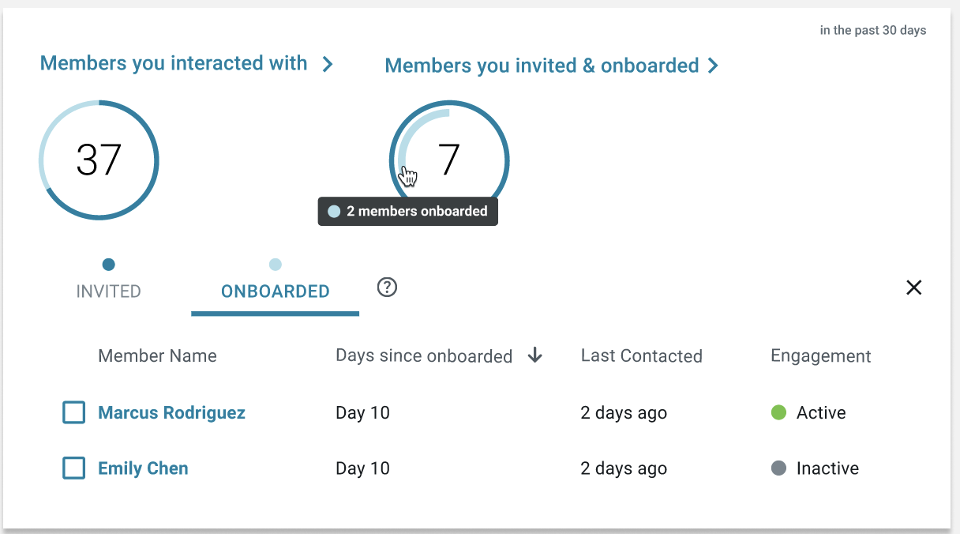
DASHBOARD OVERVIEW PAGE
A closer look
Staff can toggle between members that staff invited and members that onboarded.
Members you invited & onboarded
This includes any members the staff user invited, regardless of whether those members are still currently assigned to them.
Invited members' details included are Member Name, Days on Wellframe, Last Contacted, Messages sent by you
Onboarded members are members those whom you invited that subsequently onboarded. Details included are Member Name, Days since onboarded, Last contacted, Engagement
Staff can keep track of the members they invited and their onboarding rates.

Slide 18
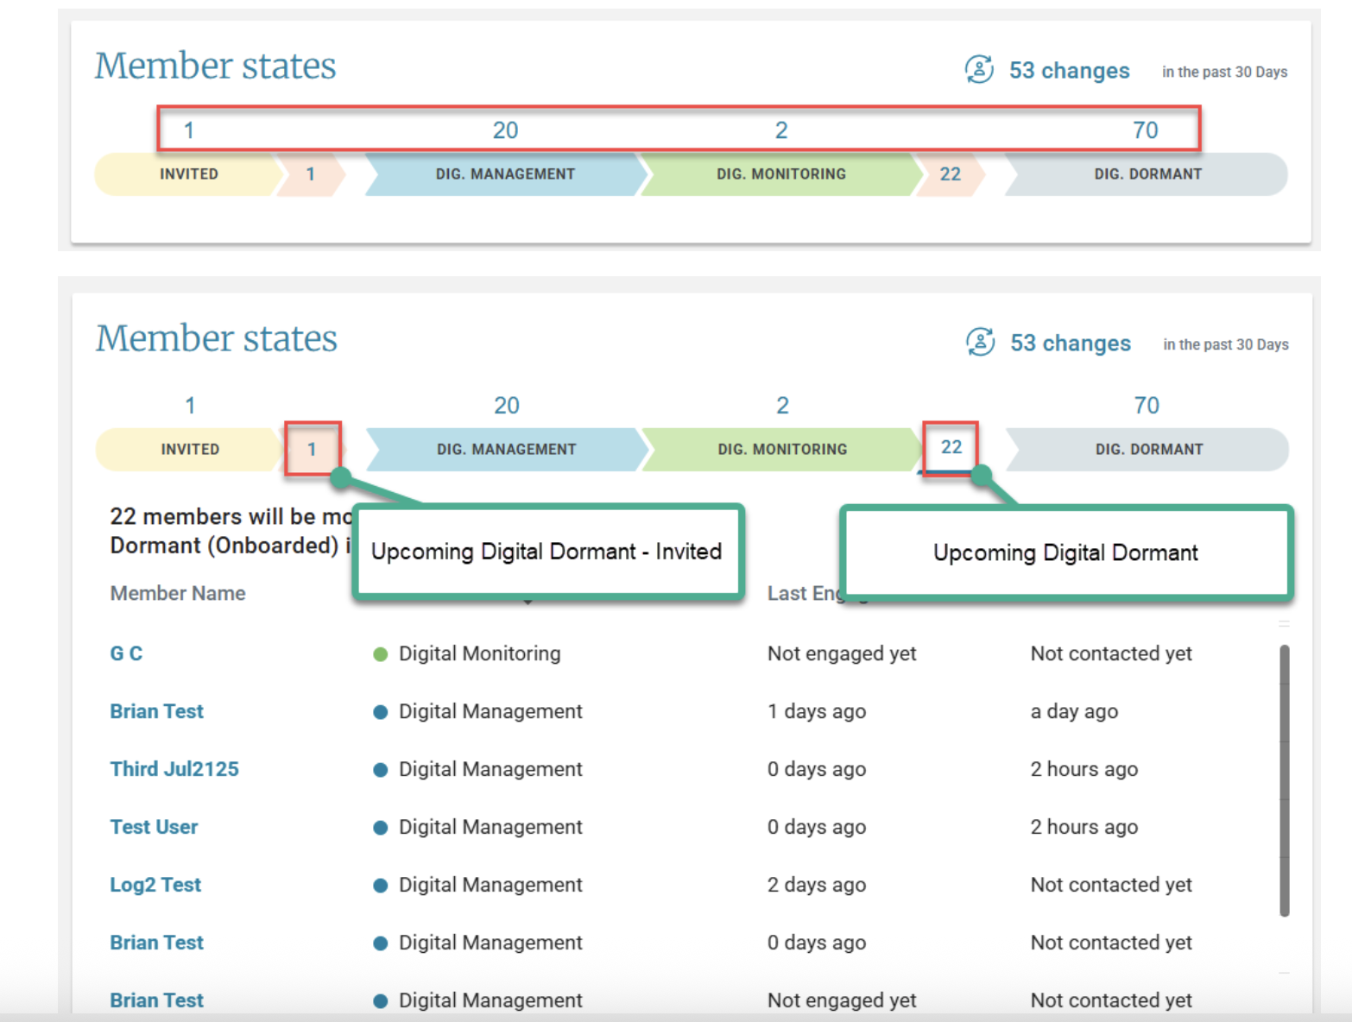
Dashboard Overview Page- Member States

Slide 19
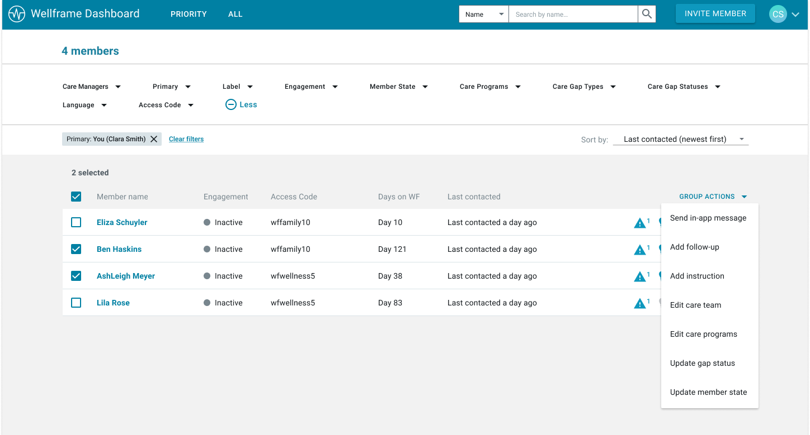
Member States are included in Group Actions on the Dashboard
Care teams can also easily move members into the appropriate member state through group actions on the All View and Priority View.
Filter and Update Member States with Group Actions
Staff will have the ability to view, filter, and update member states on the All View and Priority View to efficiently identify groups of members in the same state of their care journey that require a member state update.
NEW! Date Range All View Filters:
Last Contacted
Last Opened App
Days on WF
Last Engaged (coming soon)

Slide 20
Key Takeaways

Slide 21
Key Takeaways
The Dashboard Overview Page will identify those members needing welcome message, without condition specific care program and members with care program requests.
The Dashboard Overview including Member States will identify those members transitioning to digital dormant invited and digital dormant onboarded – consider using group messages to re-engage these members.
Using the Group Actions and/or My Messages features will help to save time while also improve member engagement.

Slide 22
Questions?

