Slide 1
Benefits of Digital Care Management Inservice
2025

Slide 2
Agenda
Care Manager Digital Journey Review
Activation & Engagement Framework Overview
Dashboard Efficiencies
  Dashboard Overview Page
  Group Actions - Messaging
Benefits of Digital CM after Activation
  Care Managers/Intake Coordinators
  Members
Activity- Member Examples

Slide 3



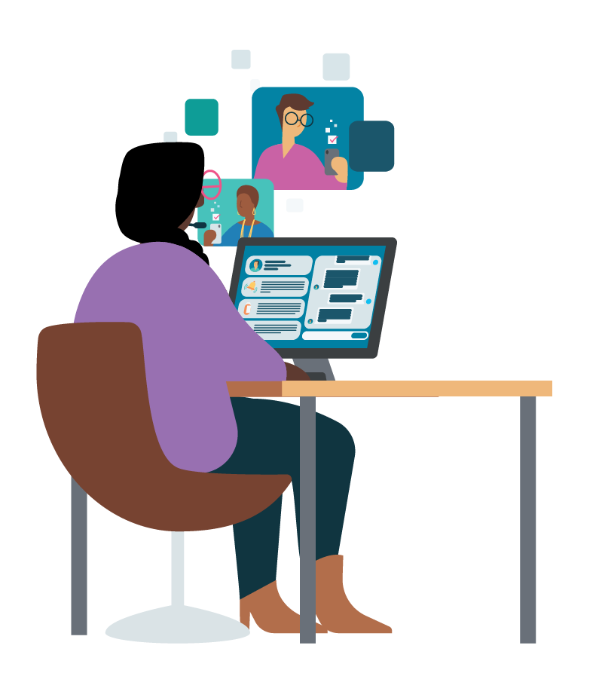


Staff Journey
INVITE
ACTIVATE
Welcome the member and curate their profile using app features and care programs to drive member engagement and retention.
Provide members with a personalized value story for digital care management.
OPTIMIZE
Track and manage your overall caseload activity and engagement using the app efficiency features.
ONBOARD
ENGAGE
Facilitate timely member onboarding, including downloading the app and setting up their account.
Continue to engage
your members regularly. Address their needs through messaging, reviewing insights and updating care plan as needed.
Notes:
Invite: Provide members with a personalized value story for digital care management.
Onboard: Facilitate timely member onboarding, including downloading the app and setting up their account.
Activate: Welcome the member and personalize their profile using app features and care programs to drive member engagement and retention.
Engage: Continue to engage your members regularly. Address their needs through messaging, reviewing insights and updating care plan as needed.
Optimize: Track and manage your overall caseload activity and engagement using the app efficiency features.

Slide 4
Activate Best Practices

Slide 5




Staff Journey
ACTIVATE
ACTIVATE
Welcome the member and curate their profile using app features and care programs to drive member engagement and retention.
STAFF
Make a first impression.
Your welcome message is the first chance to set the tone with your member and start building your relationship. Use this message to align on goals and set expectations around how using different features in the app will help guide how you support them.
Set up your member's profile.
Consider the member's goals and priorities to guide how you personalize the app for your member. Use of biometric programs, medication reminders, supplemental care programs, and patient instructions can lead to increased member engagement and retention.
Timing matters.
Set up your member's profile as soon as they onboard to ensure that the app is as personalized and relevant as possible. Data shows that they greatest drop off of members is in the first few days on the app. This is your window to make an impact.
Identify member priorities and goals.
Leverage the intake assessment (digital or telephonic) to develop your plan of care. Document your member's goals in the general notes section so you can always refer back to them.
Notes:
Example of this engagement

Slide 6
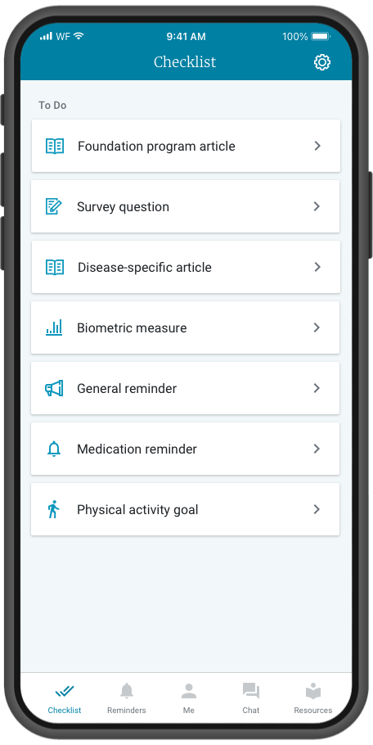
Personalization of the health checklist is driven by staff actions
Care Programs
Added by staff based on the members needs; each program has a curriculum of daily articles and surveys.
Biometric Monitoring Programs
Added by staff, these survey programs ask members to input key biometric data on a recurring basis.
Medication or General Reminders
Daily or 1-time reminders that can be set up
by the member or staff.
Notes:
Checklist will have items for Care Programs, supplemental education resources, reminders, and more – creating a personalized educational experience via the Wellframe app

Slide 7
Activation & Engagement Framework

Slide 8
Why it matters
Personalized, relevant content significantly impacts app abandonment
Members who are enrolled into programs more tailored to their needs (maternity, chronic disease, lifestyle management, behavioral health) by Day 14 have much lower abandonment rates and a much higher likelihood of being highly engaged (5+ days) within the first 30 days than members in more generic programs like Wellness or Welcome.*
*Data from across all members onboarded in 2023. Many factors impact Member activation, engagement and retention, and individual customer data will vary, nevertheless personalized value maximizes a positive first impression and increase the likelihood of stickiness.

Slide 9
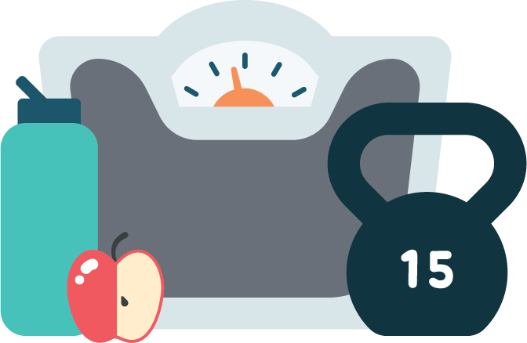
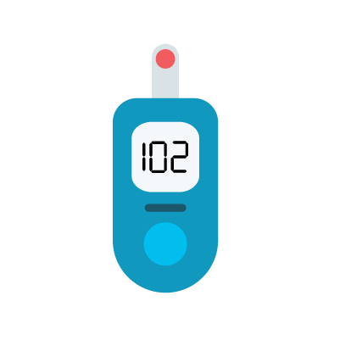
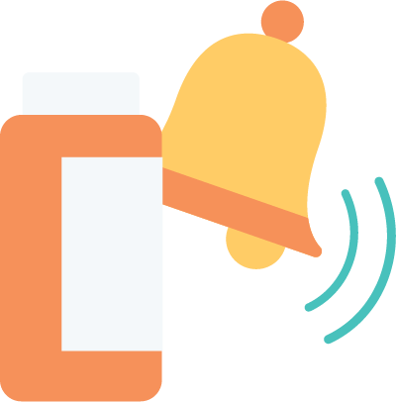
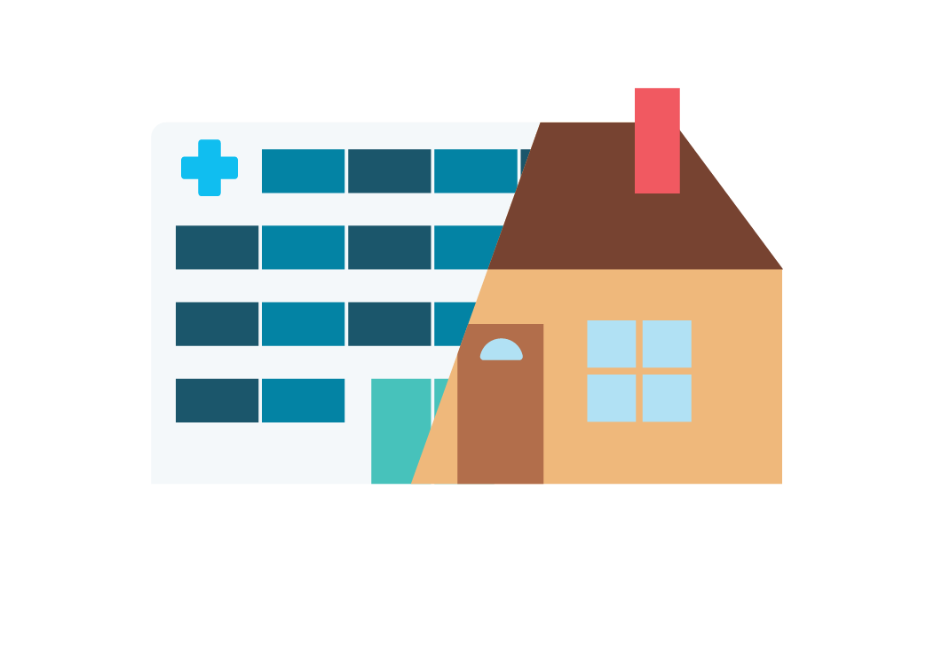
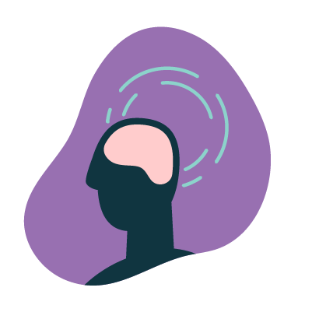
Member Activation & Engagement Framework
Care Programs
Biometric Monitoring Programs
Medication & General Reminders
Engagement & Retention
Instructions
Messaging

Slide 10
Wellframe Digital Care Management programs address a range of conditions across the care continuum
LIFESTYLE MANAGEMENT
& COMORBIDITIES
Managing Stress
Weight loss
Migraines
Physical Activity
Smoking Cessation
Fall Prevention
Social Isolation
Caregiver Support
Substance Use Disorder*
Prediabetes Support*
Adult Biometrics*
GAPS IN CARE BUNDLE
  Breast Cancer Screening
  Colorectal Cancer Screening
  Cervical Cancer Screening
  Chlamydia Screening
  Diabetic: Blood Sugar
  Diabetic Kidney Disease
  Diabetic: Eye Exam
  WOMENS HEALTH
  Perimenopause
CHRONIC CARE & COMPLEX CARE
Type 2 Diabetes
Prediabetes Support*
Coronary Artery Disease
Heart Failure
Hyperlipidemia
Atrial Fibrillation
Asthma
Hypertension
Chronic Obstructive Pulmonary Disease
Chronic Kidney Disease
Behavioral Health & Wellness
Depression*
Anxiety*
BEHAVIORAL HEALTH
Bipolar Disorder
Post-Traumatic Stress Disorder
Schizophrenia
Substance Use Disorder*
Depression*
Anxiety*
CARE TRANSITIONS
Medical Care Transitions
Surgical Care Transitions
Behavioral Health Care Transitions
Coronary Artery Disease
Percutaneous Coronary Intervention
Myocardial Infarction
Cardiac Rehab
Heart Failure
Chronic Obstructive Pulmonary Disease
Total Knee Arthroplasty*
HEALTHSPAN BUNDLE
Your Health Across Your Life: How to Feel Better Longer
Preventive Care: Why Regular Appointments Add Up
Making Habits Stick: The Foundation of Good Health
Helping Yourself and Others in a Medical Emergency
PEDIATRIC CAREGIVER
Medical Care Transitions
Surgical Care Transitions
Behavioral Health & Wellness
Newborn Wellness & Prevention
Pediatric Biometrics
Asthma
Neonatal Intensive Care Unit Support
Early and Periodic Screening, Diagnostic & Treatment (EPSDT) Medicaid Only
Care Transitions: Type 1 Diabetes
Care Transitions: Pneumonia
MUSKULOSKELETAL
Chronic Back Pain
Total Knee Arthroplasty*
MATERNAL HEALTH
Maternal Health: Prenatal & Postpartum
Multiple Pregnancy
Gestational Diabetes
Gestational Hypertension
Substance Use Disorder & Maternal Health
Prenatal Biometrics
ONCOLOGY
Cancer Support
Breast Cancer
Lung Cancer
Prostate Cancer
* These programs appear in multiple bundles
Notes:
Newest bundle Healthspan includes: 4 programs ranging from 13-21 days in length
Your Health Across Your Life: How to Feel Better Longer
Preventive Care: Why Regular Appointments Add Up
Making Habits Stick: The Foundation of Good Health
Helping Yourself and Others in a Medical Emergency

Slide 11
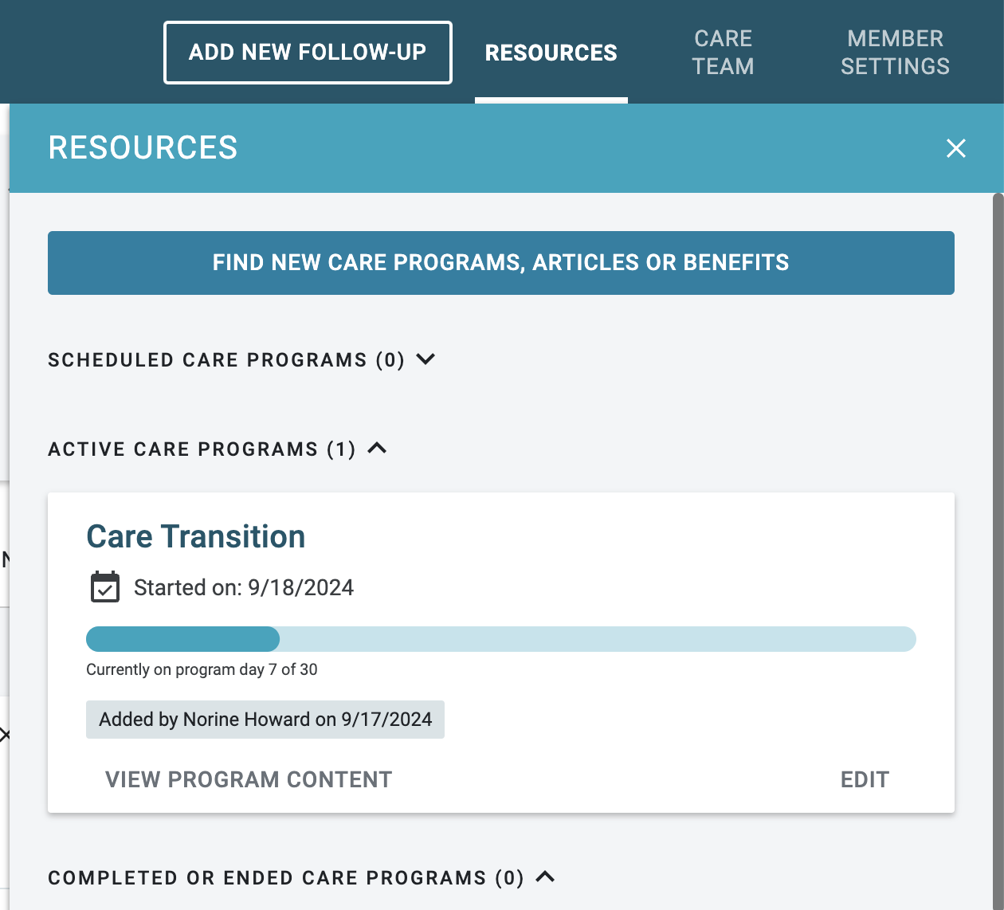
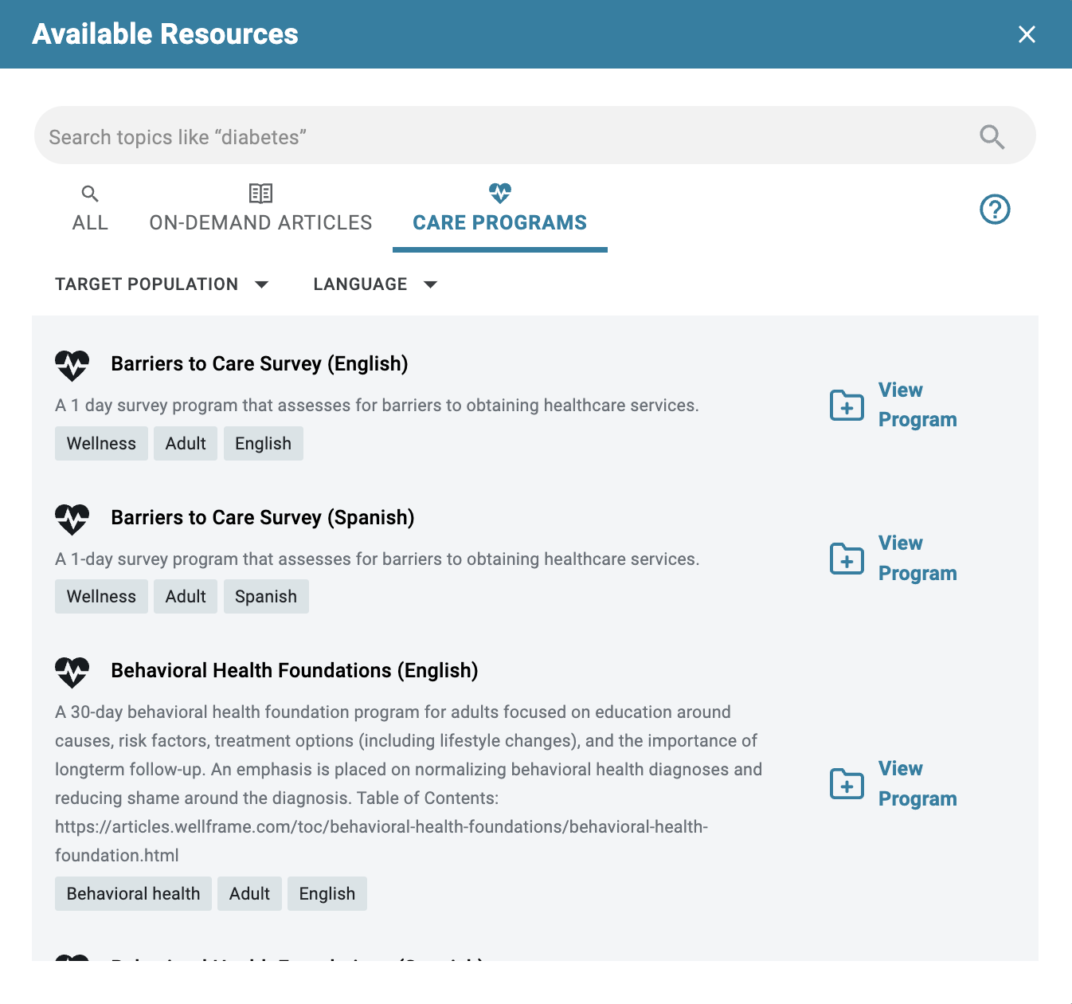
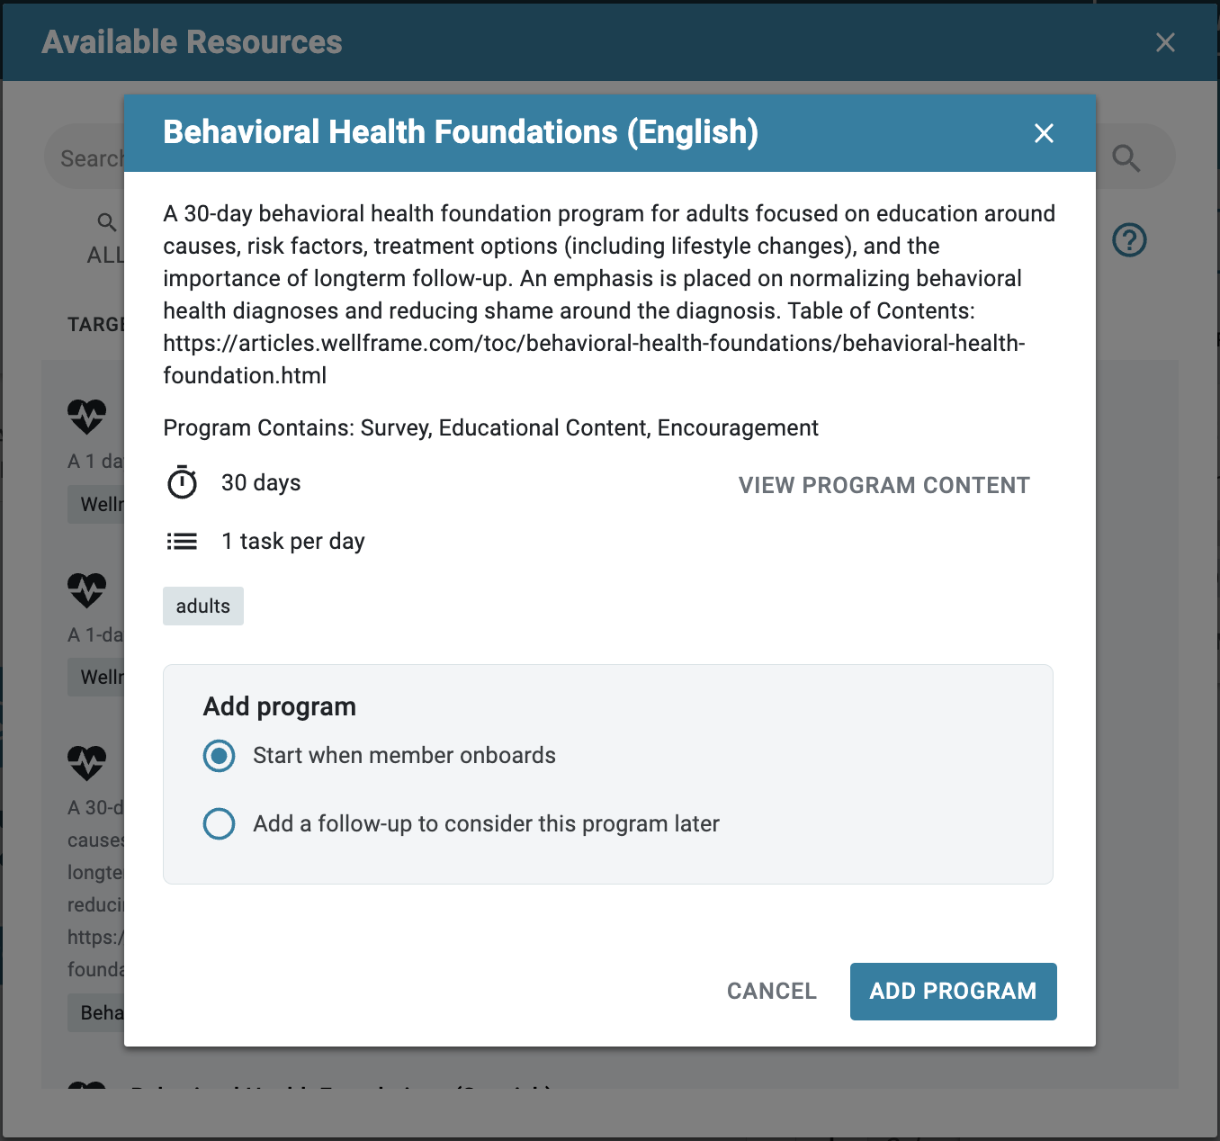
How to assign a care program prior to member onboarding
CARE PROGRAMS
See subsequent slides for details at each step.
Step 1
Navigate to Resources modal; select “Find new care programs…” *
Step 2
Search, filter, or scroll to find the care program for member enrollment
Step 3
Select “Start when member onboards;” then “Add Program”
* “Find new care programs…” button name reflects the Resources enabled for each customer’s dashboard

Slide 12
Adding biometric monitoring programs to promote self-management and accountability
BIOMETRICS
Care Transitions
Behavioral Health
Chronic Care
Given the acuity of members in care transitions, biometrics are especially pertinent and impactful.
Most appropriate Biometrics for Care Transitions members include:
Daily Weight (targets members at risk for fluid overload)
Daily Pain
Blood Pressure
Blood Sugar
Daily Blood Oxygen Saturation
Weekly Physical Activity Report
Biometric Programs can be used to track side effects from behavioral health medications or to co-manage a chronic disease in addition to their Behavioral Health program:
Weekly Weight, Lifestyle
Blood Pressure
Blood Sugar
Weekly Physical Activity Report
Weekly Pain
Biometrics help supplement a Chronic Disease member's checklist and track progress against a member's plan of care:
Daily Weight (targets members at risk for fluid overload)
Weekly Weight, Lifestyle
Blood Pressure
Blood Sugar
Weekly Physical Activity Report
Daily Peak Flow
Depending on a member's goals, it may be appropriate to enroll a Chronic Disease member in a Lifestyle Management Program and a Biometric Program or just a Biometric Program, in lieu of a Chronic Disease Program.
Notes:
https://docs.google.com/spreadsheets/d/11BiTPuMW-Gl_TEjFNCqpxHPA8-nLeQ5Q/edit#gid=952704090

Slide 13
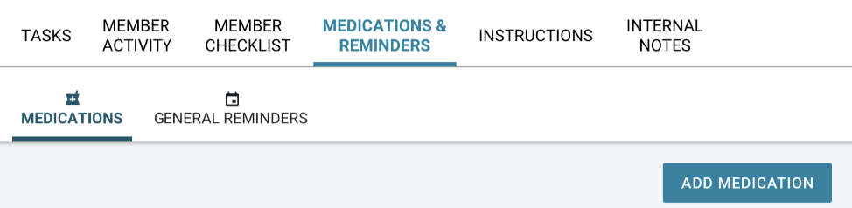
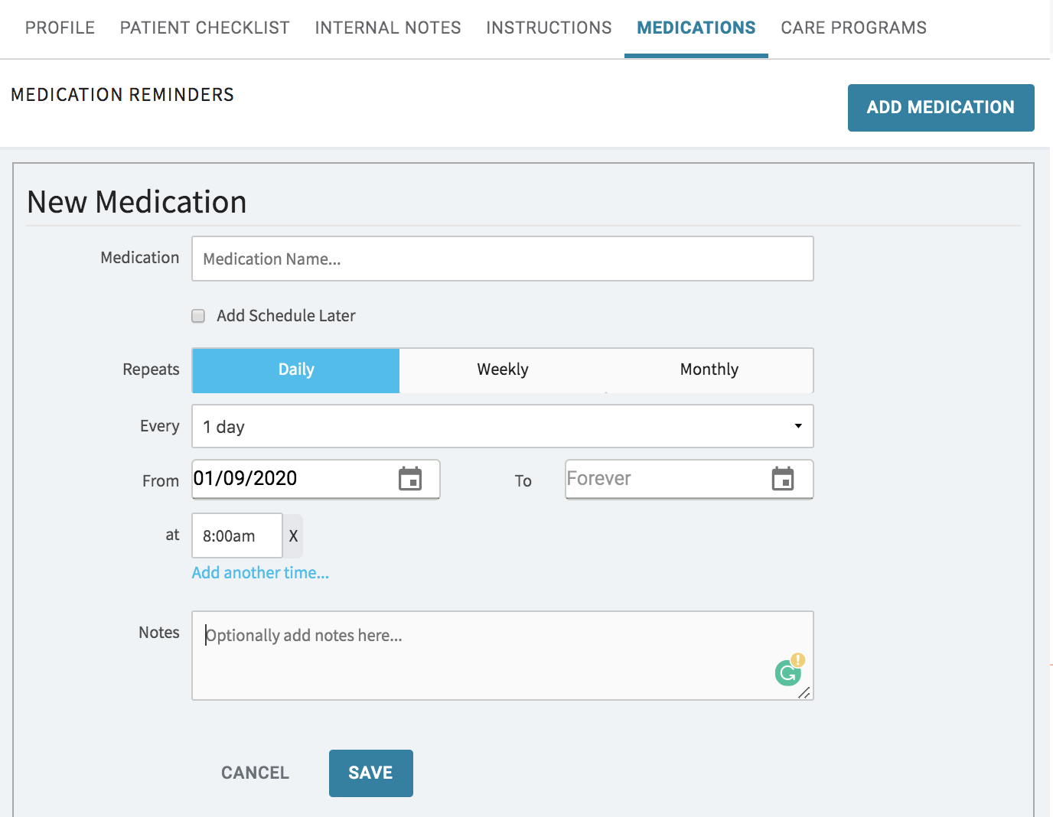
Adding medication reminders and general reminders to improve adherence and track health events
ACTIVATE
REMINDERS
REMINDERS
1
Use medication reminders to reconcile members’ meds or align on current medication list
  Review dosage, time, form/route
Track members’ adherence to identify and address barriers
Promote goals by setting general reminders to: walk, exercise, journal, etc
Set reminders for important activities such as:
  Picking up medications
  Scheduling or attending appointments
  Scheduled phone calls with care team
2
3
4
Notes:
Norine
Best practice call outs - Norine and best practice work group - with Sherry

Slide 14
Sample On-Demand Articles: Expanded, self-service educational content for all members, regardless of risk level
ANNUAL CHECKLIST
Yearly Health List: 20s Male
Yearly Health List: 20s Female
Yearly Health List: 30s Male
Yearly Health List: 30s Female
Yearly Health List: 40s Male
Yearly Health List: 40s Female
Yearly Health List: 50s Male
Yearly Health List: 50s Female
Yearly Health List: 65 & Up Male
Yearly Health List: 65 & Up Female
GAPS IN CARE
What Are the Options for Colorectal Cancer Screenings?
How Do I Get Ready for a Colonoscopy?
What if a Polyp is Found?
When Depression Isn’t Treated
Depression Medication Adherence
Why Do I Need a Mammogram?
High Blood Pressure And Diabetes
Self Breast Exam & Clinical Breast Exam
Why Do I Need A Pap Test?
Stories From People Who Had Cervical Cancer Screenings
Why Do I Need An A1C Test?
Why Do I Need A Diabetic Eye Exam?
Tips For Staying On Medication
Preparing For A Preventative Care Visit
Why Seeing Your Nephrologist Matters
Why A Lipid Test Matters With High Blood Pressure
Why Do I Need Spirometry Testing For COPD?
Staying Connected With Your Diabetic Care Team
COVID-19
COVID-19 and Adults
COVID-19 and Kids
COVID-19 and Pregnancy
LIFESTYLE & WELLNESS
Getting Vaccinated: The Flu
Screening for Prostate Cancer
The Transition to Menopause
Skin Cancer Prevention
Preventative Dental Care
Making Time For Exercise
The Importance of Sleep
Managing Food Allergies
Eating Well for Heart Health
Deciding to Quit Smoking
The Importance of Cholesterol Screenings
WOMEN’S HEALTH
Choosing Between Birth Control Options
Sexually Transmitted Infections in Women
Before Pregnancy: Invest in Your Health Now
The Stages of Menopause
What Does Post-Menopause Feel Like?
Considering Hormone Therapy for Menopause?
Pelvic Floor Health and Therapy for Women
How to Feel Your Best Through Menopause
HEALTH PLAN NAVIGATION
What Should I Know About Using The Emergency Room?
How Do I Prepare For A CT Scan?
How Do I Prepare For My Health In Retirement?
What Should I Know About High Performance Health Networks?
What Should I Know About Social Determinants Of Health?
What Should I Know About Prior Authorization?
What Should I Know If I Need A Specialty Medication?
CAREGIVER SUPPORT
Self-Care
Medications and Aging
Advocating for Your Loved One
Asking For Help
Decreasing Caregiver Stress
Taking a break
Using a sitter
Learn through play
The Tough Stuff
The Digital Age
MUSCULOSKELETAL
How Can I Prevent Back Pain?
What Should I Know About Arthritis?
How Can I Prevent Injury At Work?
What Are The Benefits Of Physical Therapy?
What Are The Benefits of Occupational Therapy?
ELDERLY AND AGING
Early Recognition of Alzheimer’s
How to Lower Alzheimer’s Risk
What to Do if You Think a Loved One Has Alzheimer’s
Treating Those With Alzheimer’s With Dignity
BEHAVIORAL HEALTH & WELLNESS
When to Get Therapy for Grief
How to Feel Better While Grieving
How to Help Someone Who’s Grieving
Notes:
Newest bundle Healthspan includes: 4 programs ranging from 13-21 days in length
Your Health Across Your Life: How to Feel Better Longer
Preventive Care: Why Regular Appointments Add Up
Making Habits Stick: The Foundation of Good Health
Helping Yourself and Others in a Medical Emergency

Slide 15
Use instructions to provide members with specific information and/or guidance
INSTRUCTIONS
Care Transitions
Chronic Care
Behavioral Health
Sample Instruction use cases for Care Transitions members:
Detailed discharge instructions and education
New medication education
Wound care instructions
Important telephone numbers and contacts information for care team, including home health services
Relevant benefits information or health plan contacts
Sample Instruction use cases for Chronic Disease members:
Member-facing plan of care
Goal-tracking
Medication education
Important telephone numbers and contacts information for care team
Relevant benefits information or health plan contacts
Sample Instruction use cases for Behavioral Health members:
Member-facing plan of care
Goal-tracking
Medication education
Important telephone numbers and contacts information for care teams
Relevant benefits information or health plan contacts
Notes:
https://docs.google.com/spreadsheets/d/11BiTPuMW-Gl_TEjFNCqpxHPA8-nLeQ5Q/edit#gid=952704090

Slide 16
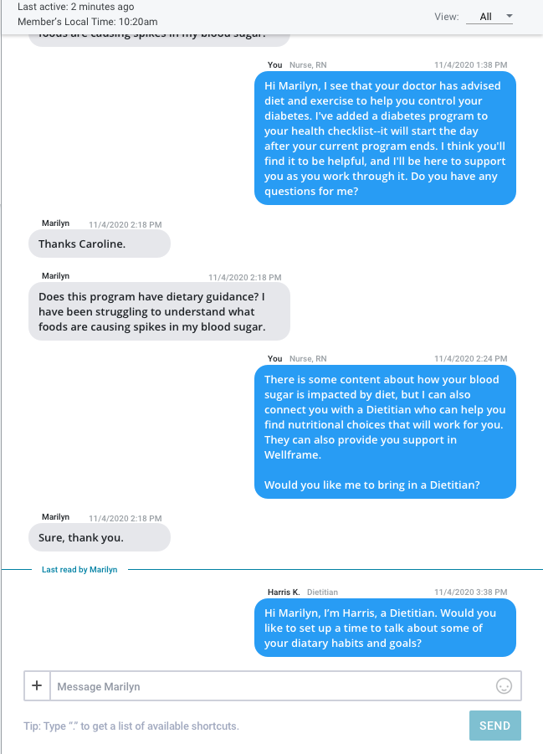
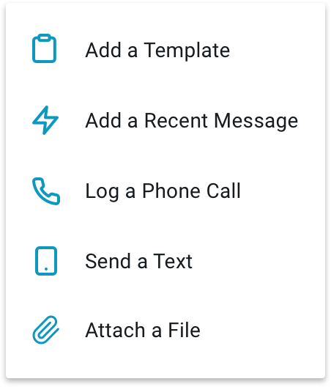
ACTIVATE
MESSAGING
Proactive messaging helps to engage members and guide their journey
Outreach to members right after they onboard to welcome them to digital care management, align on care management goals, and set expectations around their digital engagement
  What should they expect from you?
  What do you expect from them?
Use group messaging to regularly outreach to your caseload
  Send encouragements to engage with features on the app
  Send reminders to attend preventive health visits, keep a safe environment at home, practice mindfulness, or provide tips for managing meds
Messaging quality impacts member engagement - the more personalized, the more likely a member is to respond or take action
Send template or recent messages
Notes:
Norine

Slide 17
Dashboard Efficiencies

Slide 18
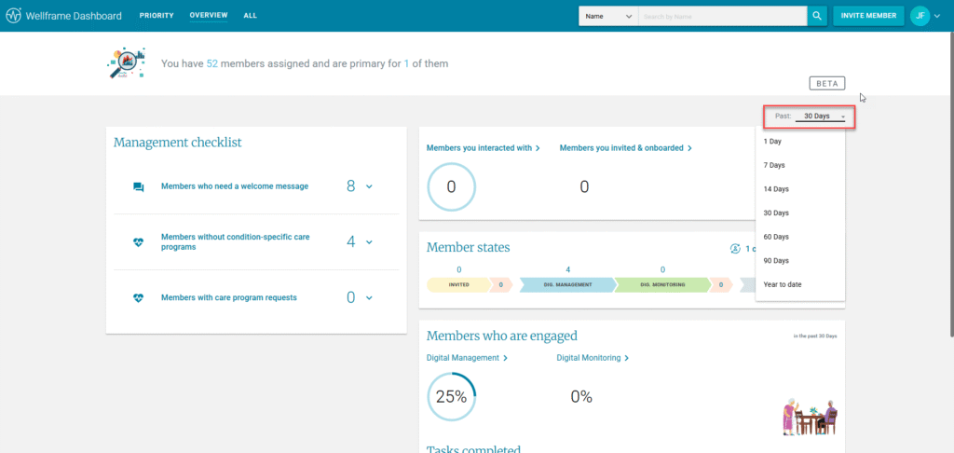
Dashboard Overview Page
Each of the options within each section contains functionality to view the list of members and the ability to drill into their respective profiles.
Within the Overview Page, there are four individual widgets you can use to help you manage your digital panel:
Management Checklist
Member Counts
Member States
Members Who Are Engaged
Reach.

Slide 19
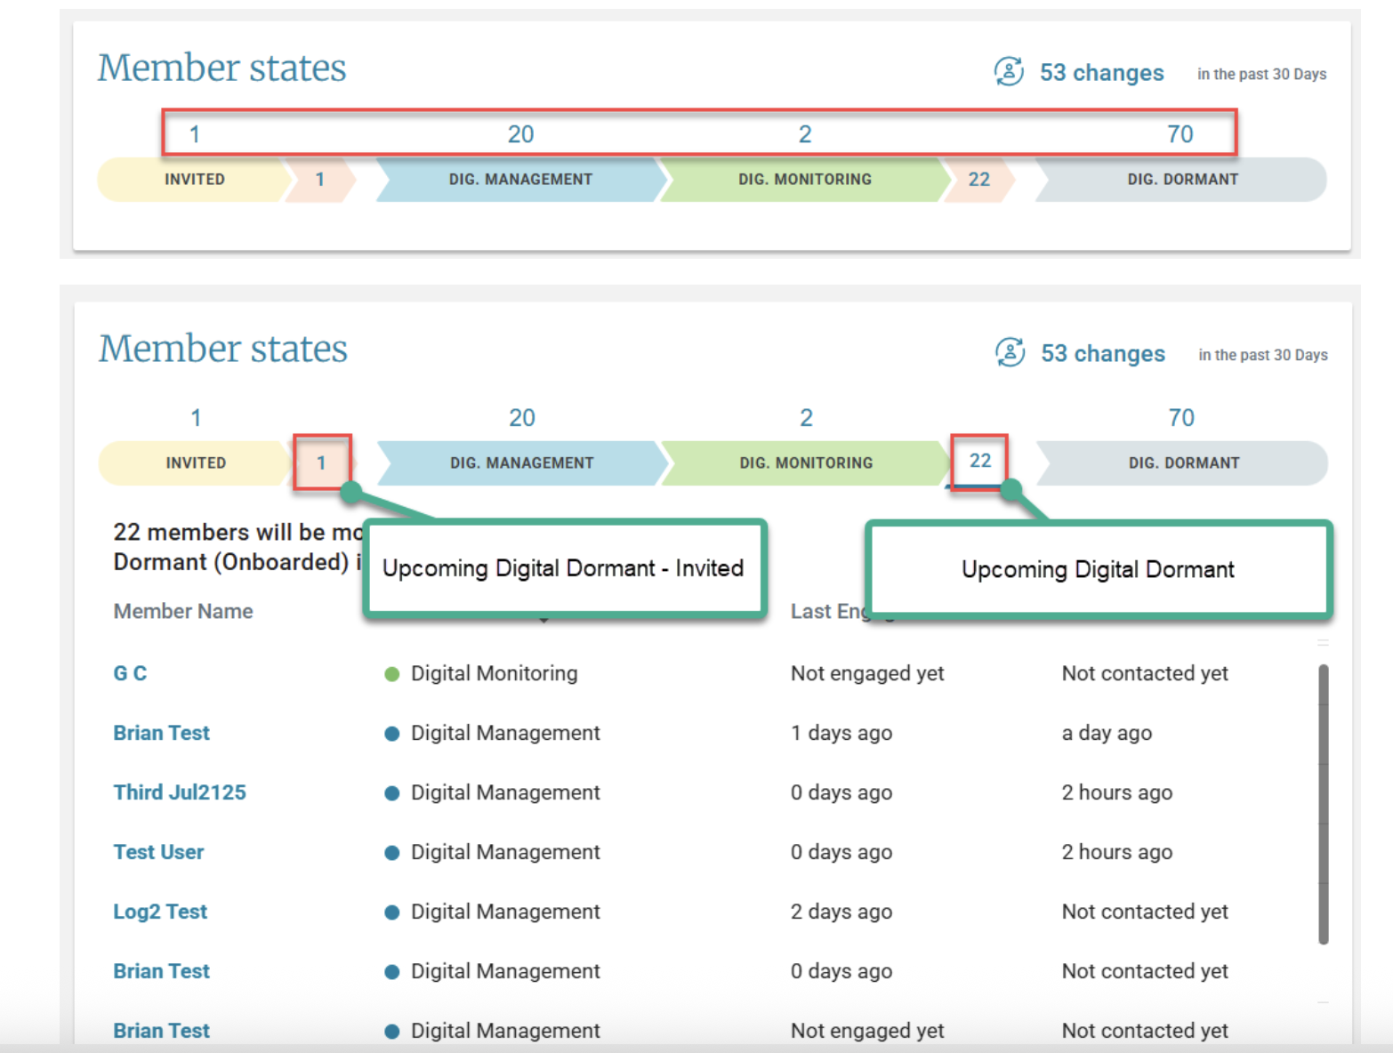
Dashboard Overview Page- Member States

Slide 20
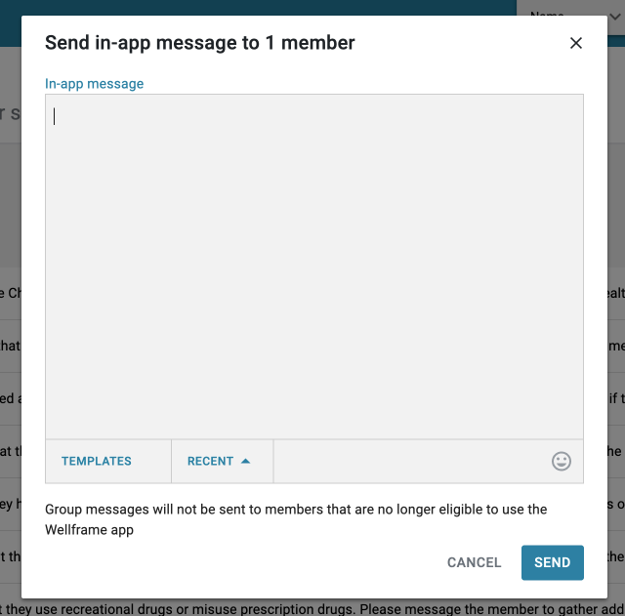
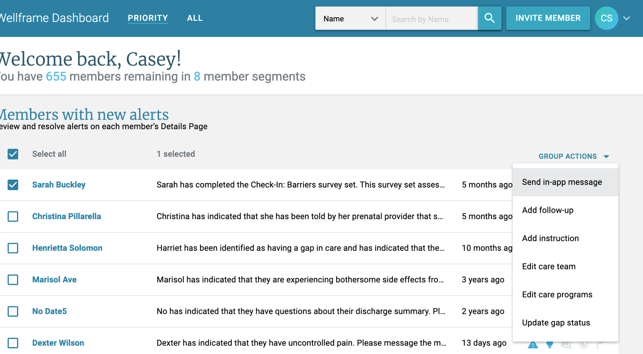
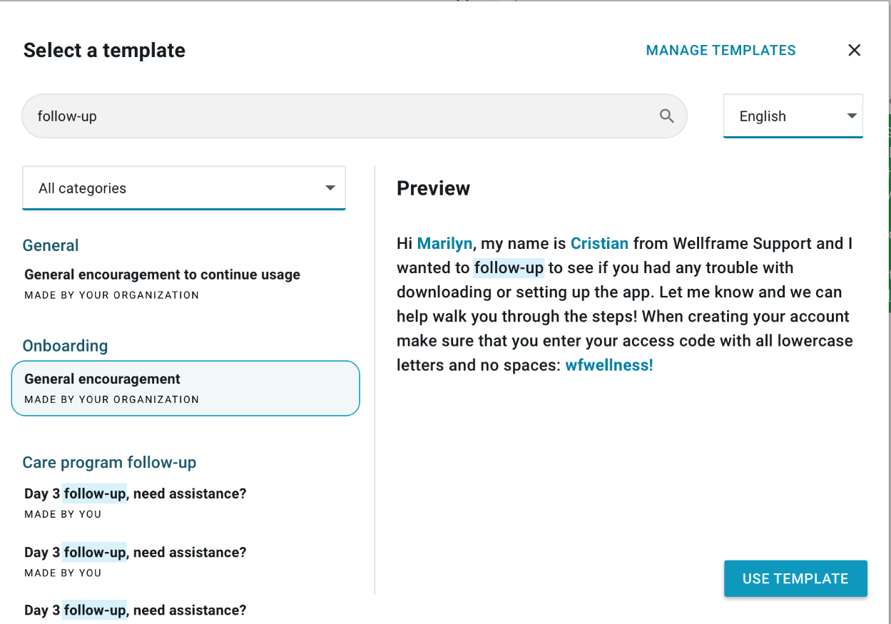
Group Actions- Messaging
Staff can use pre-written messages for group messaging.
1
Select members and initiate a group message from dashboard priority or all view
2
Note: Templates button no longer has a carrot icon
IMAGE: in-app group message modal
3
IMAGE: Staff dashboard priority view
Find and select a pre-written message
IMAGE: ‘Select a template’ screen in the My Messages feature

Slide 21
Break

Slide 22
Benefits of Digital after Activation

Slide 23

Benefits for Staff
Staff Benefits
Message function allows quick and easy interactions.
  Schedule calls for certain LOBs
  Quick follow up to member with an answer
  Attachments in chat
Receive quick insights and alerts from members that impact their clinical outcomes.
  Examples: Mood/Pain/BP/Blood Sugars
  New information that may impact care plan goals.
Dashboard efficiencies help save time.
  Group functions- messages/follow-ups/actions
  Dashboard Overview Page
    Condition-specific Programs
    Welcome Message
:
Activating and engaging members will drive digital member insights and alerts leading to efficiencies in workflows.

Slide 24

Benefits for Members
Activation and Engagement Best Practices will provide a personalized digital experience for the member resulting in improved engagement and retention.
Member Benefits
Quick and easy interactions on the Member's timeframe.
Care Team Access!!!
Assistance with navigating the complicated health care system.
Personalized care programs and reliable health library.
Supports healthy changes.
  Positive lifestyle changes – stress management/weight loss/ smoking cessation.
  Gain confidence in managing their health condition.
    Medication/General reminders
    Checklist
    Instructions
    Messaging to Care Team
:

Slide 25
Member Examples

Slide 26

Felicity, 54, has hypertension. She missed her last cardiologist appointment. She has multiple Emergency Room visits for heart palpitations/chest pain and high blood pressures within the last six months. She tends to look up information about her condition by Googling and at times relies on unreliable sources.

Slide 27


Felicity – Hypertension/ED
Member Activated
Staff Benefits
Member Benefits
Care Program: Hypertension
Biometrics- Blood Pressure Monitoring
Welcome Message
Medications added
Gen. Reminders
  MD Appts
  Care Team calls (if needed)
Receive alerts on Blood Pressure monitoring.
Able to follow medication compliance/ adherence.
Message with member quickly-follow up questions.
Receive insight/alerts based on care program.
Access to Care Team
Reminders for MD appointment and/or care team calls
Med Reminders
Blood Pressure tracking
Information on condition- reliable sources
Navigation assistance- ED specific (dependent on LOB)

Slide 28

Nancy is 69 and came in to the hospital after experiencing chest pain and extreme shortness of breath. She was diagnosed with complex empyema pneumonia with surgical intervention. She is very weak from her 7 day hospital stay and is now discharging on several antibiotics, physical therapy. She has new specialist appointments.
Notes:
Supplemental program education & monitoring program CAD and HTN

Slide 29
Nancy- Complex
Member Activated
Staff Benefits
Member Benefits
Care Program: Care Transitions- Surgical
Biometrics- Pain Monitoring
Supplemental- Fall Prevention
Welcome message
Medications added
General Reminders
  MD appts.
  Care team calls
Receive alerts on pain monitoring
Able to follow medication compliance/ adherence .
Messaged member after follow-up appt. with MD.
Received insights based on survey results.
Access to Care Team
Reminders for F/U appt.
Med Reminders- new antibiotics
Pain monitoring
Information on worsening condition/when to call MD.

Slide 30

Meredith, 28, is pregnant with her first child and has a diagnosis of gestational diabetes. When you connect, you have meaningful calls, but, many times you get her voicemail. She’s also said that she sometimes forgets what information/ advice you shared.
Fast forward, Meredith delivers early at 32 weeks, and new baby girl is in the NICU.

Slide 31
Meredith – Maternity
Member Activated
Staff Benefits
Member Benefits
Care Program: Maternal Health (prenatal/post-partum)
Gestational Diabetes
Neonatal Intensive Care Unit Support- post delivery
Biometrics- Blood Sugar gestational diabetes
Welcome message
Medications added
General Reminders
  MD appts.
Receive alerts on blood sugar tracking.
Able to follow medication compliance/ adherence.
Ability to message member after follow-up appt. with MD.
Able to receive insights based on survey results.
Access to Care Team
Reminders for MD appts.
Med Reminders added.
Blood sugar tracking
Diet information
Access to time- specific educational content through the entirety of pregnancy, as well as post-partum support.

Slide 32

Roger, 63, is diabetic who doesn’t communicate his blood sugar readings. He expressed interest in setting some goals that he shared with you but says he’ll probably forget about them. He enjoys connecting with you, but he says he’s so busy that he sometimes does not have the time for a call.

Slide 33
Roger- Diabetic/Chronic Care
Member Activated
Staff Benefits
Member Benefits
Care Program: Type 2 Diabetes
Biometrics- Blood Sugar Monitoring
Welcome Message
Medications added
Gen. Reminders
  MD Appts
  Care Team calls (if needed)
Receive alerts on Blood Sugar monitoring.
Able to follow medication compliance/ adherence.
Message with member/answer questions.
Receive insight/alerts based on care programs.
Access to Care Team when it is convenient for him.
Reminders for care team calls (if needed).
Med Reminders
Blood Sugar tracking
Review information on condition/diet

Slide 34

Lorena is 70 scheduled for an elective hip replacement, she has a co-morbidity of congestive heart failure. She has been given a lot of information about a care plan but is scared she won’t remember it all and left the all the papers she was given in her daughter's car. She said she is taking pain meds as needed. She takes her weight daily and she is starting back on her diuretic. She is on a low salt diet.
Notes:
Instructions- Plan of Care, Post discharge transition of care content
Mention the pre-admission content

Slide 35
Lorena – Hip Surgery/HF
Member Activated
Staff Benefits
Member Benefits
Care Program: Care Transitions- Surgical
Biometrics: Pain, Daily weight
Supplemental: Heart Failure
Welcome Message
Medications - Pain Meds (as needed)
Gen. Reminders
  MD Appts.
  Care Team calls (as needed)
Receive alerts on pain monitoring / daily weights.
CM able to follow medication compliance/ adherence.
Receive insight/alerts based on care program added.
Access to Care Team
Reminders for care team calls
Med Reminders- starting diuretic pain meds (as needed)
Access to education on condition/ Low salt diet
Weight tracking

Slide 36
Questions?

