Slide 1
Leadership Series
2024

Slide 2
Topics
Change 101
Conveying the Why
Creating the How
Common Staff Personas
Pitfalls and Tips
Coaching 101
Will Versus Skill
All About Metrics
Creating a Champion Enablement Program
Notes:
For more information on recommendations on timings and pairing of sessions see https://healthedgetrial-my.sharepoint.com/:w:/r/personal/nhoward_healthedge_com/_layouts/15/Doc.aspx?sourcedoc=%7B3BC34EFE-C6DB-4B64-9386-A845A035B4E9%7D&file=Timing%20for%20Leadership%20Workshops.docx&action=default&mobileredirect=true&DefaultItemOpen=1

Slide 3
Change 101
Notes:
Welcome to Change 101- In this session we will walk through Change management at a high level and will have various activities to help leaders feel very comfortable in moving their teams through the implementation of digital care management.

Slide 4
Change 101
Overview: review of what change management is and how you can help move your team through the stages of change
Objectives:
Leaders will be able to define the goal(s) of the change.
Leaders will create a vision statement for the upcoming change.
Leaders will identify stakeholders to participate in the upcoming change.
Leaders will develop a plan for the change.
Notes:
In this session you will get a high level review of what change management is and the steps to move teams through change – as it pertains to digital care management. At completion of the session you will be able to define the goal of the change, have created the vision for this change, identify your stakeholders that will participate in the upcoming transformation and have an initial plan for the change, Sound good? Ok, let's get started.

Slide 5
Stages of Change
1
4
Create a Vision
Develop a Plan
2
5
Define Your Goals
Enable and Implement Changes
3
6
Stakeholder Involvement
The Cycle: Build, Measure, Learn, Iterate
Notes:
Inspiring change in the workplace requires that (you) the leader create a vision, help define goals, include stakeholders and help to keep them involved. Then the planning begins, enabling and implementing the actual change. Then there is this cycle of build, measure, learn and iterate that continues. Through this session we are going to walk through each of these and there are activities to drive each of these concepts home.

Slide 6
Creating a Vision Statement
What is a vision statement? It should describes a long-term, idealistic state of the future.
How to create a vision statement:
Step 1: Define what you do as an outcome.
Step 2: Define what unique twist your organization brings to the above outcome.
Step 3: Apply some high-level quantification.
Step 4: Add relatable, human, 'real world' aspects (connection)
Creating a memorable vision statement:
Keep it short - max 2 sentences.
Make it specific to your business and describe a unique outcome that only you can provide.
Simple is best. Stay away from jargon, metaphors, and business buzzwords.
It should be ambitious enough to get people excited, but not so ambitious that it seems impossible to achieve.
Notes:
The vision describes the long term, state of the future. This is your compass so really important. In this activity we are going to take some time for you to create YOUR own vision for this change. This is going to be key when transitioning to a digital care management model- When you get the questions- internal or external, and you come to the forks in the road with decisions- it could be workflows, goals, or staffing, really any barriers that may arise- you always come back to the vision... it is the compass.
Let's start with Step 1. Define what you do as an outcome- how can you put that into words when it comes to digital?
Step 2. What is the unique twist your organization or in this case, care management area brings to that outcome? Maybe it is doubling down on transitions of care or maternal health maybe it is meeting members at every level- whatever it is that makes your care management area unique.
Step 3 – Let's talk about numbers? How do we know when we get there? By reaching X percent of the population or by engaging x many members...
Step 4 – Add some relatable, human aspects. Examples related to care management might be making health care navigation easier for members, or improving care management effectiveness, or staff efficiency- depending on above

Slide 7





Sample Vision Statements
To provide an unparalleled experience as the most trusted partner for health care.
We will be known as the most caring, trusted, and respected source of financial guidance and solutions in the communities we serve.
To provide access to the world’s information in one click
To help people throughout the world realize their full potential
To make the best products on earth and to leave the world better than we found it.
Notes:
These are some examples of vision statements for some very familiar companies- Let's take a look at these- Do they define what they do as the outcome? Can you see their unique twist they bring? A high level quatification? And a relatable human aspect- connect.

Slide 8



Define Your Goals
Imagine 1 year from now
How will you define success?
One-word goal setting
Notes:
(Facilitator can elect to do as many activities as time allows.)
Activities:
Use your imagination – imagine 1 year in the future, what does this look like- for digital care management, how does this look? From a staffing perspective, from an clinical outcomes perspective, from a sales perspective. Is there one that might stick out? What is a realistic goal?
Write down what success will look like? When do you know that you have achieved what you set out to do?
One word goal setting is choosing a word to describe the current status of the team/performance/KPI and then choosing another your word for the upcoming year- an intention.

Slide 9
Stakeholder Involvement
Why? Involving stakeholders in the change process helps them understand the shared vision and how the project will affect them, making individuals more likely to be invested - this minimizes risk and resistance.
Stakeholders determine whether the changes introduced will last or not.
If the adoption of the project deliverables is poor and perceived unfavorably, the project can be considered a failure.
Regularly engage various stakeholders throughout the project life cycle.
Understand stakeholder needs and expectations.
Communicate early and often.
Notes:
Once the goals are defined it is time to involve stakeholders in the change process. Gartner reports only 42% of employees feel heard and valued. The sooner the better- involvement helps them to better understand the shared vision and also how the project will directly impact them. This step is very important as it can minimize resistance to change and overall risk to the project. This is because stakeholders determine whether changes introduced are implemented well and with sustained outcomes. It is important to understand how this change is
Connected to them and and seeing themselves as part of the larger picture that benefits them.
https://www.walkme.com/blog/change-management-principles/
going to impact the stakeholders before, during and after the implementation. Keep in contact with the stakeholders regularly and communicate within a channel that works for them to express their needs and expectations.

Slide 10
Develop a Plan
Create a timeline
Assign specific due dates to each task on your list and make sure that those deadlines are met.
Create a task list
This is a checklist of actionable tasks you must complete to achieve your goals.
Create a communication strategy
Ensure all stakeholders, including employees, customers, suppliers, and external partners are aware of the project timeline and objectives.
Your plan should revolve around the project's overall due date.
It keeps your team on track and is easy to reference when determining the next steps.
Have clear channels of communication. Examples include email, phone, or in-person meetings.
Ensure that everyone understands the company's change management process and procedures.
Notes:
In order to meet any goal - a plan is necessary, right? First, we need to consider a timeline, when is the due date for the project to be implemented? Everything will be based off that date so it is very important. Next, what are the actionable tasks that need to be completed? The due dates of these tasks will need to correspond with meeting the due date. Often times, it is best to work backwards from the due date, once the actionable tasks are identified. And finally, it is very important to create a communication strategy. This strategy ne3eds to include all stakeholders, and have clear channels. Does the company have a change management process? Make sure everyone is aware of the company's change management process and procedures.

Slide 11
Enable and Implement
Execute the communication plan
Provide training
Identify and quickly address roadblocks
Monitor progress
To help build momentum for the change, be sure to communicate all successes and consider providing incentives for embracing the change.
Employees should also be encouraged to experiment and share their experiences to harness their emotional energy and overcome any natural resistance that may arise.
Notes:
As the change is implemented, the communication plan is executed to all the stakeholders, those impacted by the change will be provided training. It will be important for the leader to identify and quickly address any road bloacks that could prevent progress in the plan implementation. Lastly, as the change moves forward, make sure to monitor progress- having certain times to stop and track certain metrics.
Bright ideas- Providing incentives may help staff embrace changes- make sure to think about these both individual and team level, making sure that these incentives will help to promote long-term stability so while planning a reward system for short-tearm goals (metrics/KPIs) but also planning for what the future goals will look like- organizational structures and/or innovative behaviors are some examples. Also, consider creating time for employees to present best practices to each other- either case reviews or less structured. Another idea is to identify through data who is doing well with certain topics, onboarding, conversion rates, listen to calls, see what they are doing different than others on the teac. Ask them to present to the team.

Slide 12

The Cycle: Build, Measure, Learn, and Iterate
Build: Conduct one on one conversations with the team structures.
Measure: Use data to track and trend KPIs/goals.
Learn: Conduct team meetings – what's working, what's not working, what can be improved?
Iterate: Take this input and reiterate- adjust KPIs/Goals/Strategy, as necessary to promote efficiencies.
Build
Iterate
Measure
Learn
Notes:
A bit on the Cycle of change to embrace with change- this is a continuous cycle of build, measure, learn and iterate.
So build includes the building the structrue to monitor the progress- this might include one on one conversations with staff/employees using the goals/KPIs that were developed earlier within the processes.
Measure is using data to track and trend KPIs/goals at certain intervals to determine if adjustments are needed.
It is important to keep this lens of learning in place- what is working? What is not working? What can be improved- what are some solutions? Using that data- who are the high performers- what are they doing to be successful – share best practices with colleagues. Having formal and informal solutions available. - employees at all levels are responsible to look for opportunities for improvement in the process.
Lastly, iterate. Once all of the information from the first three steps has been reviewed, it may be necessary to make adjustments to promote effeciencies- this could be with goals/kpis, with in DCM it is most often with tweaks in the workflows.

Slide 13
Conveying the Why

Slide 14
Conveying the Why
Overview: A session to assist leaders in gaining clarity around the why of transitioning to Digital Care Management. This is a very important piece to include, everything builds upon this session.
Objectives:
Leaders will be able to describe how change can impact productivity and morale.
Leaders will identify three out of the five strategies presented that would be possible to add to their roll out plan.
Leaders will be equipped to describe the why to their team.

Slide 15


Health plans are under tremendous pressure from industry and internal forces
Growing employer impatience
Reduce costs while improving the member experience
Complying with policy changes
Digital transformation adoption
Improving care quality & member outcomes
Adapting to value-based care
Urgency to differentiate
Threat of disintermediation
Using big data effectively and securely
Notes:
We know that right now, it may feel like you’re getting it from all sides. Which of these challenges are you feeling most acutely? Any challenges not represented on the slide that may impact your strategic why? Write them down.

Slide 16

Time to Discuss
Staff productivity during change....
How change feels to staff....
How teams discuss change....
How does knowing the WHY help?
Notes:
A few things to discuss-
How do you think staff productivity changes during a change? Pause- allow time for an answer. When learning a new process the staff productivity may drop before it picks up. Keep this in mind at go live within that first month also with quality audits.
What about how change feels to staff? (Pause- allow time for an answer) Do you think they feel comfortable with their first digital onboard? As the staff onboards more members the comfort increases and they adjust their script depending on the member. This is something to consider with the numbers in that go live timeframe as well as- pushing through the discomfort - all part of the change process.
So you review this change with the team- what do you suppose is the team's first response? Do you think they are excited to change how they do everything that they currently do? Now add in varying levels of expertise with digital? How do they discuss change when you (the leader) are not around? Do you think it is positive? Right most times we lean to the negative when it comes to change because it is unknown, we don't REALLY know how it will impact me or my job.
Can you see how having clarity of your and the organization's why will help with driving this change, by first helping you to explain this change to the team, but then it becomes the compass providing direction for the change- helping to ease the discomfort of doing something different. Because you have a vision with a clear why.

Slide 17




Leading through Change: Conveying the Why
Encourage Communication
Address Uncertainty
Guide to Solutions
Remove Barriers
Model Innovative Mindset
What do you NOT want to tell me?
What is keeping you up at night about this change?
Ask staff to bring a potential solution WITH any identified problem.
Daily stand ups with the team.
Pace of the pack is determined by the leader.
Notes:
There are some strategies to include that will help convey the reasons for the upcoming change
First one is Encourage Communication- it might feel scary to keep the door or chat open but BE available for questions- "What do you NOT want to tell me?", allow them to bring the fears, concerns. It is okay to parking lot some of these if there is not an answer today.
Second- Address uncertainty- A question "What is keeping you up at night about this change?" Is a question that could be used. Most times your staff will tell you. Again, you might not have the answers to all the concerns at this point but it is important to track the concerns and make sure that you are able to listen.
Guide to Solutions- As the change progresses it becomes easy for staff to find problems, one way to keep them in the positive mindset is to challenge them to bring a solution with any problem that they identify, so that they are assisting with the implementation. If they are skilled at the workflows or have a lot of indirect influence over the team – you may want to consider them for the Super User group. We will talk more about this in Staff Personas
Remove barriers- As a leader, what barriers are you able to remove to make the change easier for the staff? This could be in the way of empowering the staff to make workflow decisions. This could be establishing a line of communication with the Internal IT department for security permissions, whatever it is.
Model Innovative Mindset- This is the one that has to done at 100% - behind closed doors you can have doubts, concerns, questions but forward facing to your team you are the leader- The pace of the pack is determined by the leader. They are watching your every movement and listening to every word which is why so it is important to have clarity around the overall reason for this change.

Slide 18
Creating the How

Slide 19
Creating the How
Overview: This session will walk through the plan for this change and leadership's role in supporting it.
Objectives:
Leaders will be able to identify the necessary roles to assemble a top-notch super user team.
Leaders will be able to articulate a detailed plan for rolling out this change including their role within each step.
Notes:
Walk through the overview and Objectives

Slide 20

Time to Discuss
Who are your stakeholders?
Do you have a spokesperson?
What is the timeline for the project plan?
How about the training plan?
How does knowing the HOW help the team?
Notes:
In starting to figure out the how – So you have probably figured out the why for you change by now. So the next question that will come to mind for your team will be how in the heck are we going to do this with everything else that we have going on?
Honestly, it is a great question. Because most often, your other priorities don't go away. So as a leader, this is going to take some thought. Some of the first questions that might come to mind are on the screen but these are not the only questions the team may have but some examples of some are.... who are the stakeholders, do you have a spokesperson, what is the timeline, and what will the training plan be?
What I want us to discuss at this point is how will knowing and communicating this information help the team you are putting together? Even if it is at a high level.

Slide 21



Leading through Change: Conveying the Why
Assemble the Team
Create a Plan
Designate a Spokesperson
Hold Status Meetings
Educate and Explain
Evaluate the team
Are the right people in the right roles?
Who are the best players for the Super User team?
Project plan that is date-driven
Short-term and long-term goals
Tangible strategic steps
Procedure development
Workflow development
Point person
Decision maker
This may be a sponsor that can socialize the change within an organization
Review: Decision points, workflow changes, policy implications, important dates (example training)
Training Plan: Super Users and All staff
Provide resources

Slide 22
Common Staff Personas

Slide 23
Creating the How
Overview: Describing the common staff personas that leaders can expect during change and how to utilize these persona types to expedite the change.
Objectives:
Leaders will be able to describe common staff personas.
Leaders will describe how to utilize these personas to promote the change management process.

Slide 24





Staff Personas
Go Getter Gloria
Tech Savvy Tammy
Problem
Finder Pam
See It to
Believe It Sam
Fearful
Fred
Loves change- first to volunteer- ROCK Star- the “go to” for management.
Very comfortable with new technology, average processing, adaptable to change, very often newer staff.
Resistant to change, finds problems within the proposed changes, verbalizes why it won’t work, leans to the negative, usually has a longer tenure.
Hesitant to believe that digital is the way to go for CM, usually has moderate tenure on the team, but will follow the rules.
Main concern is that a digital change is going to replace the current role. Main concern is about why the change is happening.

Slide 25
Staff Personas
Go Getter Gloria
Tech Savvy Tammy
Problem
Finder Pam
See It to
Believe It Sam
Fearful
Fred
Consider adding as a super user or train the trainer role.
Include in planning sessions.
Gain feedback for use cases.
Consider adding as a super user or train the trainer role.
Include in planning sessions.
Encourage this persona to bring a solution with the problem.
Important to included from start.
Bring back success stories to the team.
Staff & member satisfaction scores and/or testimonials.
Needs to see the benefit for the member.
Review the why of moving to DCM.
Increase confidence through training.
Keep included in the planning and workflow development.

Slide 26
Activity
Consider your team:
Are there members on your team that fall into one of the five personas?
Did you have any surprises when reading the personas?
Think about some creative ways to include different personas in upcoming changes.
Discussion topics:
What persona might be helpful as a super-user or train the trainer role?
Which persona is important to include but might need reminding to bring solutions?

Slide 27
Pitfalls and Tips

Slide 28
Pitfalls and Tips
Overview: Arming clinical leaders with everything they need to navigate teams through change.
Objectives:
Leaders will be able to describe three pitfalls to avoid when implementing a change.
Leaders will be able to articulate five tips to improve change management experience for their staff.

Slide 29
Pitfalls and Tips
Pitfalls
Unrealistic expectations
One person completing all the work
Unilateral decisions
Tips
Be honest
Allow time for learning
Value feedback
Set an example
Empathize
Notes:
Discuss why each of the pitfalls would impact achieving the vision? What might be an example of these- unrealistic expectations? Have you seen these play out in other initiatives?
Discuss how the tips my look in action. Being honest for example- what does that mean when it comes to digital care management transformation? Will everyone on the team want to transform? Honestly, maybe not. Will it take time for learning this new workflow? Yes, it does take time.

Slide 30
Coaching 101

Slide 31
Coaching 101
Overview: This session will help leaders identify specific coaching strategies to promote positive behaviors helping staff to reach identified goals, metrics and KPIs while also improving employee engagement and confidence.
Objectives:
Leaders will describe the key differences between managing and coaching by providing examples of each.
Leaders will articulate two situations in which they could apply coaching related to Wellframe.
Leaders will schedule one-on-one coaching and include conversations related to Wellframe.

Slide 32
Coaching vs. Managing
Coaching
Improve employee performance
Increase employee engagement
Collaborate in long-term decision-making processes
Help employees with professional development
Provide constructive feedback3
Managing
Assign tasks
Delegate work
Monitor and evaluate progress
Train new employees
Meet target deadlines
Solve problem and conflict situations
Respond to emergencies
Notes:
The best leaders know when to apply coaching techniques and when to use managing techniques. Think about transitioning from telephonic CM to digital – what comes to mind as where you might have to spend much of you time with staff?

Slide 33
Team Coaching Tips
Foster a collaborative environment.
Provide and ask for feedback.
Instill transparency.
Empower continuous learning.
Understand individuals' strengths.
Set long and short-term goals.
Celebrate team and individual successes.
Build trust.
Display compassion.
Communicate effectively and efficiently.
Be flexible.
Recognize work life balance.
Notes:
Touch on the importance of all but highlight some that will directly impact digital CM transformation- provide and ask for feedback, empower continuous learning, set long and short-term goals, celebrate team and individual successes, communicate effectively and efficiently.

Slide 34
Preparing for Coaching Conversations
Define purpose of the meeting
"PIE"- Performance, Innovation, Execution
Establish the overall goal (smart)
Establish milestones – KPIs
Evaluate performance, innovation, execution
  Regular one on one meetings- monthly, quarterly, annually
  Data provides accountability (Performance)
  Following workflows? (Execution)
Include:
What's going well?
What's not going so well?
What could be better? Ask for a solution. (Innovation)
Active listening skills
Notes:
Let's talk about preparing for a coaching conversation- and how it might differ from a managing conversation.
Direct feedback
Encouraging words

Slide 35
Activity
Describe a Wellframe topic for an upcoming coaching session.
  Examples might include:
    Onboarding numbers
    Invite script
    Care programs being used
What were some of the coaching interventions you might choose to use?
  Examples might include:
    Use encouragement
    Identified goals
    Use transparency
    Identify strengths
    Display compassion

Slide 36
Key Takeaways
Identify the differences between coaching and managing skill sets.
  Do you know which of these you tend to favor and which ones you may need to lean in on for digital transformation?
Incorporate specific coaching skills to assist in transforming to digital care management.
  Which coaching tips could you add to help your team transform?
Prepare, schedule and hold regular "coaching conversations" with direct staff regarding Wellframe.
  Give yourself a due date to have these scheduled.

Slide 37
Will Vs. Skill

Slide 38
Will vs. Skill
Overview: This session will help leaders assess whether staff members need encouragement versus additional trainings and how to apply proper coaching strategies.
Objectives:
Leaders will describe how to accurately assess a staff member’s performance.
Leaders will identify management strategies to implement based on the staff assessment to improve their performance.

Slide 39
Defining Will and Skill
What is skill?
Skill is how competent a worker is at a specific task or how effective they are in their role.
What is will?
Will is how motivated they are to complete their task or perform their role well.
Why does assessing this matter?

Slide 40
Questions to Address Will or Skill
Does the person have a clear picture of the goal of the task or the project? Is it a SMART goal?
Has this team member done this kind of work successfully before?
(high skill/low skill)
Does the team member feel excited about doing this task or project?
  What concerns might they have?
  (high will/low will)
How much input will they need from you in terms of:
  Direction: Telling them what and how to do things
  Support: Listening and helping them problem-solve for themselves.

Slide 41
The Skill/Will Matrix
Guide
Delegate
HIGH WILL
Direct
Excite
LOW WILL
LOW SKILL
HIGH SKILL

Slide 42
Coaching/Managing Will and Skill
Individuals like this should be supported and guided so that they improve their level of skill. They want to learn and develop and should be helped to do so.
Your role as a manager is to get out of their way, let them perform, recognize their achievements and support them as required, perhaps as a coach or mentor.
HIGH WILL
Individuals with low levels of both skill and will may be in the wrong role. Managers and leaders should focus on helping these individuals increase their skill and will, or perhaps help them find a role they truly want.
They have the ability but lack the drive – managers can help motivate them, to excite them about the tasks at hand.
LOW WILL
LOW SKILL
HIGH SKILL

Slide 43
Activity
Use questions to assess your team member's status regarding will and skill.
Use the matrix and plot out each team member. Take notice to where most are falling.
Are you surprised by where any of the team members are located on the matrix diagram?
What coaching strategies would be best to implement based on this assessment?

Slide 44
All About Metrics

Slide 45
All About Metrics
Overview: This session is designed to provide leaders' strategies in using metrics within Wellframe reports/dashboards regularly to manage and monitor progress toward goals.
Objectives:
Leaders will describe which metrics they will use to track progress on goals.
Leaders will develop a preferred cadence of tracking progress (how often to review – reports/dashboards)
Leaders plan how to use the metrics to guide the 1:1 and team discussion(s) related to Wellframe.

Slide 46
CUSTOMER INSIGHTS PORTAL
Available reports
Report Name | Objective | Value Measure
Staff Performance | Measure how staff are performing on a weekly basis and what actions staff can take to improve performance. Track weekly trends in performance and understand staff caseload size. | Operational Efficiency
Member Activity | Understand how different segments of members are using the app (features, messaging, program tasks) as well as how frequently and consistently. Measure retention rates across care areas. Depicts how member activity changes over time relative to onboarding date and program start date. | Engagement
Onboarding Detail | Measure onboarding across the plan, including the number and demographics of members invited and onboarded, conversion rates, self and staff onboards, and programs members onboarded into. | Volume
Ecosystem | One report for executives and account managers to broadly observe trends and current state metrics. | All

Slide 47
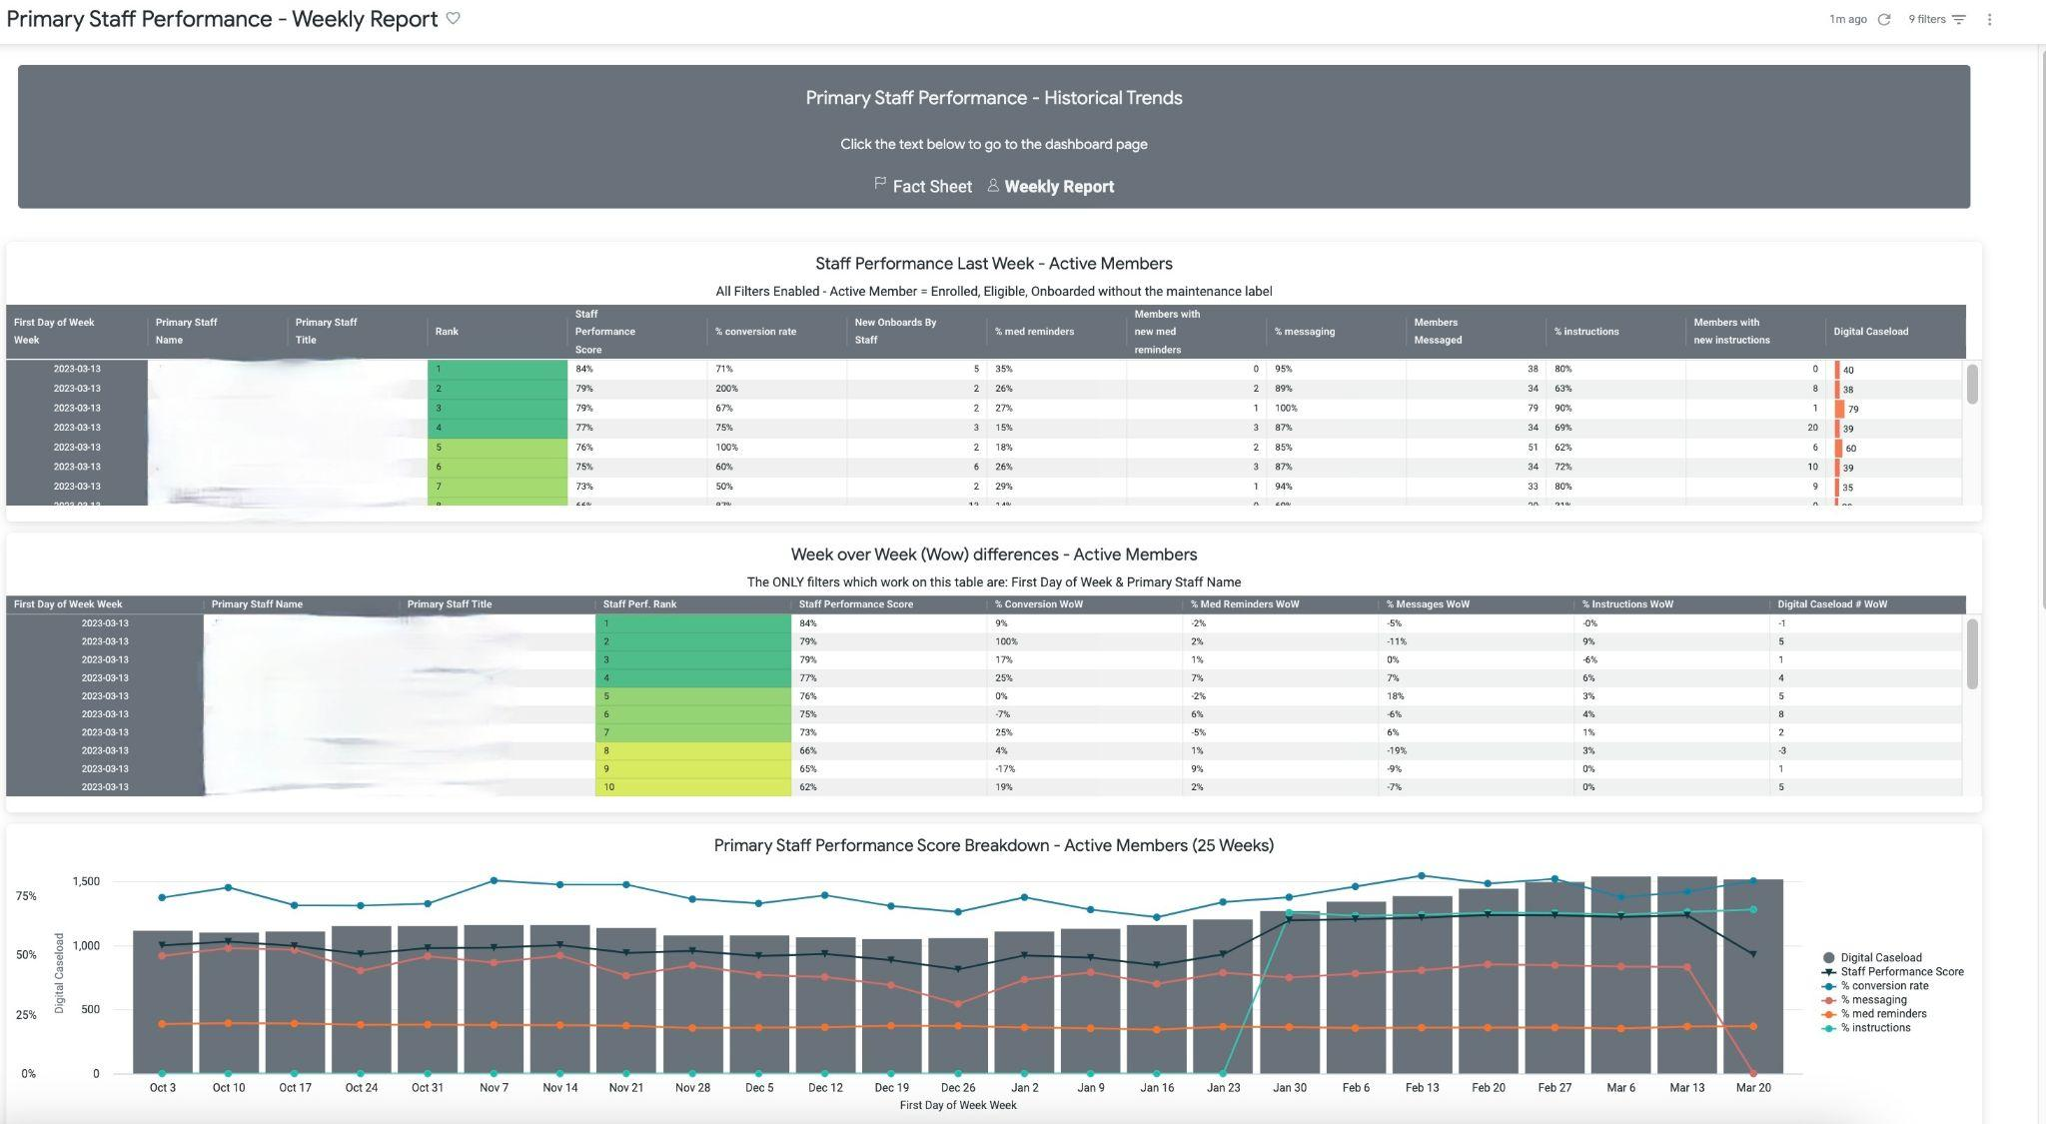
CUSTOMER INSIGHTS PORTAL REPORT SUMMARIES
Staff Performance Report
Purpose | Measure staff performance over time and increase efficiency using a single Staff Performance Score. Includes 3 sections that break down performance at the individual level: Staff Performance by Week, Staff Performance Week over Week, and Staff Score Breakdown. | Measure staff performance over time and increase efficiency using a single Staff Performance Score. There are 3 key sections that help break down performance at the individual level: Staff Performance by Week, Staff Performance Week over Week, and Staff Score Breakdown.
Key Filters | Week Primary Staff Name Primary Staff Title Primary Staff Manager Primary Staff Team | Access Code Prefix Enrollment Primary Care Area Enrollment Care Area
Key Metrics | Staff performance score Staff performance rank Digital caseload % caseload engaged Conversion rate New onboards | % caseload with med reminders # caseload with new med reminders # caseload messaged % caseload with instructions # caseload with instructions

Slide 48
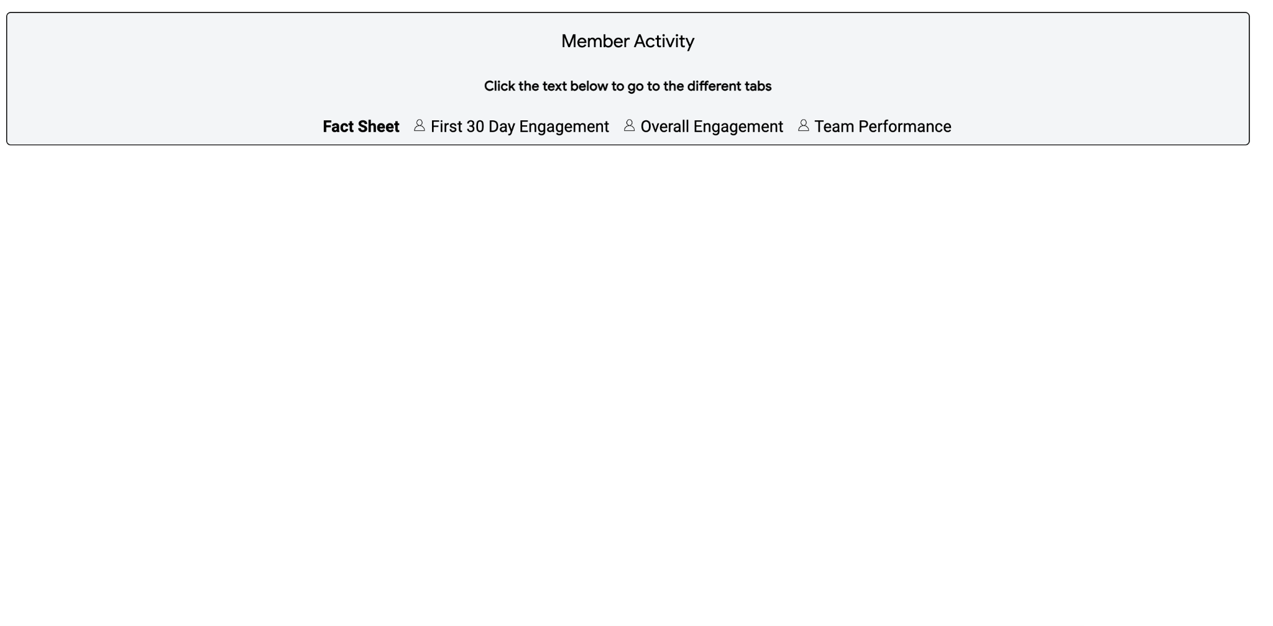
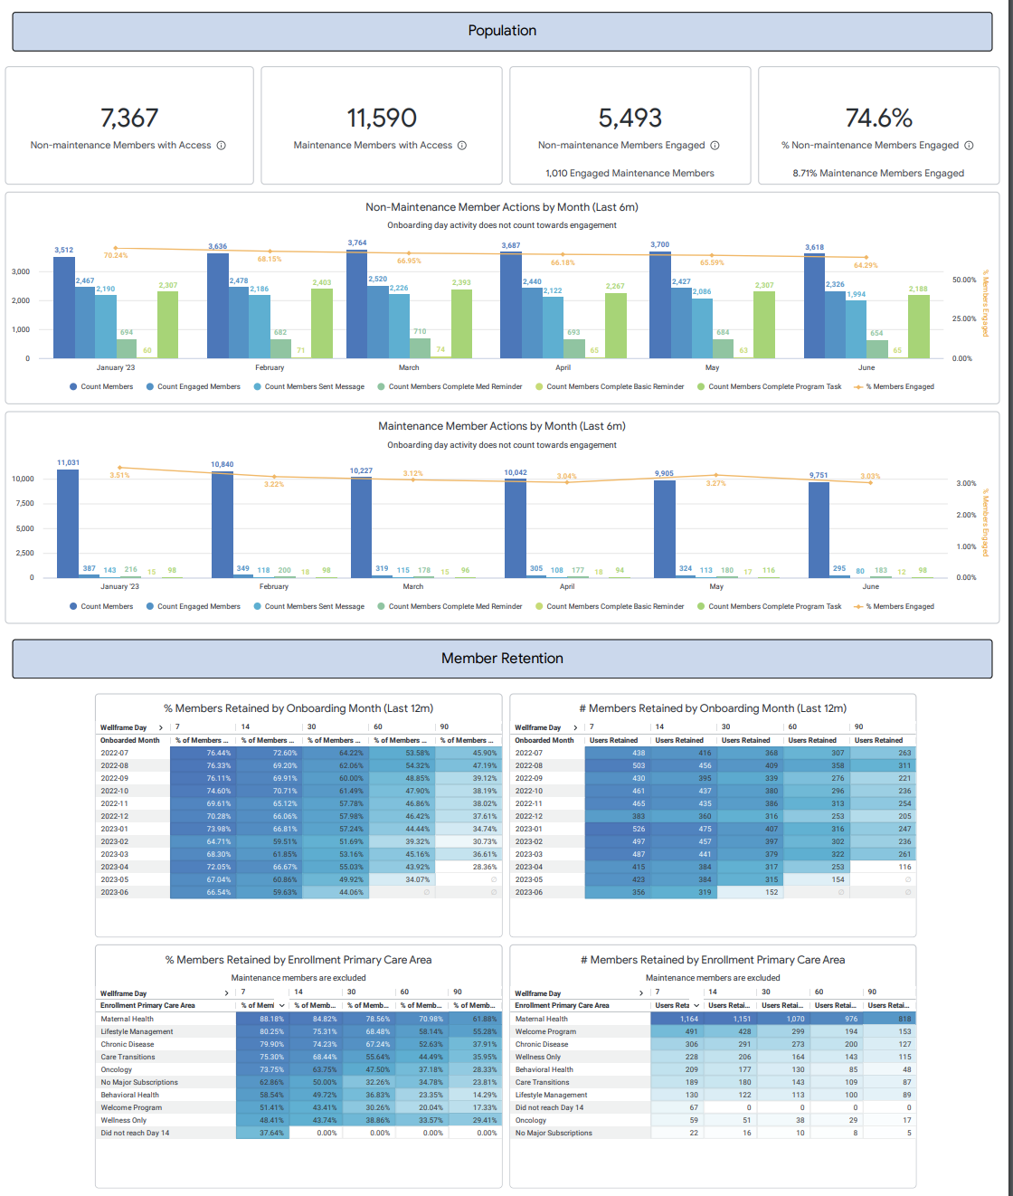
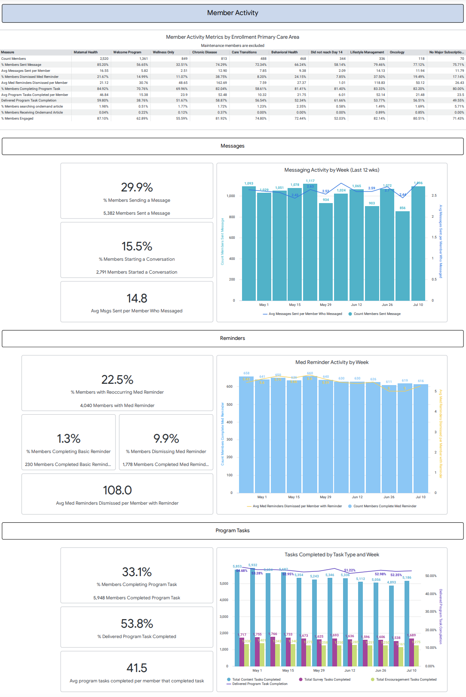
CUSTOMER INSIGHTS PORTAL REPORT SUMMARIES
Member Activity Report
Purpose | Aggregates metrics related to member engagement, retention, and use of key app features. Customers can filter the report by member segments to track engagement trends and app activity. | Measure staff performance over time and increase efficiency using a single Staff Performance Score. There are 3 key sections that help break down performance at the individual level: Staff Performance by Week, Staff Performance Week over Week, and Staff Score Breakdown.
Key Filters | Enrollment Primary Care Area Employer Group Access Code Prefix | Member Line of Business Business Unit Code Onboard Date
Key Metrics | % members highly engaged, engaged, and never engaged Distribution of days engaged in first 30 days Activity metrics by engagement cohort | # members with access / on maintenance # members engaged / on maintenance % members retained by onboard month, primary care area, day 7, 14, 30, 60, 90

Slide 49
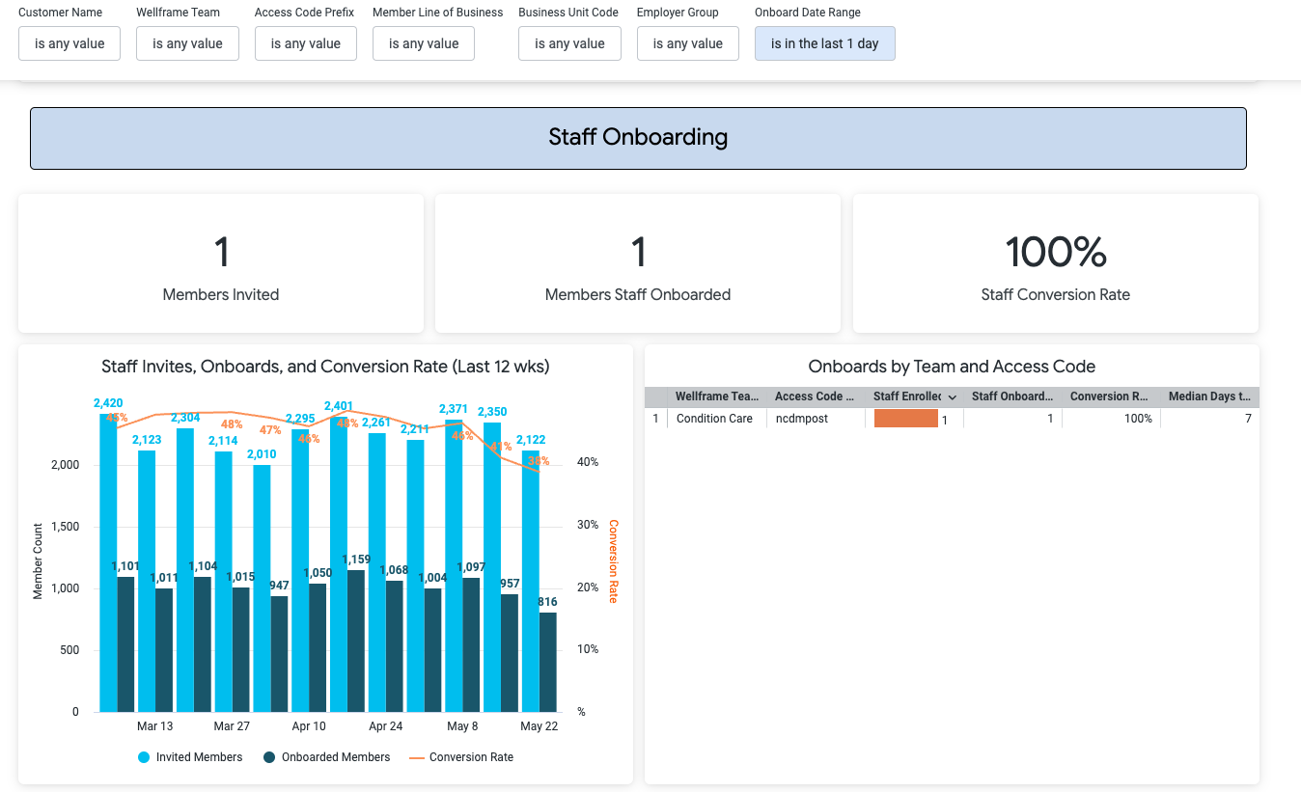
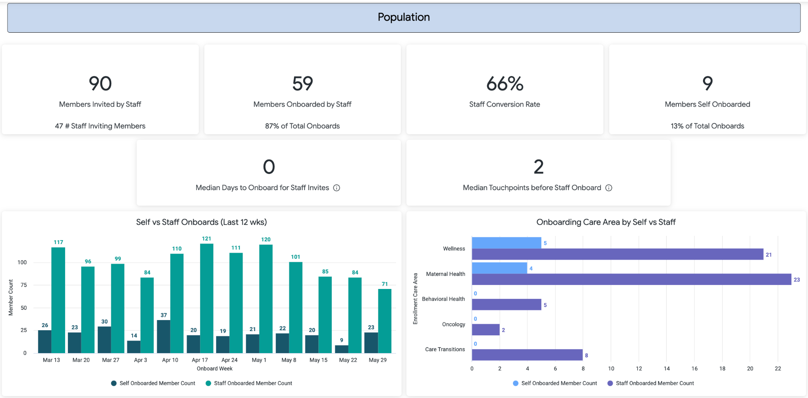
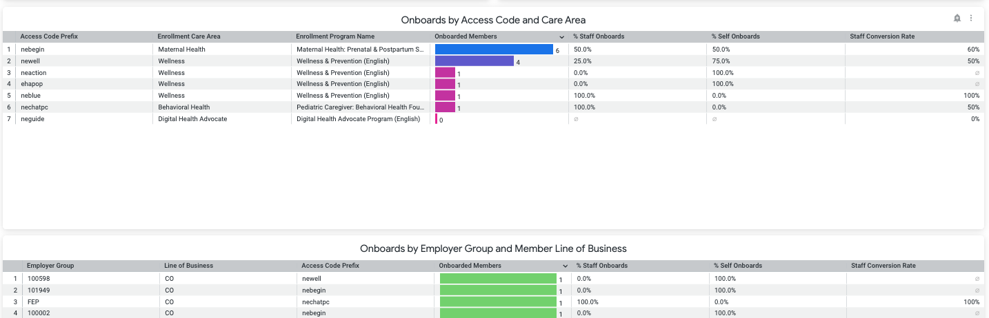
CUSTOMER INSIGHTS PORTAL REPORT SUMMARIES
Onboarding Details Report
Purpose | Aggregates metrics related to onboarding, making it easy to identify trends and spot opportunities for improvement. Includes four sections: population, staff onboarding, self-onboarding, and member demographics. | Measure staff performance over time and increase efficiency using a single Staff Performance Score. There are 3 key sections that help break down performance at the individual level: Staff Performance by Week, Staff Performance Week over Week, and Staff Score Breakdown.
Key Filters | Enrollment Primary Care Area Employer Group Access Code Prefix | Member Line of Business Business Unit Code Onboard Date
Key Metrics | # members invited # members onboarded Staff conversion rate # members self onboarded Median days to onboard from staff invite | Median touchpoints before onboard # members by age bucket # members by gender

Slide 50
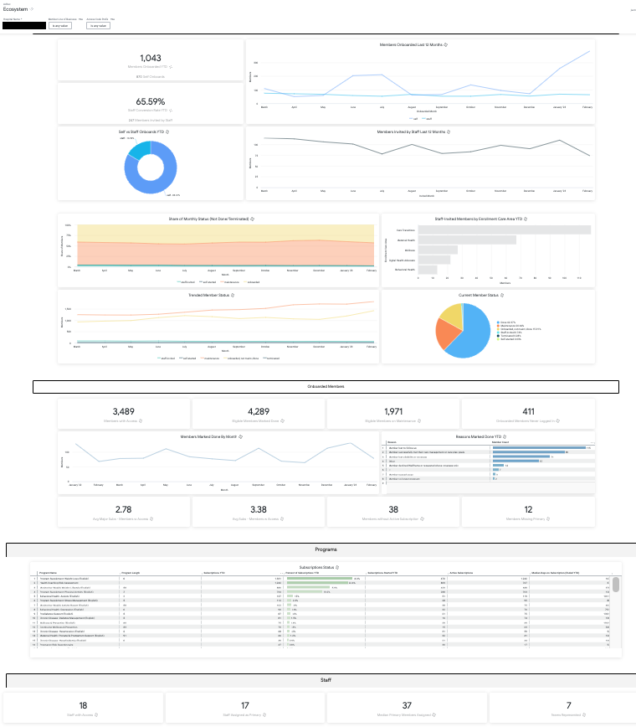
CUSTOMER INSIGHTS PORTAL REPORT SUMMARIES
Ecosystem Details Report
Purpose | One report for executives and account managers to broadly observe trends and current state metrics without needing to refer to multiple operational reports. Contains YTD metrics pertaining to member population onboarded, member subscriptions to programs, and aggregated staff counts. | Measure staff performance over time and increase efficiency using a single Staff Performance Score. There are 3 key sections that help break down performance at the individual level: Staff Performance by Week, Staff Performance Week over Week, and Staff Score Breakdown.
Key Filters | Member Line of Business Access Code Prefix Business Unit Code
Key Metrics | Members Onboard YTD Staff Conversion rate YTD Current member status Avg program subscriptions per member # members without a subscription # members missing a primary | # subscriptions by program name YTD # staff with access # staff assigned as primary Median primary members assigned # teams represented

Slide 51
Staff Performance Report

Slide 52
STAFF PERFORMANCE REPORT
Overview
The Staff Performance report measures staff performance over time and helps increase efficiency using a single Staff Performance Score.
The Staff Performance Score is calculated based on staff actions proven to drive performance in Digital Care Management:
Staff onboarding conversion rate
Members with medication reminders
Members to receive at least one message
Members with instructions
The report has three sections that help break down performance at the individual level:
    Staff Performance by Week
    Staff Performance Week over Week
    Staff Score Breakdown

Slide 53
STAFF PERFORMANCE REPORT
Example staff performance score calculation
Metric | Staff Conversion Rate (4 weeks) | % of Members with Med Reminders | % of Members who received at least one message | % of Member with Instructions
% Weighted | 28% | 28% | 28% | 16%
Perfect Score | 75% | 75% | 75% | 75%
Let’s say a primary staff user had the following weekly scores…
80%*
30%
75%
45%
Score after weighing
(.80/.75) * 0.28 = 28%
(.30/.75) * .28
= 11%
(.75/.75) * 0.28 = 28%
(.45 / .75) * .16
= 10%
Staff Performance Score of 77%
*all scores max out at 75%. In other words 75% = 100%, 80% = 100% etc. We wanted to keep these targets realistic for staff and also do not want staff to start sending out arbitrary communications just to reach the goal (messaging for example).

Slide 54
STAFF PERFORMANCE REPORT
Staff performance score criteria and definitions
Metric | Staff Conversion Rate (4 weeks) | % of Members with Med Reminders | % of Members who received at least one message | % of Members with Instructions
Criteria | Members onboarded divided by members invited by staff (last 4 weeks) | Members with med reminders divided by Digital Caseload* | Members to receive at least one message from staff divided by Digital Caseload* | Members that have an active instruction divided by Digital Caseload*
Rationale | We selected the previous four weeks so staff wouldn't be penalized for prior performance. | Medication reminders have been shown to boost engagement among members. | Engage members with important information or follow-ups. | Use instructions to provide members with specific information & guidance. Share important contact information & addresses.
% Weighted | 28% | 28% | 28% | 16%
Perfect score | 75%** | 75%** | 75%** | 75%**
*Digital Caseload = A count of members who are enrolled, onboarded, eligible who are assigned to the Primary Staff member
**all scores max out at 75% - We wanted to keep these targets realistic for staff and also do not want staff to start sending out arbitrary communications just to reach the goal (messaging for example).

Slide 55
STAFF PERFORMANCE REPORT
Weekly Report Summary
Staff Performance Report has 3 sections:
Staff Performance Last Week
Week over Week (Wow)
differences
Primary Staff Performance Score Breakdown
Each section is repeated twice:
Once for active members
Once for maintenance
members

Slide 56
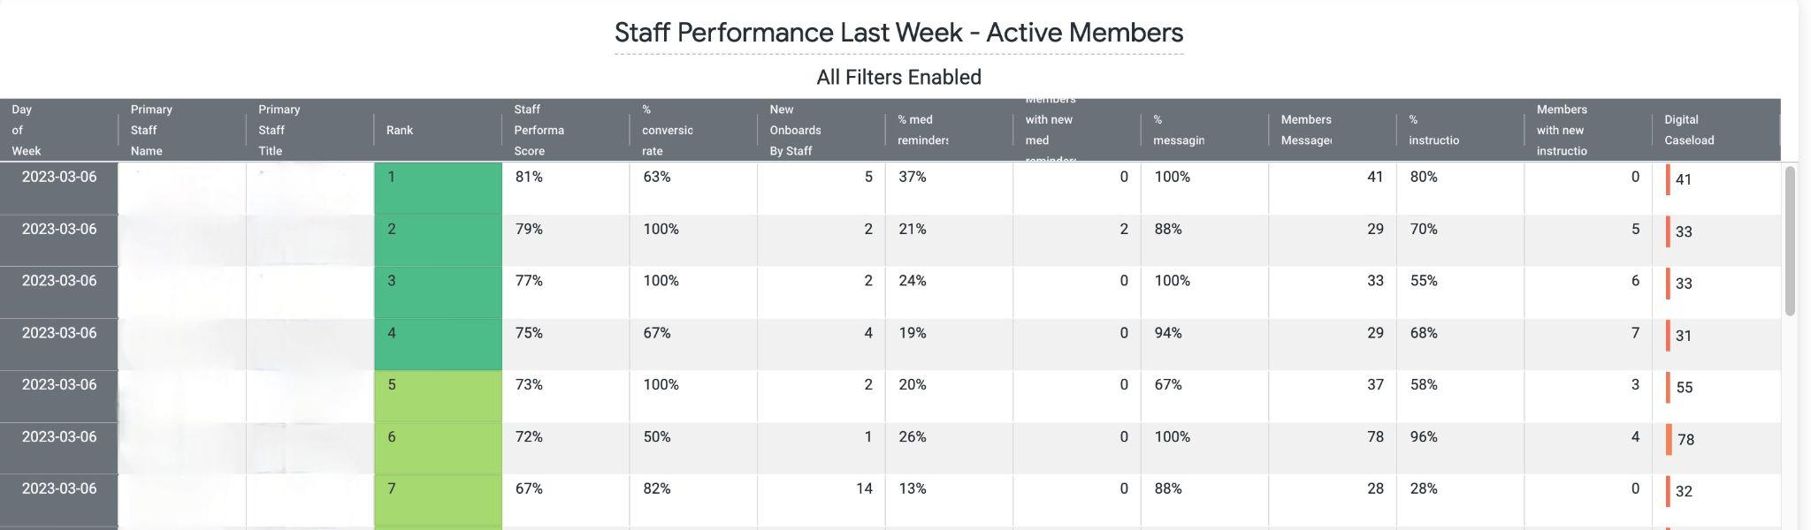
STAFF PERFORMANCE REPORT
Weekly Report: Staff Performance Last Week Section (Example)
How it helps: Provides managers with a concise view of the previous week’s metrics as an input to coaching staff users.
Ranks staff based on weekly Performance Scores
Tracks # of actions to take into consideration for each score component

Slide 57
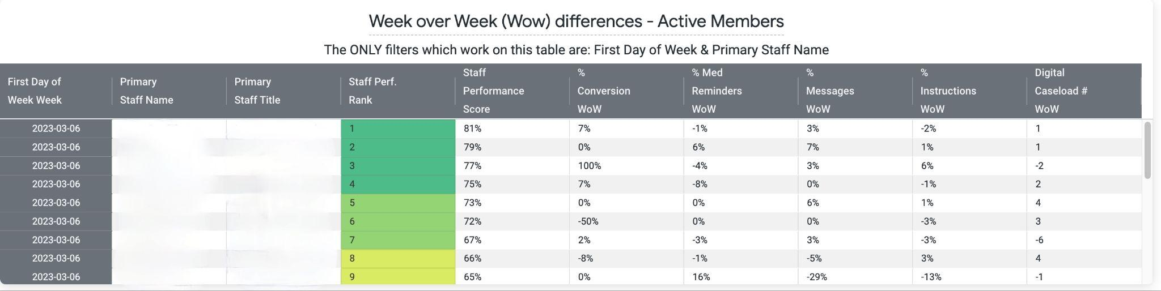
STAFF PERFORMANCE REPORT
Weekly Report: Week Over Week Section (Example)
How it helps: Provides managers with a concise view of week over week performance to track changes.
Useful to know that
caseloads are changing weekly as that may impact performance
Ranks staff based on weekly Performance Scores

Slide 58
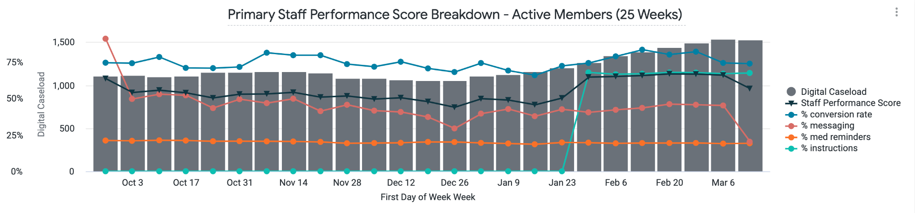
STAFF PERFORMANCE REPORT
Weekly Report: Trends Section (Example)
How it helps: Track historical trends in aggregate. Filter to review performance for individual staff users.

Slide 59
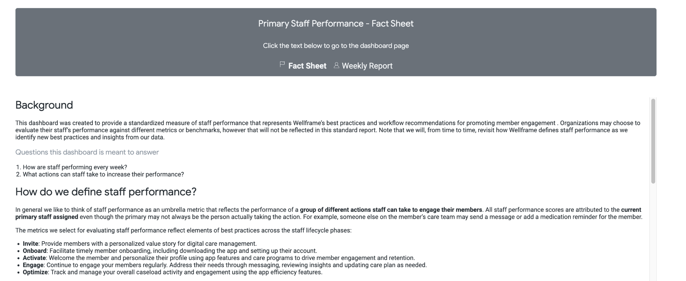
STAFF PERFORMANCE REPORT
Fact Sheet
Customer reference document for best practices and FAQs
Find it in the Customer Insights Portal > Staff Performance Report > Fact Sheet tab

Slide 60
STAFF PERFORMANCE REPORT
Fact Sheet
Customer reference document for best practices and FAQs
Find it in the Customer Insights Portal > Staff Performance Report > Fact Sheet tab

Slide 61
Performance Metrics
Performance metrics and evaluations must reflect digital goals to promote continued adoption.
Examples of Digital Competencies
Set digital performance goals and objectives
Offer Wellframe to all members
Member engagement
Dismissing alerts/insights
Use of certain features (instructions, med reminders etc.)
Adjust goals, objectives and competencies
Determine digital competencies
Feedback on Results
Measurement of performance against goals
Examples of Digital Goals
Weekly/monthly onboarding
Overall conversion rate
Digital/telephonic caseload ratio
Measurement of performance against competencies
Notes:
Onboarding
How many members should be onboarded to reach caseload goals?
Conversion rate
Of members invited, how many complete onboarding process?
Recommend > 50%
Messaging
Weekly messaging cadence
Instructions
Required documentation
eCM system
Plan of care/goals
Customer service, care team etc
Response time to alerts/insights/messages
24 business hours

Slide 62
Creating a Champion Enablement Program

Slide 63
Champions Program - Essential for Adoption
Why?
Learning via co-workers is among the most effective method in a professional environment. Champions will also provide your adoption program valuable insight about what is and isn't working regarding digital care management.
How will Champions Support Digital Care Management?
  Create a ground swell of enthusiasm that grows adoption of improved ways of working.
  Build a circle of influence among their team.
  Bring new ways of working to life across the teams.
  Identify business challenges and possible solutions quickly.
  Provide feedback to the clinical leaders.

Slide 64
Identifying Champions
What to look for in choosing champions?
  Passionate and enthusiastic
  Excited to share their knowledge
  Often helping others
  Keen to trying new things
How to reward champions?
  Allow successful membership in the Champion Program to contribute to employees' performance review.
  Acknowledge your most successful Champions with rewards of Office swag and employee perks.
  Engage your Champions with ongoing training and content that they can pass along to other employees.

Slide 65
Steps to Begin
Identify and assemble the team.
Create goals of the Champions Program.
Successful Champions Programs have a Leader.
Monthly meetings at a minimum are important part of creating positive culture in the community and fostering growth.
Create a chat-based workspace in Teams for ideas in between monthly meetings.
Champions like to have their voice heard and feel as if they are part of creating something (if unable to implement ideas use a "parking lot" approach to revisit later.
Start small and grow.

Slide 66
Activity
What team members have you identified?
Let's identify three goals for the Champions Program.
Who will lead the Champions Program?
Who can commit to creating the Teams workspace for the Champions Program and setting up the monthly meetings?

Slide 82



Our Vision
Innovating a world where healthcare can focus on people.
Our Mission
To drive healthcare transformation through a single digital ecosystem that delivers advanced automation and clinical engagement among healthcare payers, providers, and patients.

Slide 87
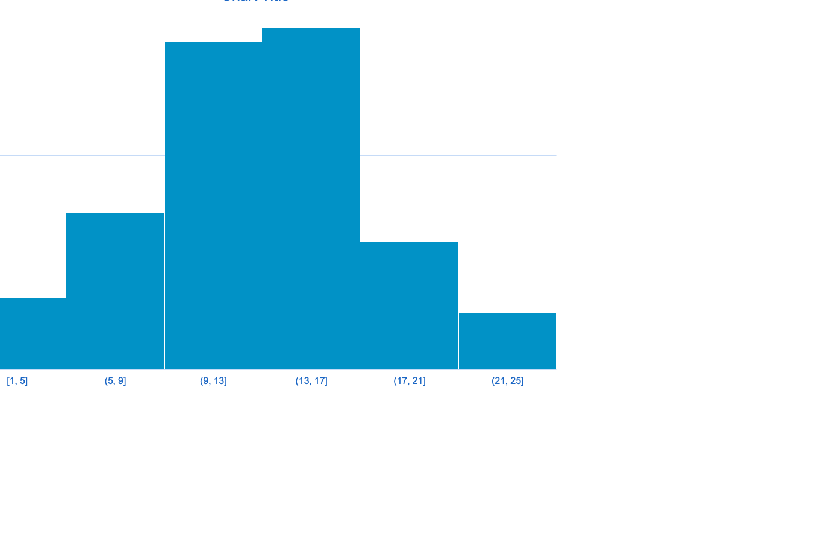

Slide 89





















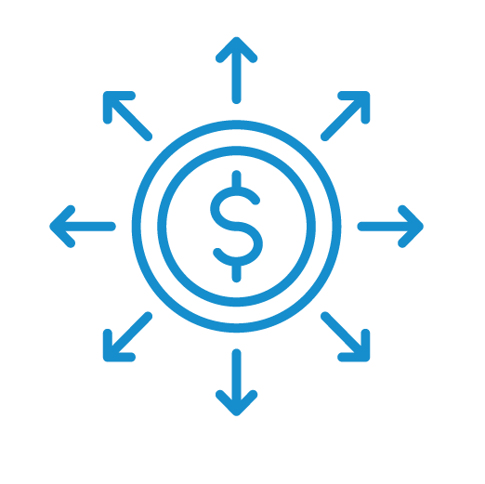














Slide 90




































Slide 91





















